Slide 1
Advancing IDEA Together
Jacque Hyatt
March 3, 2026

Slide 2
Legislature 2026 Update
Special Education Manual
Dual Enrollment
Initial Eligibility- 45 School days
High Needs Fund
Regional Service Centers
40X50

Slide 3
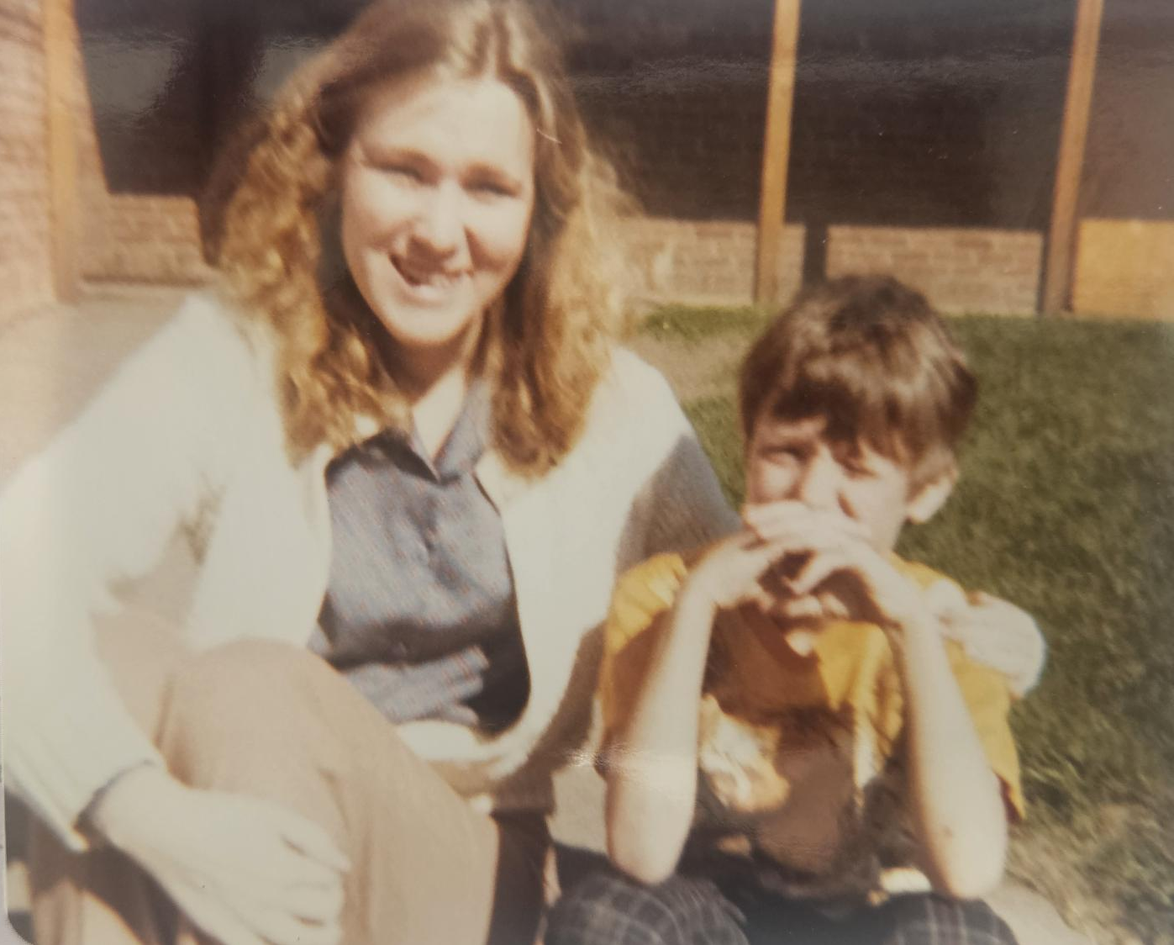
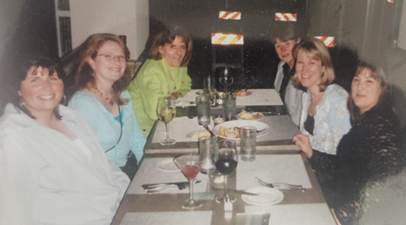
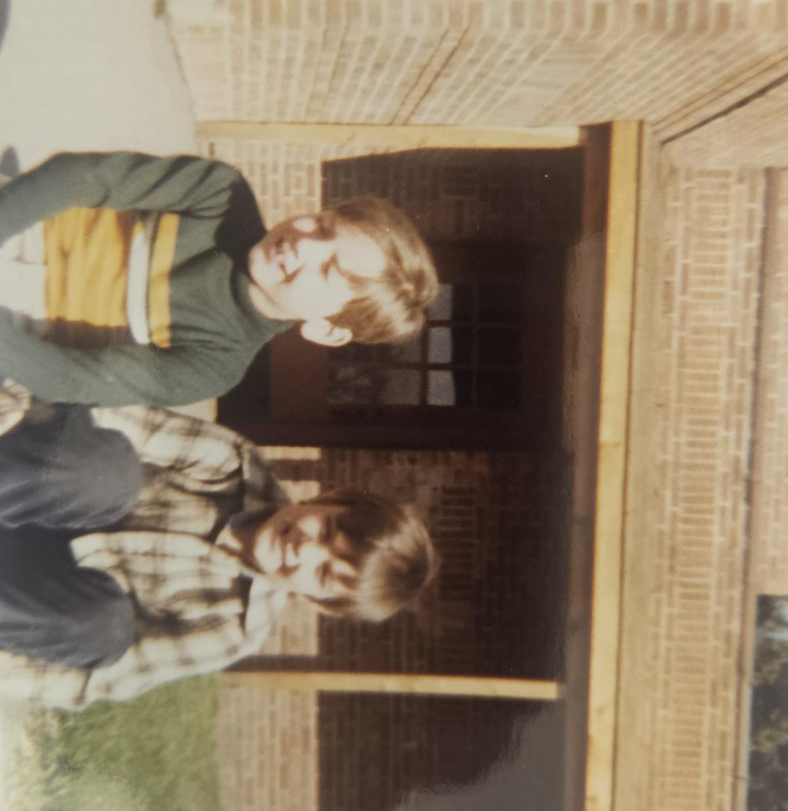
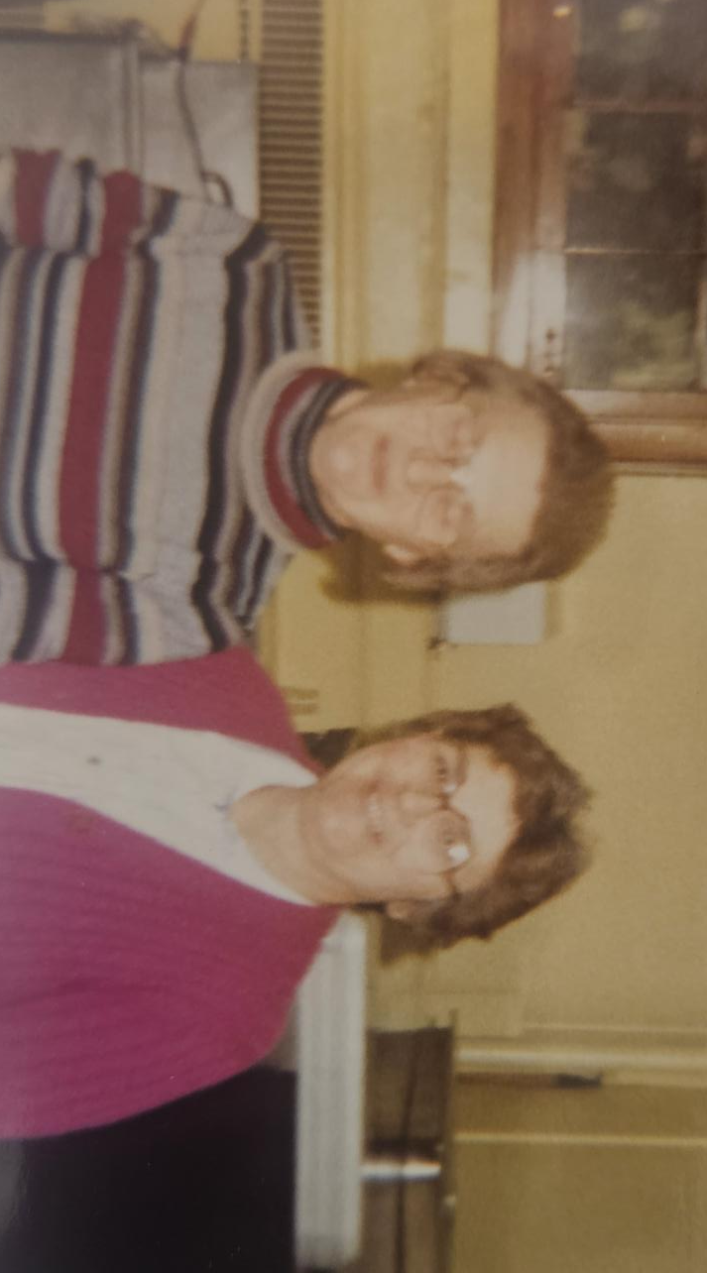
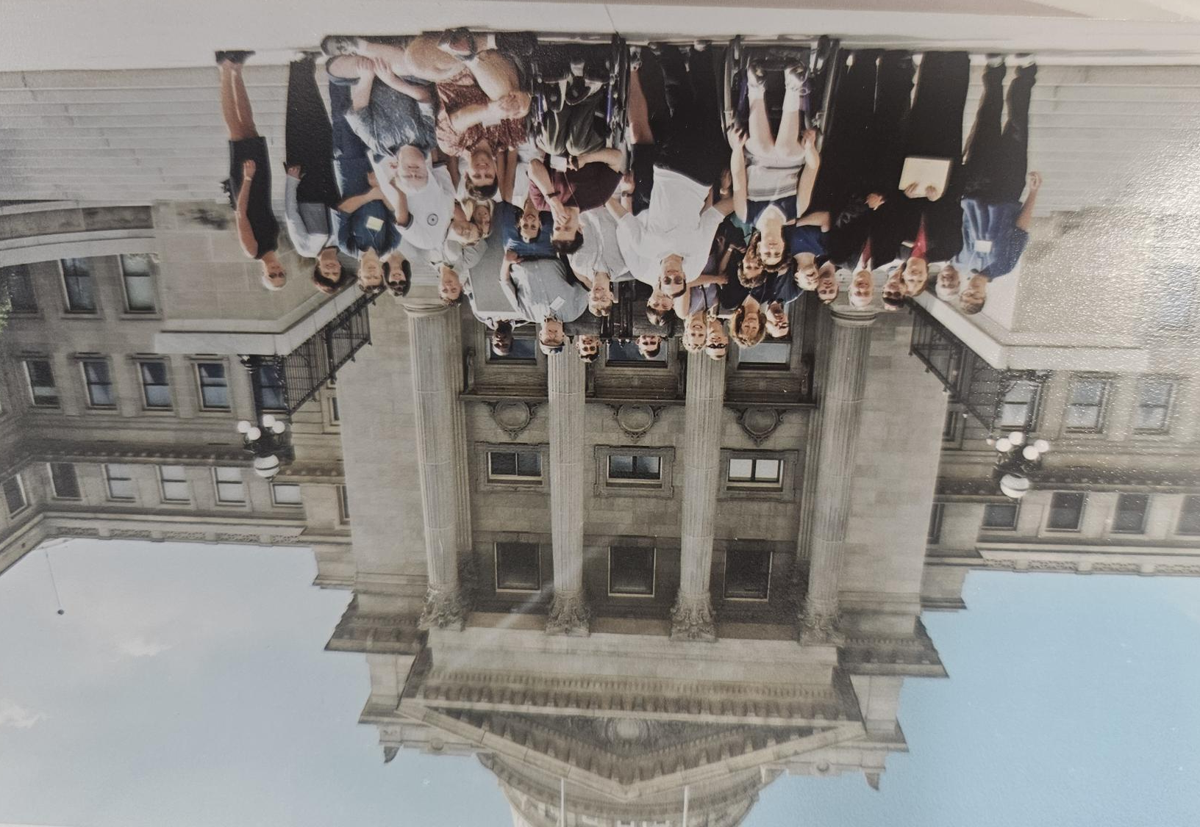
Experiences that Shape our Practice
Early Years Teaching
Mentors along the way
Our Students and Families
Administration Support
Colleagues
Partners in Advocating
Building your Team
Mentoring and Supporting others
Collaboration

Slide 4
General Supervision

Slide 5
Addressing DSM 2.0 Idaho Findings of Noncompliance
Strengthening our ability to understand strengths and needs of LEAs
General Supervision File Review (GSFR)
Cyclical Cohort of LEAs- Integrated Monitoring
LEA Determination Criteria and Process
Strengthening our ability to respond to and support LEAs
Data Collection, Analysis and Use
Early Dispute Resolution
Technical Assistance & Professional Development

Slide 6
Components of General Supervision
Policies and Procedures
Integrated Monitoring
Sustaining Compliance & Improvement
Dispute Resolution
Fiscal
Data
State Performance Plan/Annual Performance Report (SPP/APR)
Technical Assistance & Professional Development

Slide 7
Key Characteristics of Effective System
Ensures Compliance with IDEA
Promotes Improved Student Outcomes
Is Coherent- guided by a clear vision and supported by aligned and integrated accountability and support activities
Is well documented and transparent
Meaningfully engages stakeholders

Slide 8
Building a Vision

Slide 9

What values should guide our system?
What outcomes should we aim for?
How should families/students experience it?
What should success look like in 5–10 years?

Slide 10
Vision Statement
A strong general supervision system that empowers local programs to deliver high-quality, individualized special education through collaboration, training, and family partnership. By increasing staff capacity, engaging student voice early, and supporting families at every stage, we foster meaningful growth beyond standardized measures. Together, we create clear, shared goals that lead to greater opportunity, independence, and lifelong success for every student.
SEAP, November 3, 2025

Slide 11
Mission/Purpose Statement
Ensure all students eligible for special education, receive the supports they need, promote consistent practices across local education agencies (districts/facilities) using data to guide improvement, protect civil rights, and support sustainable, effective local programs while maintaining accountability.

Slide 12
Guiding Principles
Students and Families at the center –
Promote involvement, inclusion in education and community, and meaningful engagement.
Collaboration and Clear Communication –
Build strong parent, school and community partnerships using transparent, student- and family-friendly communication.
Integrity and Respect –
Assume positive intent and treat everyone with respect.
Excellence and Continuous Improvement –
Focus on measurable growth, authentic compliance, and ongoing improvement to reach positive student outcomes and achieve goals.
Notes:
Act ethically = inappropriate from an indigenous perspective

Slide 13
Your Turn….
What values should guide our system?
What outcomes should we aim for?
How should families/students experience it?
What should success look like in 5–10 years?

Slide 14

General SuperVISION

Slide 15
Supporting the Vision

Slide 16
MTSS/PLCs
State Personnel Development Grant- (2026-2031)
Partner with Content and Curriculum
Build a single state framework for MTSS/PLCs
Support LEAs to build locally informed MTSS/PLCs
Focus on Behavior, Literacy and Math
Regional coaches available to mentor and support implementation
Evaluate effectiveness to inform implementation

Slide 17
Pathway to Partnerships
Rehabilitation Services Agency- 2024-2029
Includes ages 10-24 years
Map Resources Secondary Transition Services across Agencies
Develop a Framework for LEAs and communities to evaluate and build Secondary Transition programs
Provide Regional Coaches to assist in interagency team building and program development
Create resources, professional learning opportunities, engage families
Evaluate effectiveness to inform continued improvement

Slide 18
Data Drill Down
Bring Teams of 2-4
Special Education Staff (Directors, Teachers, Related Service)
Building Administrators, General Education Teachers
4/14 Region 6 Idaho Falls, Residence Inn
4/15 Region 5 Pocatello, ISU
4/16 Region 4 Twin Falls, LaQuinta Inn
4/27 Region 3 Boise, HP Complex
4/29 Region 2 Moscow, U of I
4/30 Region 1 Couer d’Alene, NIC

