Slide 1

When They Can, But Won’t
Strategies to Overcome Challenges with Executive Functioning Disorder
Dr. Adrienne Seamans

Slide 2
Executive Function
Prevalence of ADHD/Autism Spectrum Disorder (AUDHD): 70% (Fedrico et al., 2023)
Most common executive function challenges include: working memory, impulse control, and flexibility in thinking (Kofler et al., 2024)
These three categories can be manifested by challenges:
Organizational Skills,
Planning
Achieving Goals
Delay Tolerance
Social Skills
Emotional Regulation
Staying On Task
Self Control

Slide 3
Pathological Demand Avoidance (PDA)
A profile of those diagnosed with Autism Spectrum Disorder
Not currently in the DSM
Started in the United Kingdom but is becoming more prevalent in the United States
Challenges (O’nions et al., 2016):
Extreme Demand Avoidance
Need for Control
“Surface Sociability”
Rapid Mood Shifts
Intense Role Play

Slide 4
Memory
Develop Routines
Visual/Written Schedules
Check Lists
Lower “clutter” (including visual)
Binder with colored folders (return/take home) – include personal hole punch
Different colored bags (1 color = 1 class) with materials
Homework/Project Planners

Slide 5
Social Planning
Play to their interests – Create Power Cards as quick reminder of “rules”
Social Menus – Develop a rubric to review
Social Narratives
Story cards or social stories to practice
Social Mentoring or Peer Social Coaches
Video Modeling
A great resource: https://autismteachingstrategies.com/

Slide 6
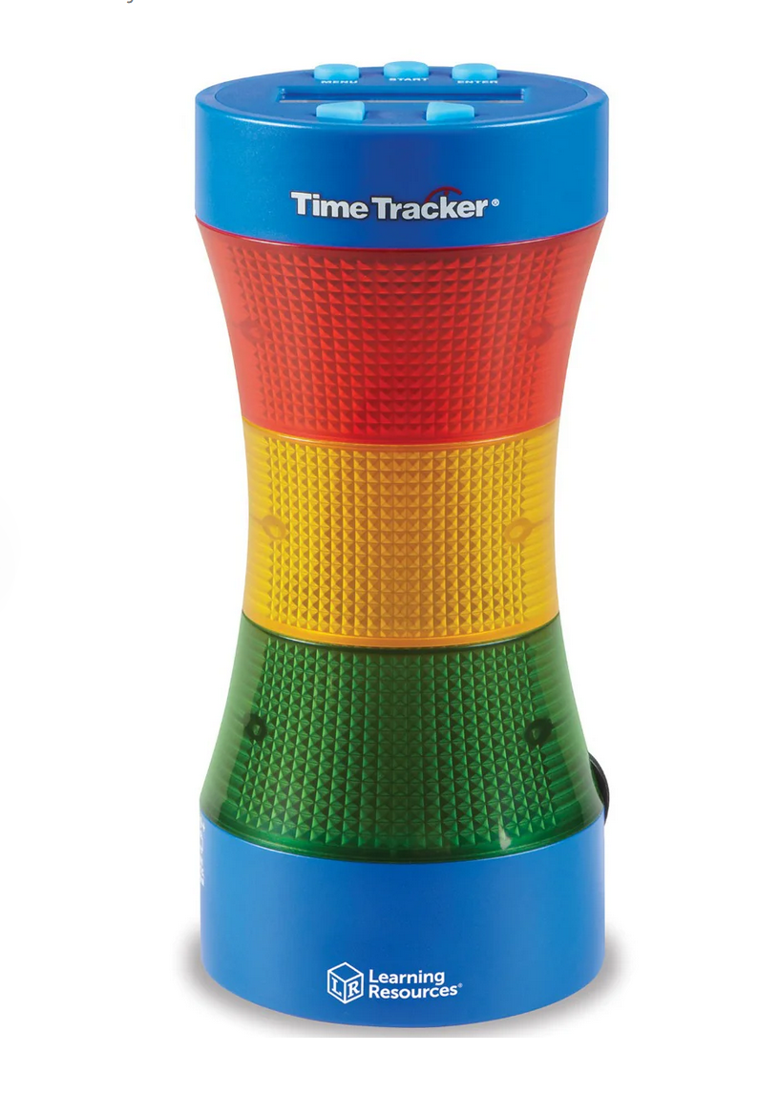
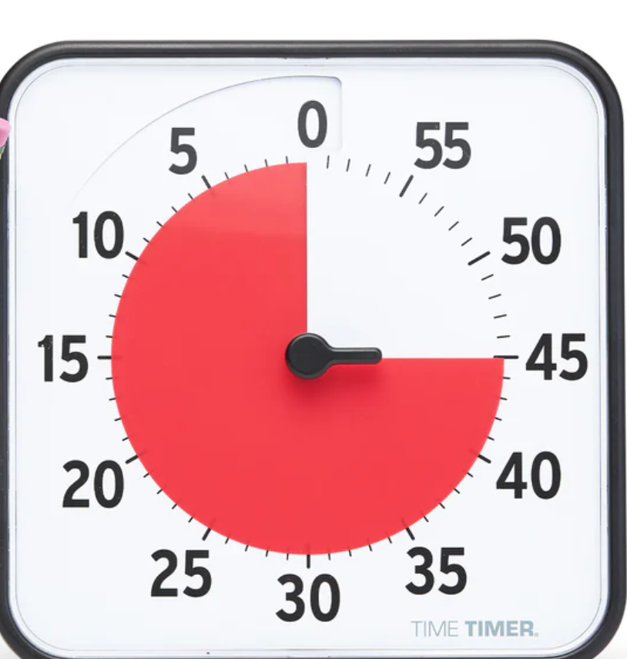

Time Management
Colored timers
(Analog vs. Digital)
Time Estimation
Assignment/Project Planners
Line Readers

Slide 7
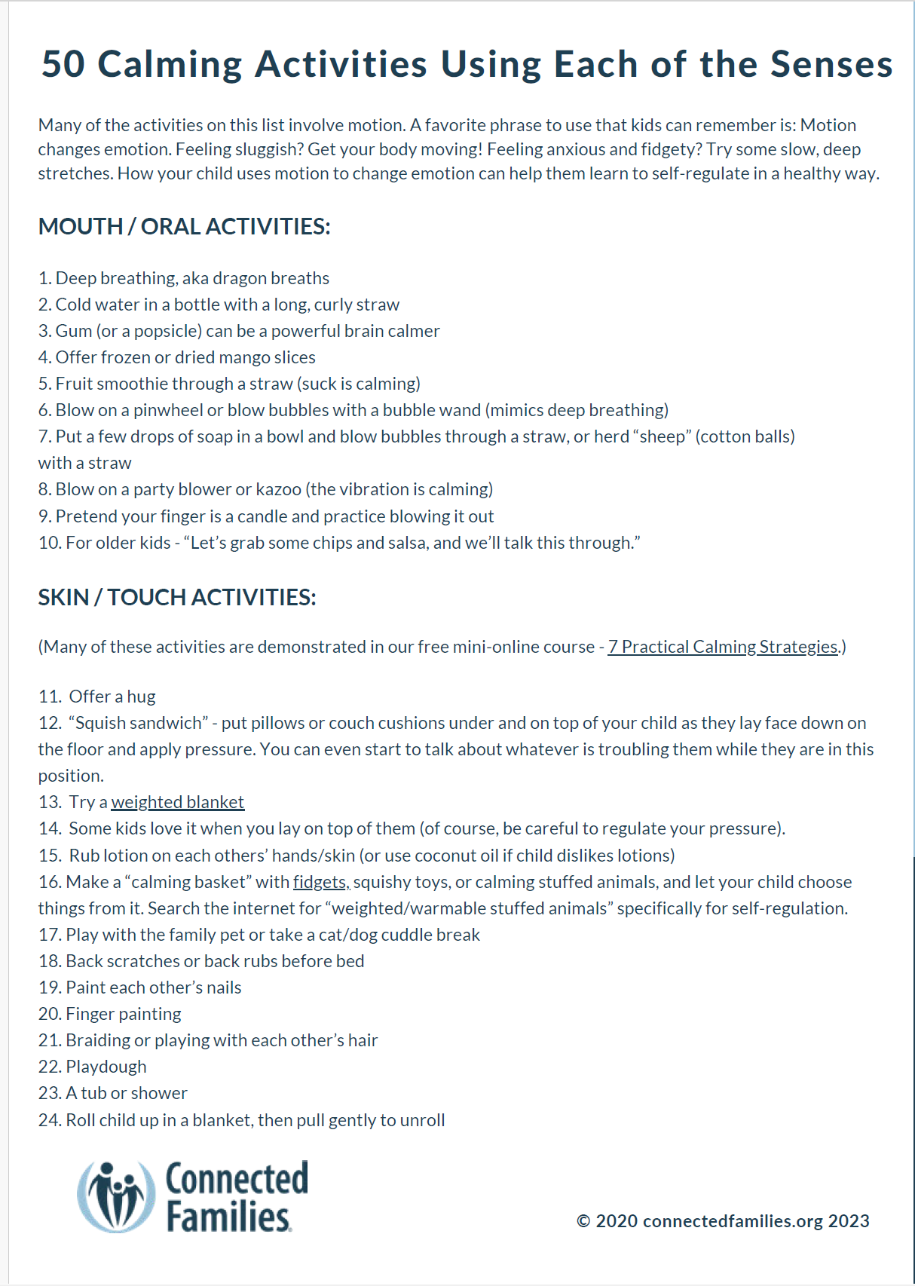
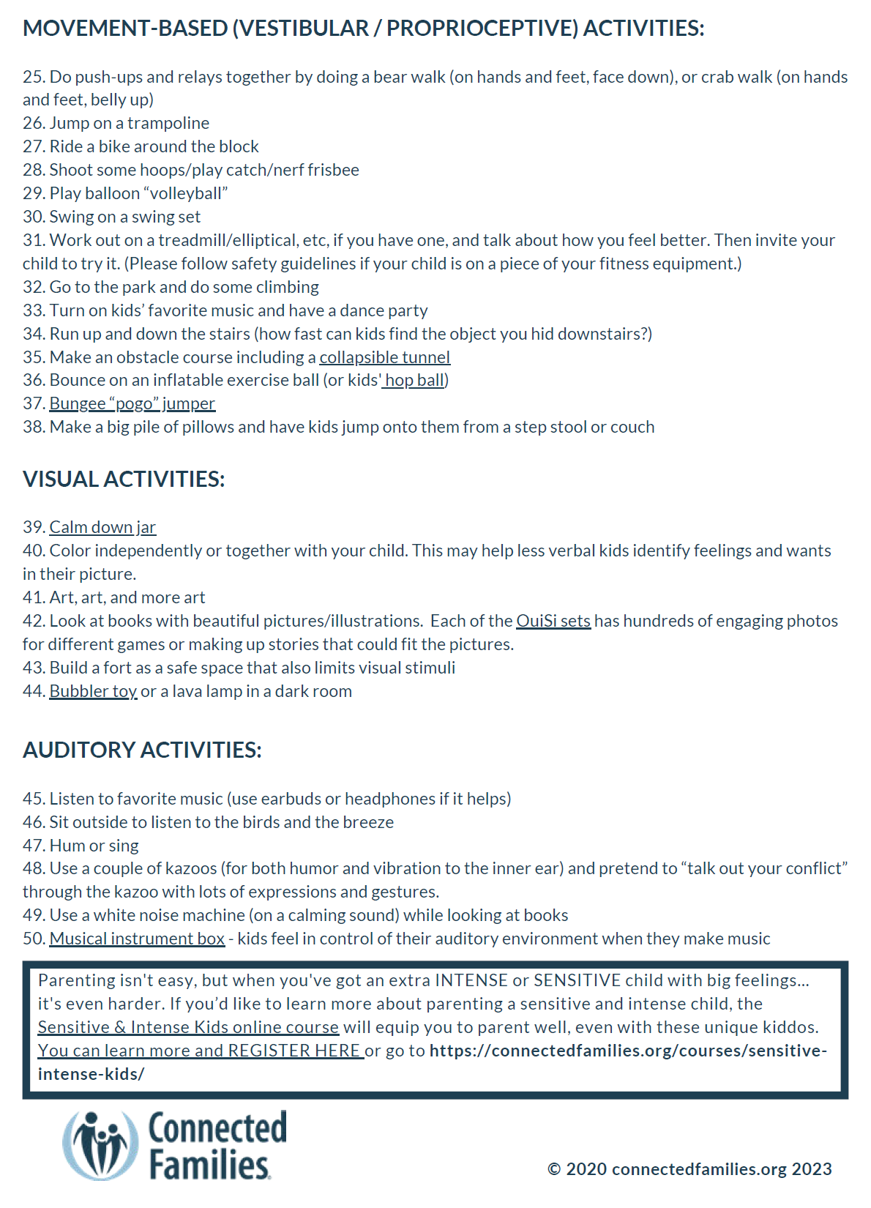
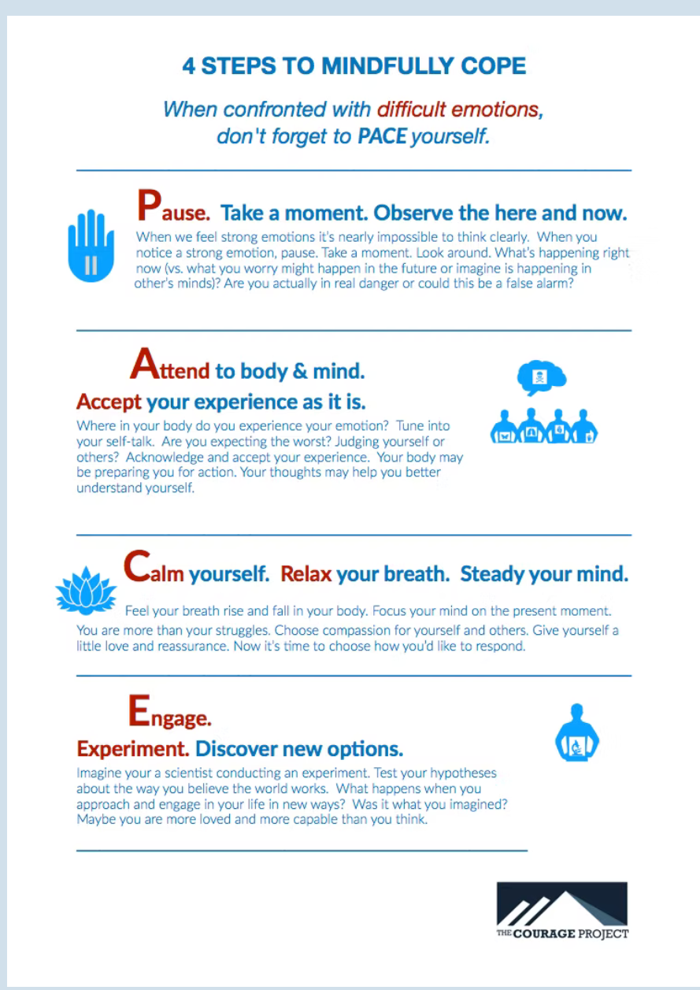
Impulse Control
Check for setting events
Do they know the correct behavior?
Noncontingent reinforcement
Red/Green Card
Break Card/Menu
Lower Task Demand
Mind Reset Activities:

Slide 8
Flexibility
Unstuck and On Target = Currently has curriculum from 8-22 and parent book (https://unstuckandontarget.com/)
Accept, Identify, and Move (AIM) by Mark Dixon
Emotional ABCs: emotionalabcs.com
https://youtu.be/oVOnRPefcno?si=9fPSVF2-Xjwu_Z9q = Bridge Flexibility
https://youtube.com/shorts/IV7xWU3t-6I?si=UFmgAHzRDB7KGoaH = Flexible Trees
https://youtu.be/jaAbzC1BVlk?si=G4mU3j44iECc2UxJ = Social Story for Flexible Thinking
Be willing to walk away and not have the last word
Find the why? (Function of Behavior)
EVERYONE has a carrot!
Questions vs. Statements

Slide 9
Resources
Curriculum:
Unstuck and On Target (Curriculum for Executive Functioning Ages 8-Adult and Parent Curriculum): unstuckandontarget.com
Emotional ABCs (Learning Emotions for Ages 4-8: emotionalabcs.com
Free Social Skills Lessons: autismteachingstrategies.com
The Autism Helper (Executive Function Toolkit and CEU Training): autismhelper.com
Accept, Identify, and Move (AIM: Curriculum to Help Kids Get “Unstuck” Based on ACT Therapy):
https://emergentlearningpress.com/collections/aim-social-and-emotional-curriculum
Books:
Scattered to Focused: Smart Strategies to Improve Your Child's Executive Functioning Skills
Smart but Scattered Teens: The "Executive Skills" Program for Helping Teens Reach Their Potential
Smart but Scattered: The Revolutionary Executive Skills Approach to Helping Kids
Reach Their Potential

Slide 10

Dr. Adrienne Seamans, PhD, BCBA, LMSW
draseamans.lbc@gmail.com
208-351-4119

Slide 11
References
Federico, A., Zgodic, A., Flory, K., Hantman, R. M., Eberth, J. M., Mclain, A. C.,
& Bradshaw, J. (2024). Predictors of Autism Spectrum Disorder and ADHD: Results from the National Survey of Children’s Health. Disability and Health Journal, 17(1), Article 101512. https://doi.org/10.1016/j.dhjo.2023.101512
Kofler MJ, Soto EF, Singh LJ, Harmon SL, Jaisle E, Smith JN, Feeney KE, & Musser ED. (2024). Executive function deficits in attention-deficit/hyperactivity disorder and autism spectrum disorder. Nat Rev Psychol. (10):701-719. doi: 10.1038/s44159-024-00350-9
O'Nions E, Gould J, Christie P, Gillberg C, Viding E, & Happé F. (2016). Identifying features of 'pathological demand avoidance' using the diagnostic Interview for Social and Communication Disorders (DISCO). Eur Child Adolesc Psychiatry. 2016 Apr;25(4):407-19. doi: 10.1007/s00787- 015-0740-2.

