Slide 1
Blue Jeans Conference
March 02, 2026
Shannon Dunstan
Idaho Department of Education
Angie Williams
Idaho Department of Health and Welfare

Slide 2
Idaho’s Transition to Comprehensive Managed Care
In March 2025, the Idaho legislature passed House Bill 345 directing the state to transition its Medicaid program from a fee-for-service system to a comprehensive managed care model.
WHAT IS FEE-FOR-SERVICE?
WHAT IS COMPREHENSIVE MANAGED CARE?
Members choose and enroll in a private health plan that help coordinate care needs.
State pays private health insurance companies, called a Managed Care Organizations (MCOs), a set monthly amount for each enrolled Medicaid member.
Medicaid members find doctors and other providers who accept Medicaid to meet specific health care service needs.
State pays providers directly for each covered service (e.g., visit, test, or procedure) provided to Medicaid members.

Slide 3
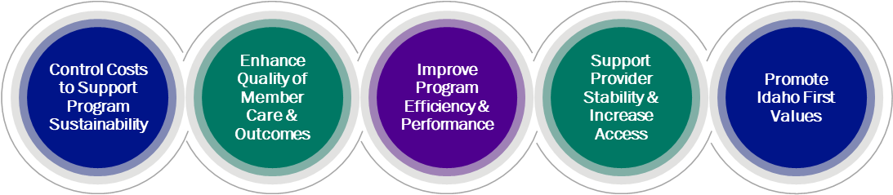
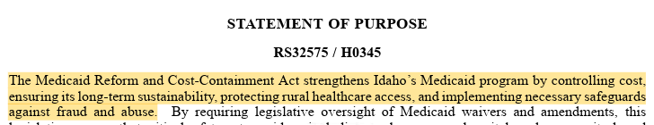
Goals for Transition to Managed Care
“

Slide 4
Managed Care in Idaho
Today, Idaho uses managed care for certain Medicaid services, including dental services, behavioral health services, non-emergency medical transportation, and the Duals program for members who qualify for both Medicaid and Medicare.
Only a small percentage of Idaho’s Medicaid members are in comprehensive managed care – 6% Duals.
When Idaho transitions to comprehensive managed care, nearly all Medicaid services, like doctor visits, prescriptions, and hospital care will be coordinated under one health plan for each member.
This change is intended to improve coordination, simplify access, and help members get the full range of care without gaps.
Idaho will be the 43rd state in the U.S. to use comprehensive managed care for Medicaid.

Slide 5
State and Federal Protections
Managed care plans must meet federal standards for quality, access, and consumer protections, and will be held accountable throughout implementation, ongoing operations and state contracts.
Timely payments to providers
Timely response on prior authorizations for services
Right to appeal denied services
Quality metrics related to improved health outcomes
Network Access Standards (requiring enough providers to serve Medicaid members)
Holding managed care plans accountable through incentives and penalties
Quality of Care Monitored External Quality Review Organization: Monitors plan performance on access, quality and member protections Quality Assessment and Performance Improvement Programs Consumer Assessment of Healthcare Providers and Systems (CAHPS) Surveys Ongoing Performance Improvement Plans (PIPs)

Slide 6






Comprehensive Managed Care Provider Journey
The following represents a sample journey of a provider delivering care in a comprehensive managed care system.
Provider submits claims to the MCO and receive payments for services provided.
Provider enters into a contract with the MCO and participates in the MCO’s comprehensive network.
Members either choose or are assigned the provider within the MCO’s network. The provider begins to receive new patient lists or attribution reports. Efforts are made to preserve existing provider/patient relationships.
Provider engages with MCO staff to support care coordination, facilitate access to clinical services, and handle billing and prior authorization issues.
Provider delivers clinical care to Medicaid members.
Provider decides to enroll and is credentialed to provide services with one or more Managed Care Organizations (MCOs) contracted by the State.

Slide 7



Initial Program Design Approach
COMPREHENSIVE MANAGED CARE
THREE PLANS STATEWIDE
PHASED ROLLOUT APPROACH

Slide 8
What Will We Do With Your Feedback?
Capture
Capture all feedback.
Analyze
Analyze feedback and identify key themes.
Inform
Use themes to inform program design. As appropriate, provide information about progress and program on our website.

Slide 9

How Findings Can Inform the State’s Approach
Transition Timing, Sequencing, and Concerns
Network Adequacy Standards
BH, DD, and Waiver Services
Care Coordination
Process Streamlining and Simplification
Pre-Launch Preparation and Activities
Respondents expressed concern that compressed or poorly phased timelines could exacerbate payment delays, administrative errors, or service disruptions, particularly for smaller and rural providers with limited capacity to absorb additional risk. Members’ concerns are transition-specific, focused on what could go wrong during implementation rather than on the transition to managed care itself.
Importance of how standards are defined, monitored, and enforced. Respondents emphasized that network adequacy is meaningful only insofar as it translates into real-world access, including provider availability, reasonable travel distances, and appointment timeliness. Standards not paired with active oversight could fail to prevent access gaps, especially in rural and specialty care markets.
Respondents emphasized sensitivity around changes to service authorization processes, continuity of existing providers, and the transitions’ impacts on individuals with complex or long-term needs. Even temporary disruptions in these areas were described as having disproportionate consequences for members and families, with limited ability to handle gaps in care.
Care coordination should decrease the navigation burden on families, with clear accountability for managing services across medical, behavioral, developmental, and educational settings. Care coordination design should avoid duplication with existing coordination roles where possible and focus on timely follow-up and navigation, confirming patients can access primary care, behavioral health, and preventive services before conditions escalate.
Members’ emphasize simplification and recommend prioritizing streamlining processes rather than layering additional requirements onto an already complex system. Medical necessity definitions, authorization criteria, and review processes should be clear, consistent, and clinically appropriate. Improvements to communication—such as plain-language explanations of coverage decisions and predictable timelines—can address many challenges.
Pre–go-live activities should include parallel claims testing, authorization workflow testing, and directory validation to identify issues before live operations. Clear, consistent communication and provider education should begin well before go-live and continue through stabilization. Transition timelines should be realistic and phased, allowing time to resolve issues before expanding scope or increasing performance expectations.

Slide 10
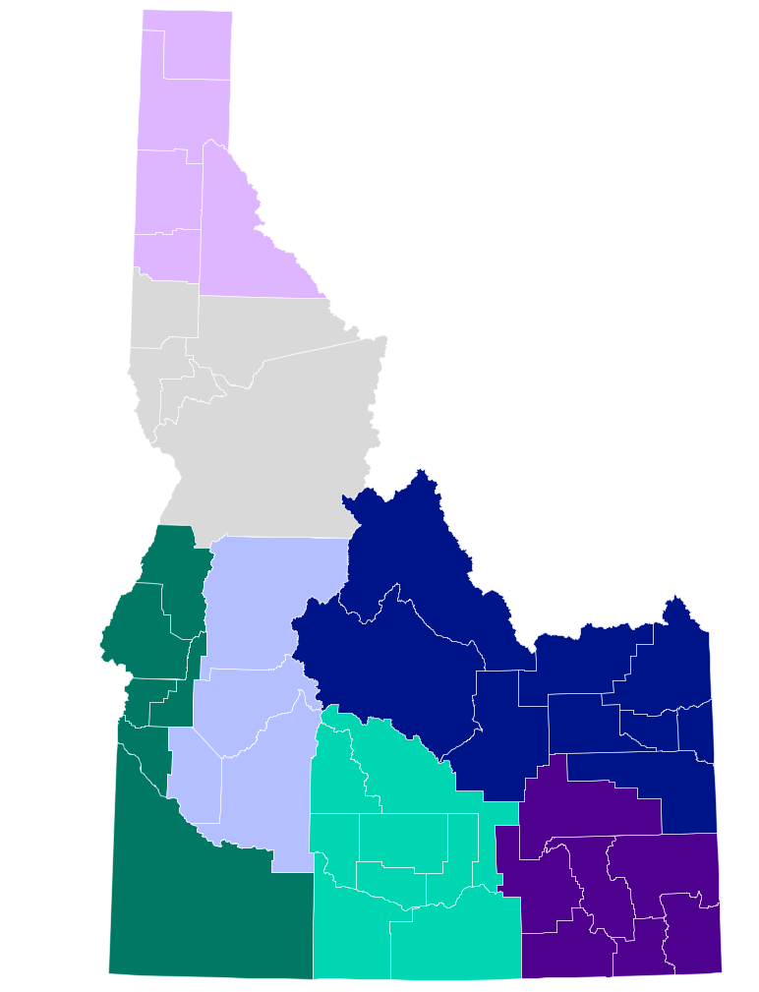
Regional Listening Sessions
September 3, 2025
6
Region 6
Twin Falls
Region 5
November 10, 2025
6
Region 6
Pocatello
Region 6
December 15, 2025
Rexburg
Region 7
Region 6
6
January 6, 2026
6
Region 6
Caldwell
Region 3
February 3, 2026
All
6
Region 6
Virtual Only
February 25, 2026
Tribal Consultation
6
Region 6
Region 4
March 10, 2026
6
Region 6
Gooding
Region 5
6
Region 6
April 7, 2026
Boise
Region 4
May 26, 2026
6
Region 6
Coeur d’Alene
Region 1
May 28, 2026
6
Region 6
Lewiston
Region 2

Slide 11

Transition Timeline
January 2031
Phase 2 Go-Live
January 2029
Phase 1 Go-Live
May 2027
Award MCO contracts
May 2027 – January 2029
Work with plans to prepare and support readiness for Go-Live
October 2026
Release Request for Proposal (RFP) for MCOs
May 2025 – September 2026
Stakeholder engagement to inform program design

Slide 12
Stakeholder Feedback
Stakeholder feedback now is critical to inform program design and the contract for Managed Care Organizations (MCOs).
COMPREHENSIVE STAKEHOLDER ENGAGEMENT CAMPAIGN
STATEWIDE LISTENING SESSIONS
DHW uses stakeholder feedback to shape the managed care program design and contract
INFORMATION REQUEST SURVEY
MCO Contracting Process Begins
PROGRAM AND OPERATIONS PLANNING
October 2026
FEDERAL / STATE PARTNERSHIP FOR MANAGED CARE
DEVELOP REQUEST FOR PROPOSAL (RFP)

Slide 13
We Want to Hear from You
We want to hear your feedback on the transition to managed care, especially on the following topics:
Network adequacy standards and barriers
Protections for providers and members
Payment and reimbursement processes
Care coordination, continuity, and referrals
Impact of managed care transition on administrative workload and new systems
Program quality, oversight, and appeals
Impacts of managed care transition on behavioral health and specialized services
Transition planning and channels for ongoing provider feedback

Slide 14
Thank you for coming! Stay Engaged With Us
The department created a new website that posts information on the managed care transition: healthandwelfare.idaho.gov/managedcare
Prior presentations
Summary of findings from the Request for Information
Comments and Concern Form
Flyers and dates for next listening sessions
Next stop – Gooding, Idaho: March 10, 2026
Notes and analysis of prior listening sessions

