Slide 1
Building One Cohesive Behavioral Support System: Aligning Early Childhood and K-12 PBIS in Idaho
Blue Jeans Conference 2026
Notes:
Shannon

Slide 2
Presenters
Shannon Dunstan, Idaho State Department of Education
Diana Morgan, University of Idaho Center on Disabilities and Human Development
Melissa Crist, University of Idaho Center on Disabilities and Human Development
Notes:
Shannon

Slide 3
Idaho’s Vision
A unified approach that brings together Idaho’s behavior support systems into one aligned framework that serves children birth through 21 years.
Notes:
Shannon

Slide 4
The Why
Aligning Idaho’s Positive Beginnings Collaborative with Idaho Tiered Behavior Supports creates a seamless, statewide system of support that strengthens social–emotional and behavioral skills from early childhood through graduation. This alignment ensures consistent expectations for children and families, improves access, streamlines training and coaching, and maximizes state resources for long-term sustainability.
Notes:
Shannon

Slide 5
EC-PBIS
Idaho Positive Beginnings
A statewide collaborative across early childhood sectors
  ECSE Classrooms
  Child Care
  Head Start/Early Head Start
  Home Visiting Programs
  Early Learning Communities
Notes:
Shannon Bolded programs coming soon

Slide 6
EC-PBIS Mission
Address and promote positive guidance practices
1
Promote family engagement
2
Use data for decision-making
3
Ensure all children have access to high-quality early childhood programs to meet their needs
4
Ensure access to high-quality coaching, professional development, and technical assistance to support Idaho early care and education environments so they will be able to:
Notes:
Shannon

Slide 7
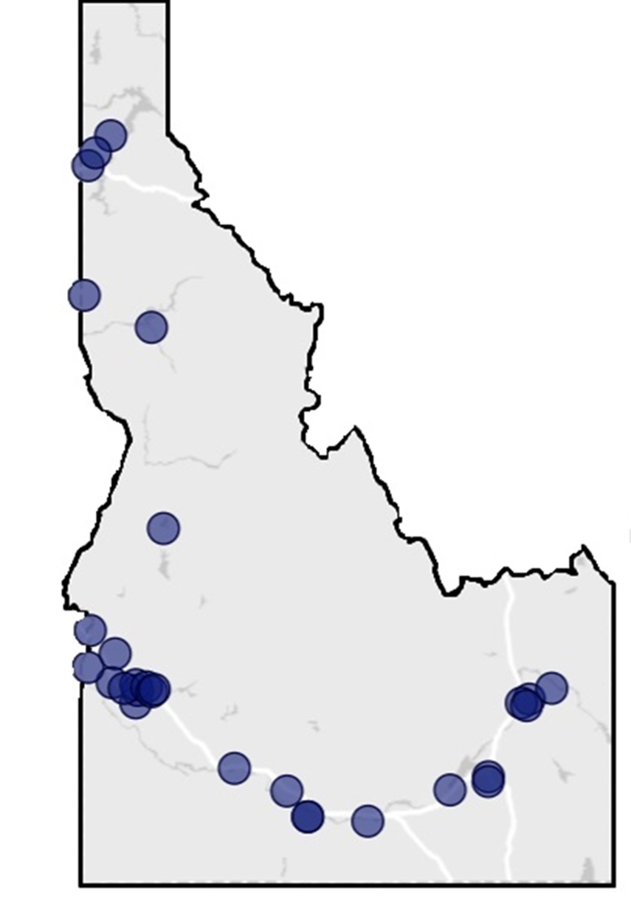
Participating Programs
2024-2025
          54 locations
        165 teachers
            61 child care programs
            67 Head Start classrooms
            37 school district classrooms
\
Notes:
Shannon

Slide 8
Idaho Positive Beginnings Collaborative Logic Model
Resources/Inputs
Highly qualified program staff
Activities
State Leadership Team
Outputs
Trainings Delivered
TA Provided
Outcomes
National TA Center Resources & Training
Funding
Materials
Technology & Software
Partners:
BSU
Idaho CDHD
Idaho Head Start Collaboration Office
Idaho Parents Unlimited
IdahoSTARS
National Center for Pyramid Model Innovations
Participating Child Care, Head Start, and School District Programs
Idaho Department of Education
Aim Early Idaho
Idaho AEYC
Program Leadership Team
Assess local infrastructure to support EC-PBIS implementation and identify areas to strengthen it.
Develop and sustain state-level infrastructure for EC-PBIS implementation.
Deliver training and provide technical assistance on developing and sustaining local-level infrastructure for EC-PBIS implementation.
Three years’ worth of EC-PBIS and behavior support modules in RISE
Monthly coaching calls
Monthly PLT calls
Support in using program/classroom tools
Tools Used
SLT BoQ
Early Childhood Program-Wide BoQ
PTR-YC
TPOT/TPITOS
BIRS
PIDS
Short-term
Increased Knowledge
Positive Perceptions
Mid-term
Increased Ability to Implement EC-PBIS
Strengthened Infrastructure
Long-term
High-Fidelity Implementation
Sustainable Infrastructure
Improved Child Outcomes
Annual survey
Notes:
Shannon

Slide 9
SW-PBIS
Idaho Tiered Behavioral Supports (ITBS)
An application-based cohort-model supporting select schools across Idaho to implement PBIS, one tier at time across 3-5 years:
Elementary schools
Middle schools
High schools
Alternative schools
Notes:
Diana

Slide 10
ITBS Mission
Expand the infrastructure to lead and support PBIS implementation across Idaho.
1
Implement a data collection and management system to support evaluation and decision-making.
2
Increase capacity of school personnel to positively impact school culture.
3
Positively impact student outcomes through the implementation of the PBIS framework.
4
Idaho Tiered Behavior Supports (ITBS) aims to create schools where ALL students can succeed through the implementation of the Positive Behavioral Interventions and Supports (PBIS) Framework. Idaho Tiered Behavior Supports (ITBS) aims to create schools where ALL students can succeed through the implementation of the Positive Behavioral Interventions and Supports (PBIS) Framework, developed to assist school teams in providing preventative, positive behavioral support for ALL students, so they will be able to:
Notes:
Diana

Slide 11
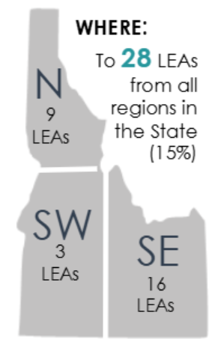
ITBS Participating School
2024-2025
          91 schools
          28 LEAs across Idaho
            551 educators participated in ITBS trainings
              General Educators – 42%
              Administrators – 17%
              Special Educators – 10%
              PBIS Staff – 9%
              Related Services – 8%
\
Notes:
Diana

Slide 12
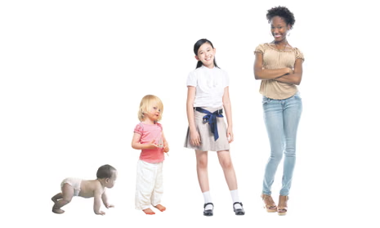
Considerations
Notes:
Shannon

Slide 13
Similarities EC-PBIS vs. SW-PBIS
Category | EC PBIS | PBIS (K–12) | Similarities
Target Age Range | Birth to 5 years (early childhood settings, preschool, childcare, Head Start, early elementary transitions) | Kindergarten through Grade 12 (elementary, middle, and high schools) | Both are developmentally appropriate frameworks that use a tiered approach across educational settings.
Framework | 3-tiered model: Promotion (relationships & environments), Prevention (social–emotional teaching), Intervention (individualized support) | 3-tiered model: Tier 1 (school-wide/universal), Tier 2 (targeted small group), Tier 3 (intensive individualized) | Both use multi-tiered systems of support (MTSS) with increasing intensity.
Primary Focus | Social–emotional development, nurturing relationships, preventing challenging behavior | School-wide behavior expectations, discipline practices, academic engagement | Both aim to promote positive behavior and prevent escalation of problem behaviors.
Notes:
Shannon

Slide 14
Differences Between EC-PBIS and SW-PBIS
Category | EC-PBIS | PBIS (K–12)
Age Range | Birth to 8 years (early childhood settings, preschool, childcare, Head Start, early elementary transitions) | Kindergarten through Grade 12 (elementary, middle, and high schools)
Primary Focus | Social–emotional development, nurturing relationships, preventing challenging behaviors | School-wide expectations, positive discipline, academic engagement
Notes:
Shannon

Slide 15
Additional Considerations
Category | EC PBIS | PBIS (K–12)
Core Practices | Teaching social–emotional skills, responsive caregiving, supportive environments, individualized interventions | Defining and teaching behavioral expectations, reinforcing positive behavior, applying consistent consequences
Family Engagement | Families are central—treated as primary partners and co-teachers | Families involved but typically less integrated into day-to-day practice
Assessment Tools | TPOT (Teaching Pyramid Observation Tool), TPITOS (Infant–Toddler Observation Scale), developmental screeners | TFI (Tiered Fidelity Inventory), SWIS (School-Wide Information System), discipline/behavior data
Outcomes | Builds readiness for school, strengthens social–emotional foundation, reduces challenging behaviors early | Improves school climate, reduces suspensions/referrals, enhances academic outcomes
Systems Lens | Developmental and relational, grounded in early learning environments | School-wide systems change, grounded in rules, consistency, and accountability
Notes:
Shannon

Slide 16
Aligned School-wide System
3-21 years of age
A cohesive system of tiered behavior support for students pre-k through 21
Cohort model
Guiding school-teams in the development of school-wide systems, practices, and data to implement PBIS tiered support
Concurrently working to build capacity of pre-k and kinder teachers/programs within the school to implement key practices and systems withing the classroom
Notes:
Diana

Slide 17
Steps we are taking:
Joint Leadership Team
Develop a Shared Language/Glossary
Communicate a Unified Message
Establishing Shared Vision and Leadership
Align Practices and Training
Map the Frameworks Side by Side
Integrate Professional Development
Build Cross-System Coaching
NEW Implementation Guide
Strengthening Data and Fidelity
Scale and Sustain
Align Fidelity Tools
Use Data for Continuous Improvement
Starting with Pilot Districts
Embedding Policies and Funding
Share Success and Build Buy-in
Notes:
Diana

Slide 18

Goal 1
Create a Joint Vision
Notes:
Melissa

Slide 19

Goal 2
Expand Idaho Tiered Behavior Supports to support 3-21 years of age for all Idaho School Districts
Notes:
Melissa

Slide 20
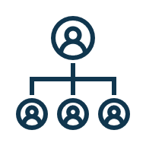
Goal 3
Expand practice-based coaching at all levels
Notes:
Melissa

Slide 21

Goal 4
Expand evaluation capacity to align across the whole PBIS system 3-21
Notes:
Melissa

Slide 22

Goal 5
Align professional development to support teachers 3-21
Notes:
Melissa

Slide 23
Coaching Infrastructure
State Coaching Support
Teachers
Staff
ITBS
Teachers
Staff
Other EC Sectors
Teachers
Staff
Families
Families
Families
EC-PBIS
Practice-Based Coaching Model
  Shared goals and action planning
  Focused observation
  Reflection and feedback

Slide 24
Pilot Project
Goals of the Pilot
Key Features of the Pilot
Create Continuity: Build a seamless school system from preschool to elementary entry.
Strengthen Alignment: Demonstrate how EC PBIS practices support and enhance PBIS Tier 1 foundations.
Develop Transition Practices: Pilot intentional transition strategies between preschool and kindergarten.
Inform Scaling: Gather lessons learned to guide statewide expansion and integration.
District Selection: Up to 5 districts representing different regions of the state.
Foundation: Each district has been engaged in Idaho Positive Beginnings (3 years of training, coaching, implementation).
Dual Implementation: These districts are also actively implementing PBIS in their K–12 system.
Kindergarten as Transition Point: EC-PBIS practices are being extended (“rolled up” or “rolled down”) into kindergarten to ensure smoother transitions and alignment school-wide
Idaho is launching a pilot project with up to 5 school districts from across the state to align EC-PBIS with the existing K–12 PBIS structure. These districts have been engaged in Idaho Positive Beginnings or ITBS.

Slide 25
Funding
ITBS: 3-21
Idaho Department of Education
Idaho SESTA
IdahoSTARS
School-Districts
Stranahan Foundation
Idaho School Readiness Project

Slide 26
Bottom Line
The strongest alignment happens when EC-PBIS and school-wide PBIS are not seen as separate initiatives, but as parts of the same statewide MTSS continuum, ensuring that children experience consistent, developmentally appropriate support from preschool through graduation. Other early childhood programs will also have aligned PBIS implementation supporting student transition into school-based settings.

Slide 27
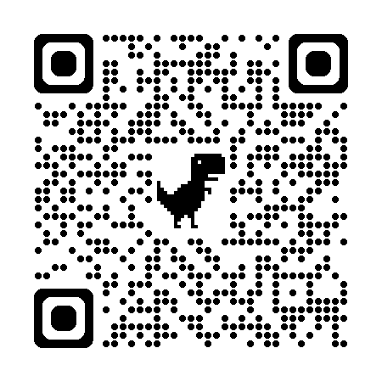
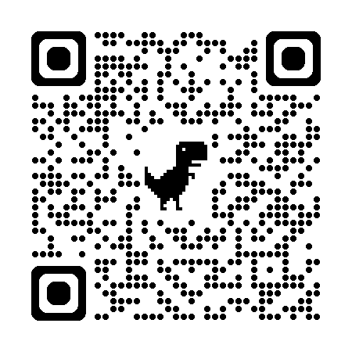
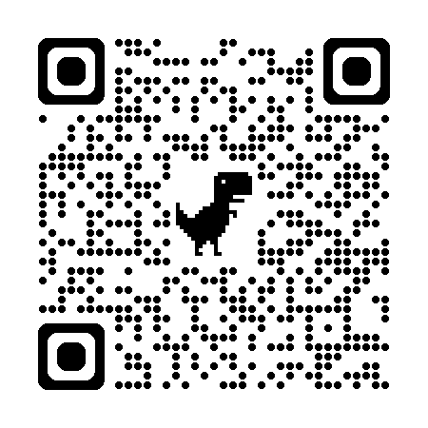
Resources
EC-PBIS topic page
https://idahotc.com/Topics/EC
ITBS topic page
https://idahotc.com/itbs
Crosswalk document
https://idahotc.com/Resources/File/RFFID/17975

