Slide 1
Getting Started with GSFR
Kari Grier and Emily Boles Idaho SESTA

Slide 2

Idaho SESTA stands for Special Education Support and Technical Assistance

Slide 3
IDAHO SESTA PURPOSE
Idaho SESTA provides resources, technical assistance, and training for educational partners to improve outcomes for students with disabilities throughout Idaho.
Special Education Support and Technical Assistance

Slide 4



ABOUT US
Idaho SESTA is a collaborative project at Boise State University and the University of Idaho and is funded by the Idaho Department of Education, Special Education Department.

Slide 5
LEARNING TARGETS
Participants will:
Be able to navigate the Compliance Tracking Tool (CTT).
Understand the steps required to fix issues of noncompliance.
Identify potential improvement activities to train and support their teams.

Slide 6

LEARNING TARGET
Learning Target Number One
Navigating the Compliance Tracking Tool (CTT)

Slide 7
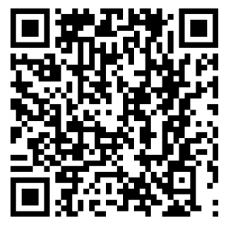
Idaho Department of Education
sde.idaho.gov/about-us/departments/special-education/

Slide 8
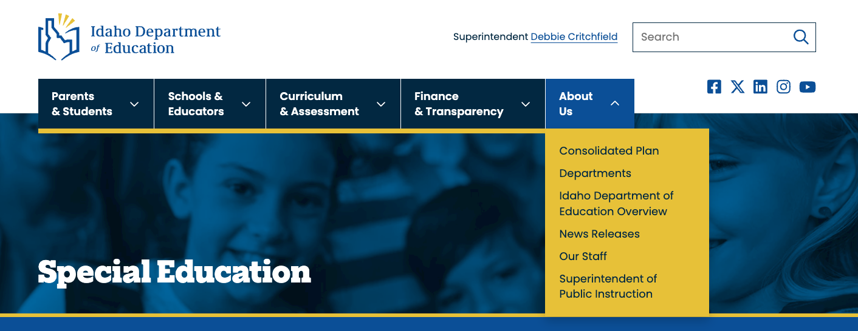
Navigate to the About Us Menu

Slide 9
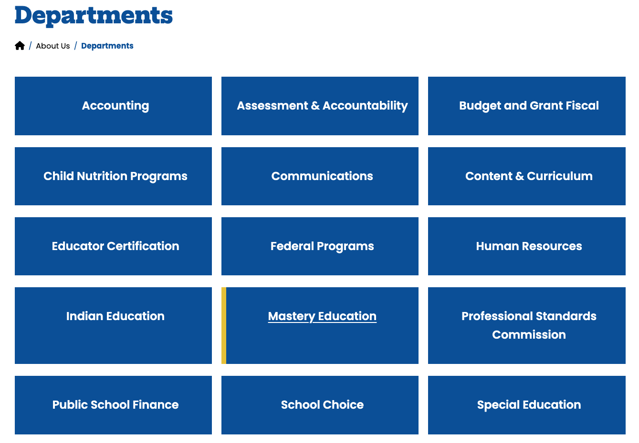
From the department list, click on special education

Slide 10
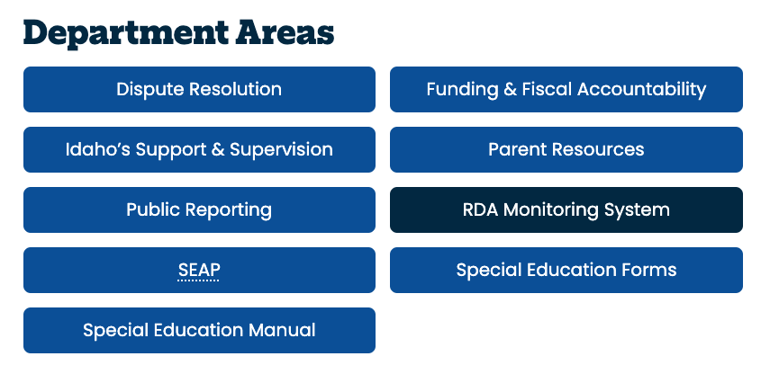
Navigate to RDA Monitoring System

Slide 11
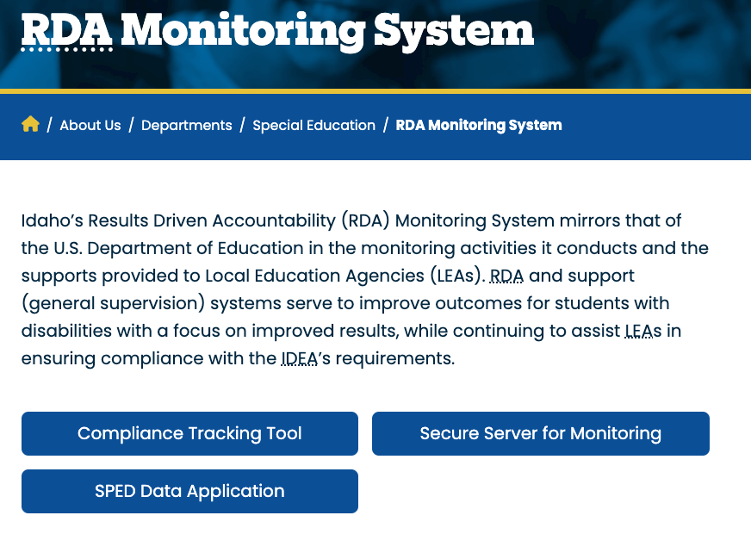
From the RDA Monitoring System page, click on the Compliance Tracking Tool

Slide 12
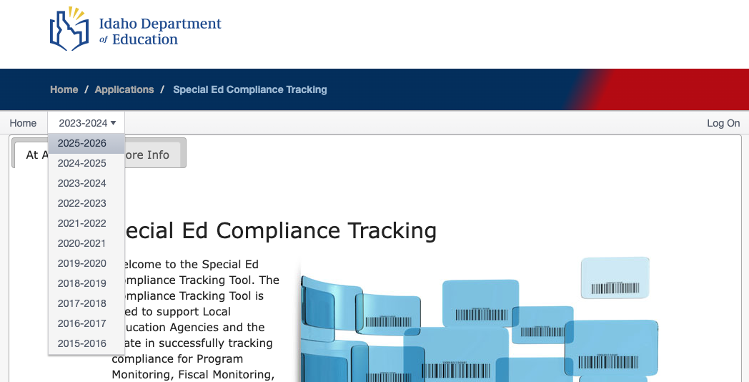
Log on to the CTT and confirm that 2025-26 is selected

Slide 13
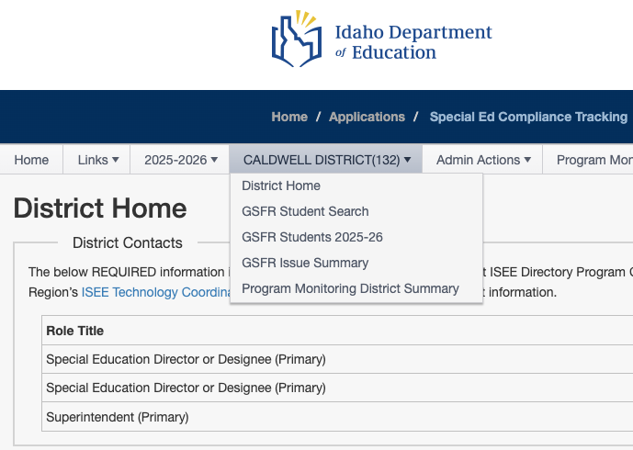
View the GSFR issue summary
ANY IDAHO LEA(007)

Slide 14

LEARNING TARGET
Learning Target Number Two
Understanding the steps to fix issues of noncompliance

Slide 15
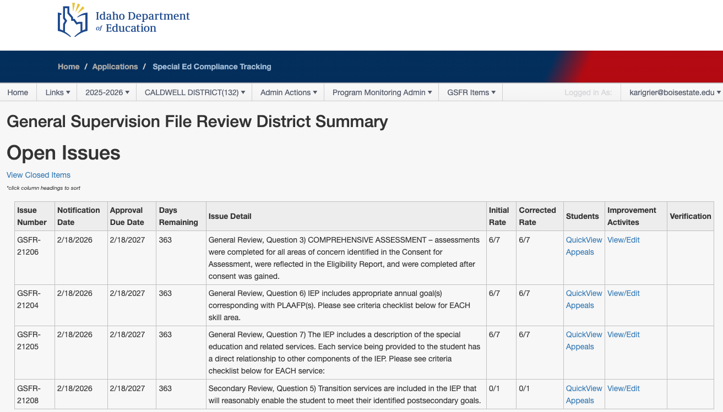
Navigate to open issues and view/edit activities
ANY IDAHO LEA(007)

Slide 16
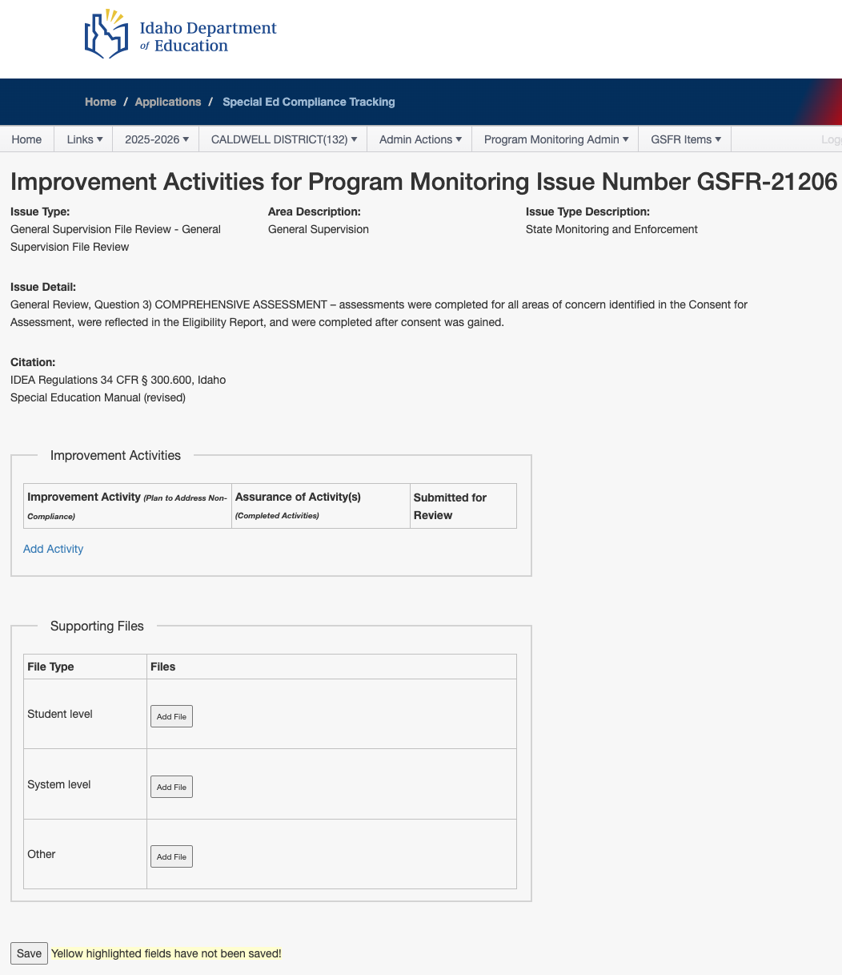
Provide documentation for each issue
Each Issue Has a Section For:
Issue Detail
Improvement Activities
Supporting Files

Slide 17
There are three components for correcting issues of non-compliance
Three Components for Corrections:
Student-level corrections
System-level verification
Improvement activities/Assurances

Slide 18
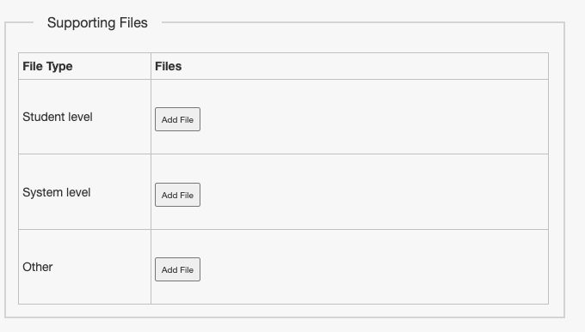
Add files to document corrections

Slide 19
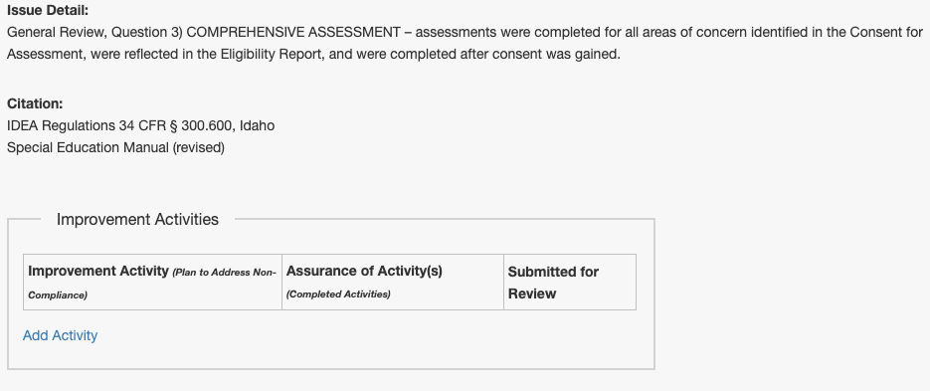
How to add an improvement activity

Slide 20

LEARNING TARGET
Learning Target Number Three
Identifying potential improvement activities to train and support teams

Slide 21
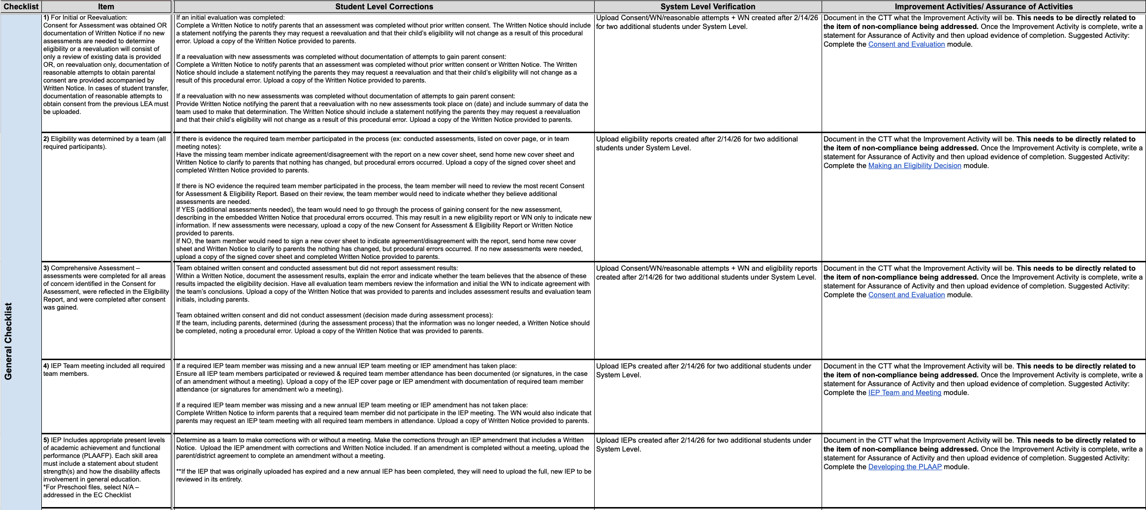
Work with Your SESTA Coordinator for Clear Guidance on How to Fix Issues of Noncompliance

Slide 22
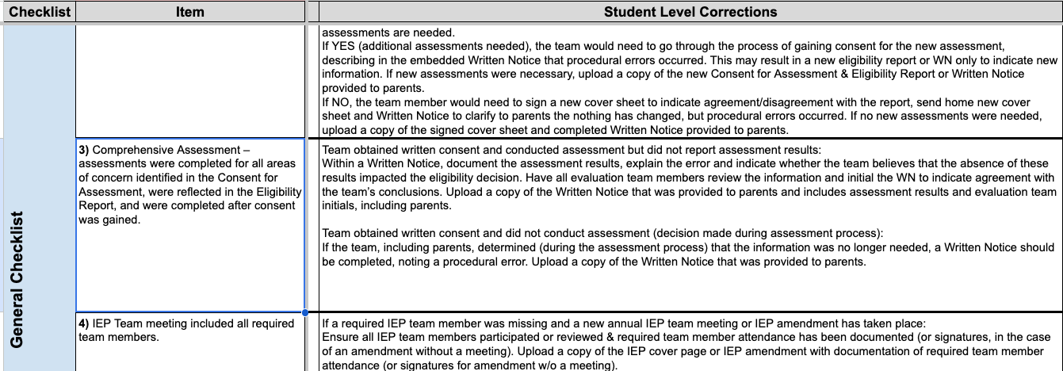
Work with Your SESTA Coordinator for Clear Guidance on How to Make a Student-Level Correction

Slide 23
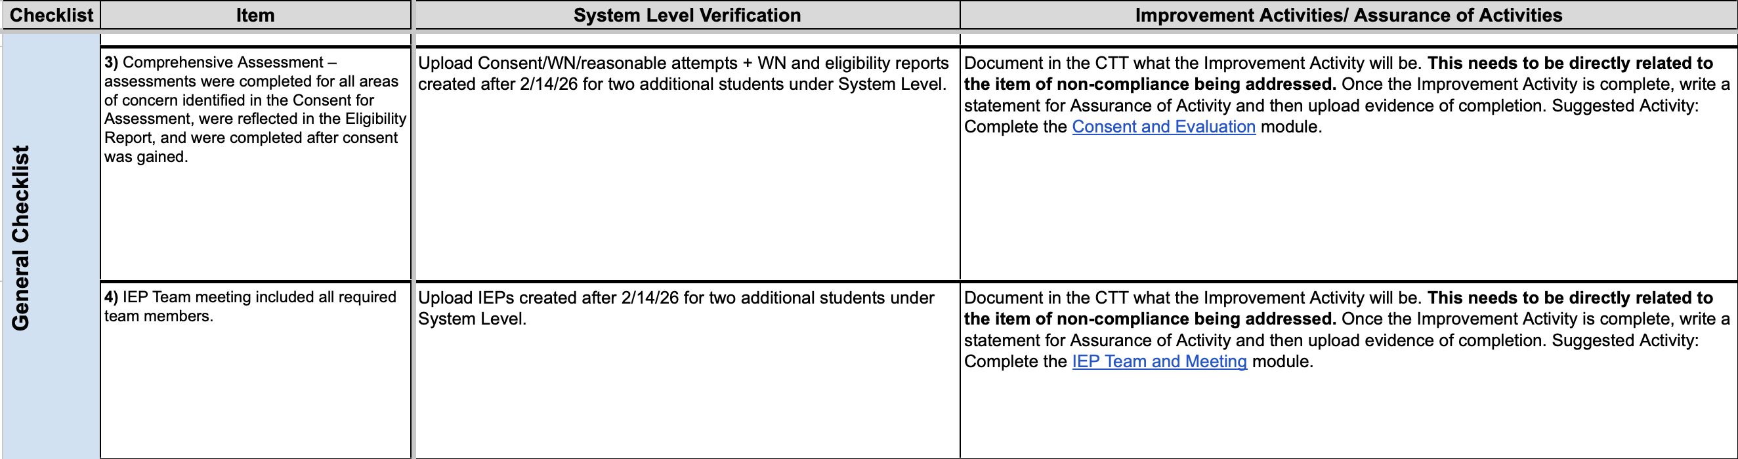
Work with Your SESTA Coordinator for Clear Guidance on How to Provide System-Level Verification and Select Appropriate Improvement Activities

Slide 24
Additional tools and resources to support you and your teams

Slide 25
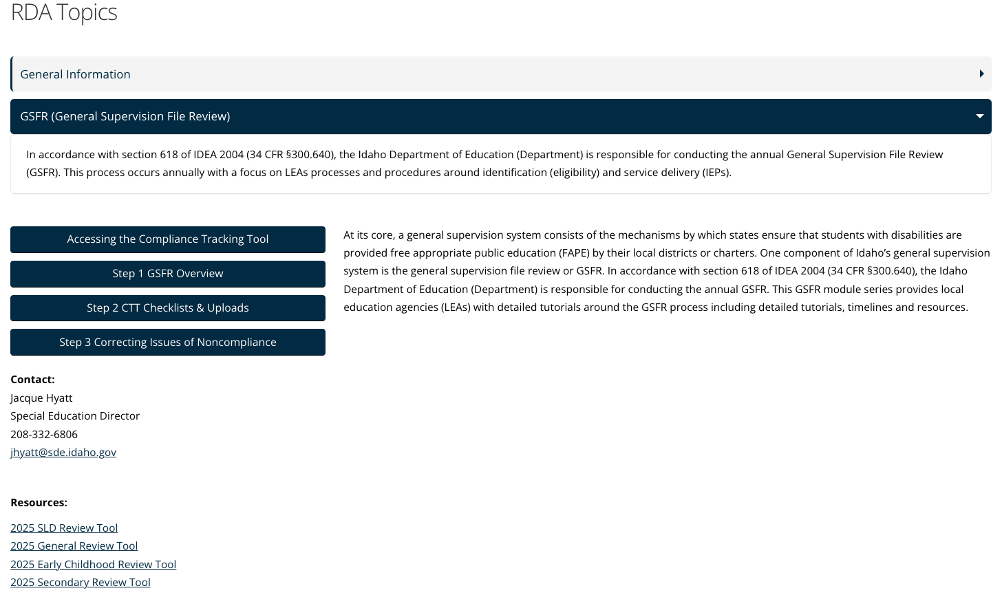
HELPFUL RESOURCES

Slide 26
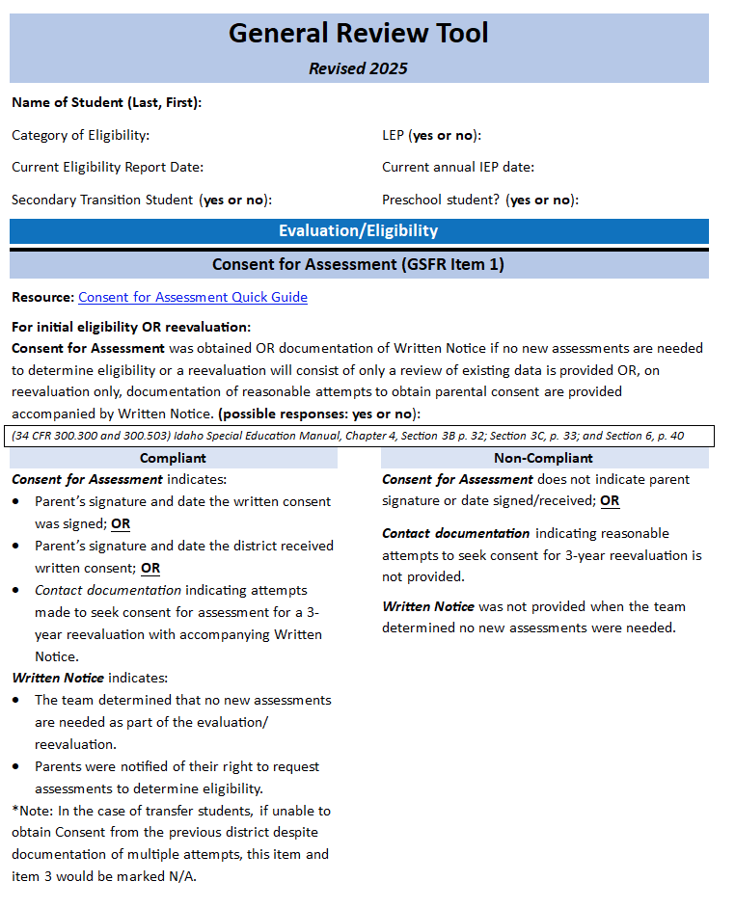
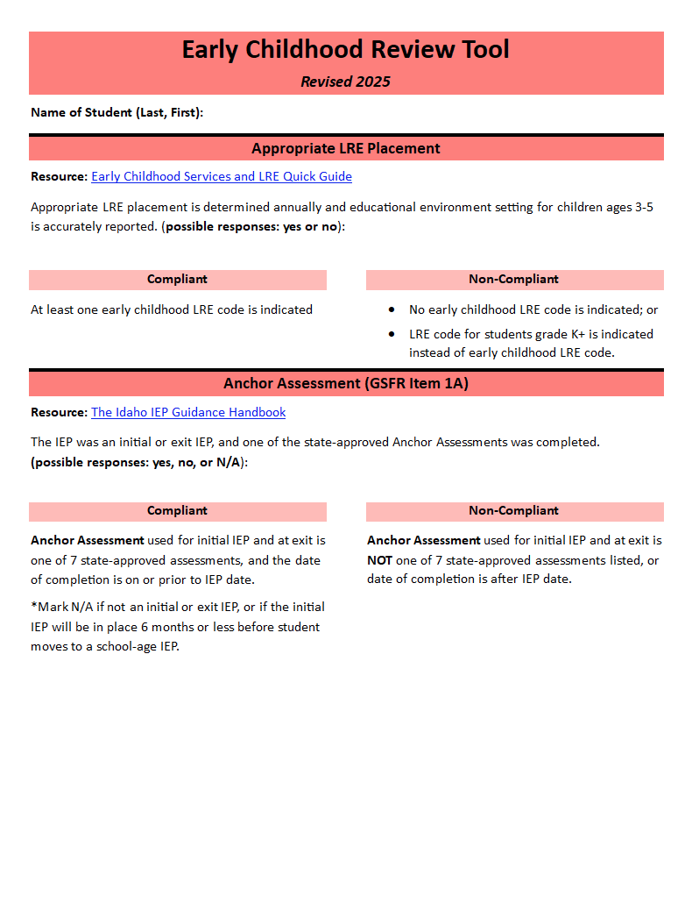
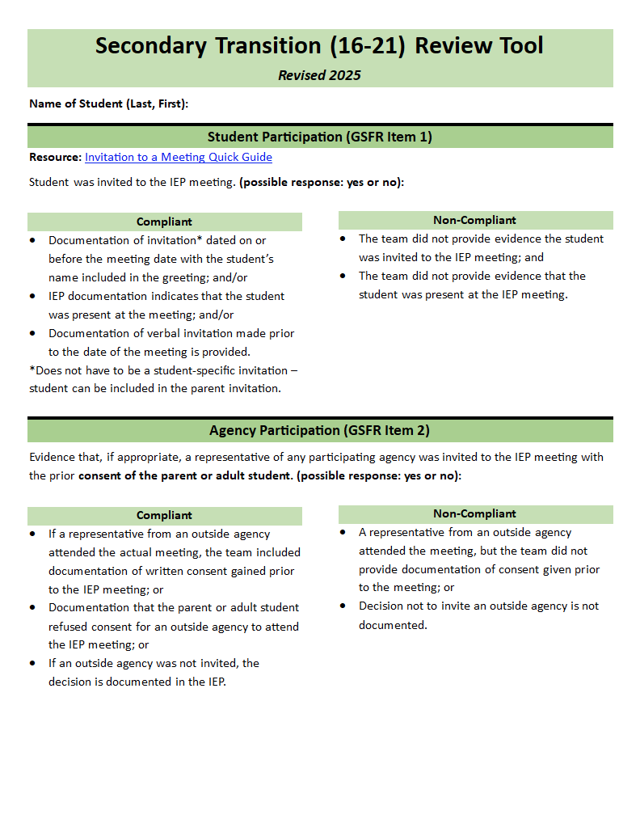
LEA Review Tools

Slide 27
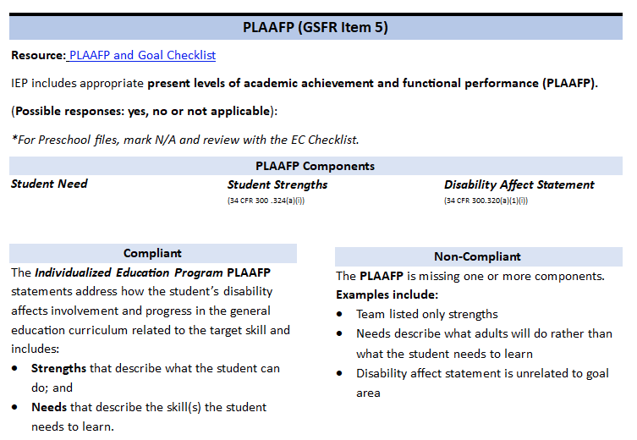
Refer to the LEA Review Tool for compliance attributes

Slide 28
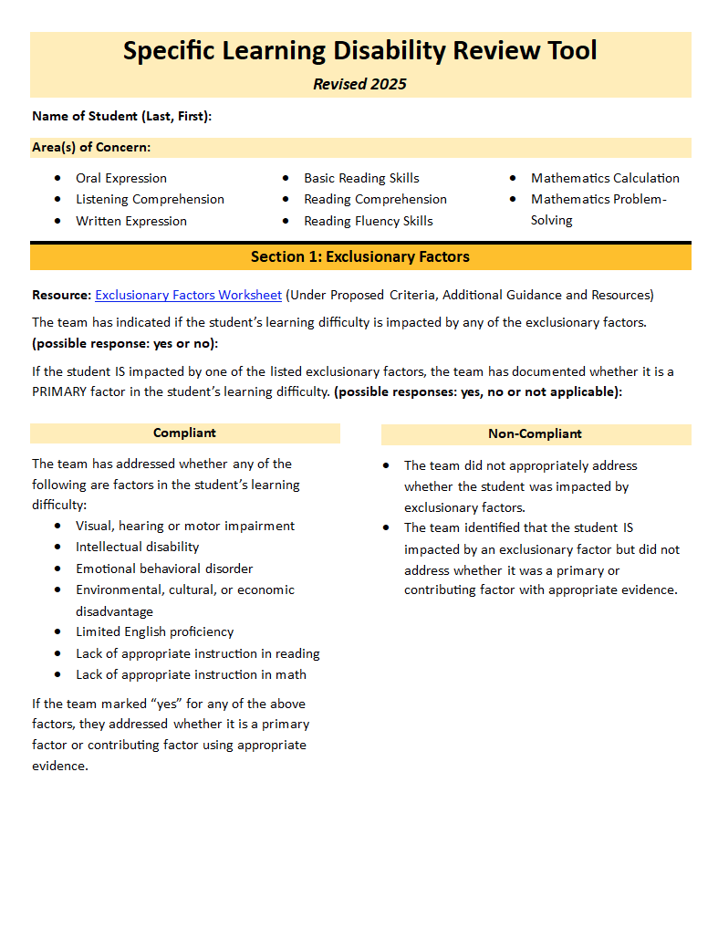
Specific Learning Disability Review Tool
While we no longer review SLD separate from the general review, the SLD Review Tool can support teams in better understanding the SLD eligibility criteria.
idahotc.com/Resources/File/RFFID/14212

Slide 29

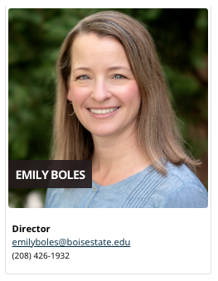
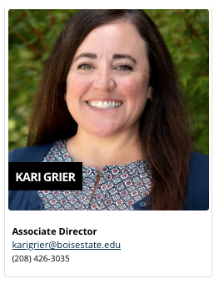
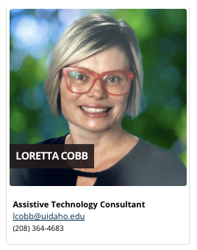
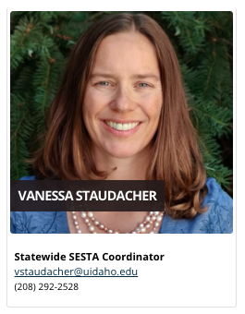
WE ARE HERE FOR YOU!
idahotc.com/SESTA/About-Us

Slide 30
THANK YOU
Idaho SESTA
idahotc.com/SESTA
help@idahotc.com

Slide 31

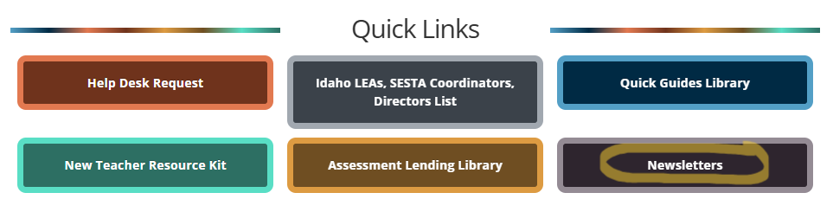
Idaho SESTA Updates - Subscribe
The easiest way to know what training and resources are available is to subscribe to the monthly Idaho SESTA newsletter.
Go to IdahoTC.com/SESTA, at the top of the webpage under ‘Quick Links,’ click on the ‘Newsletters’ button.

