Slide 1
Connecting the Dots for Federal, State, and LEA Regulations to Ensure Special Education Compliance
Ramona Lee, M. Ed.
Director of Special Services
West Ada School District (Joint School Dist. #2), ID
Dr. Joy Jansen, Ph. D.
Director of Special Services & Federal Programs
Lake Pend Oreille School District #84, ID

Slide 2
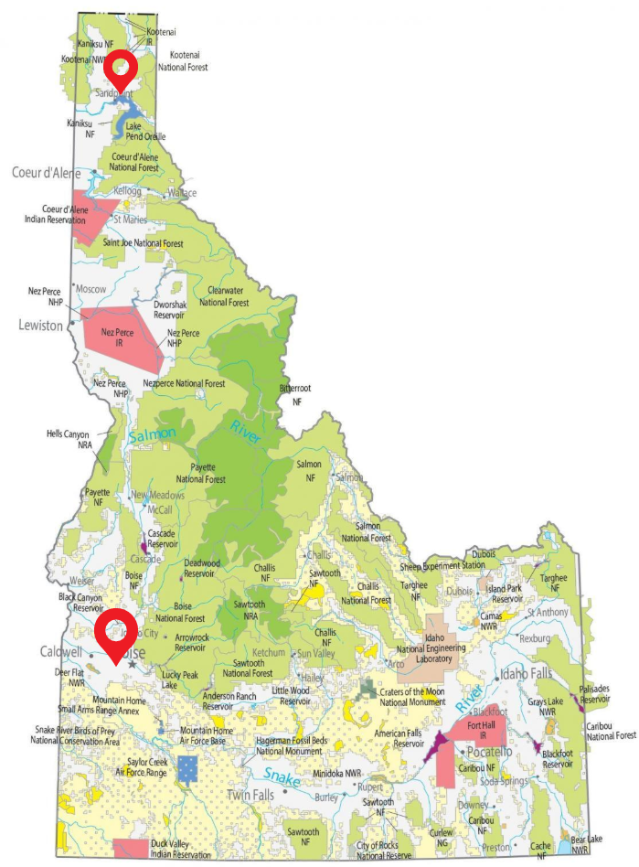

Who are we? Who are you?
Lake Pend Oreille School District (LPOSD)
3,650 Students
West Ada School District (WASD)
39,000 students

Slide 3
Learning Intentions
Define compliance and non-compliance from a special education lens
Increase awareness of federal, state, and local requirements that guide compliance efforts
Explore both proactive and reactive strategies that special education directors can use to increase compliance and sustain it.
Notes:
Learning Objective 1
Participants will learn how to identify federal, state, and LEA legislation and policies important for special education compliance.
Learning Objective 2
Participants will learn how to integrate compliance into districts’ professional learning.
Learning Objective 3
Participants will learn how to create compliance sustainability with special education staff and administrators.

Slide 4
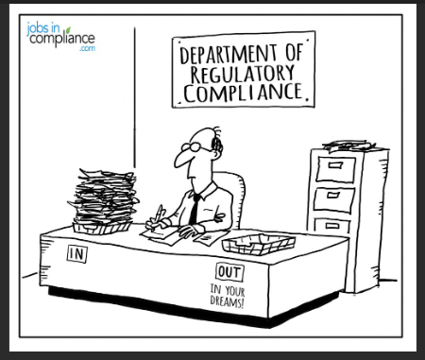
What IS special education compliance?

Slide 5
Laws and Regulations
Compliance is defined at many levels
Federal > State > Local Education Agency (LEA)
What is important to know and understand to bring compliance to your district?

Slide 6
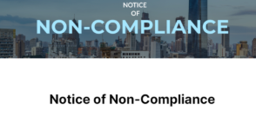
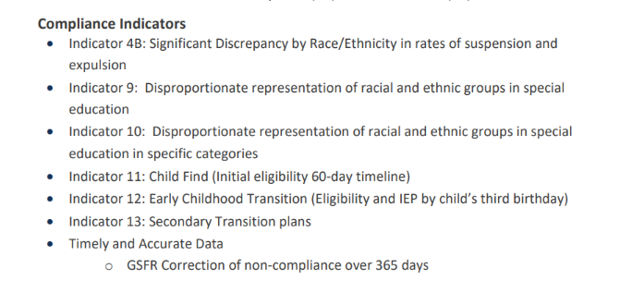
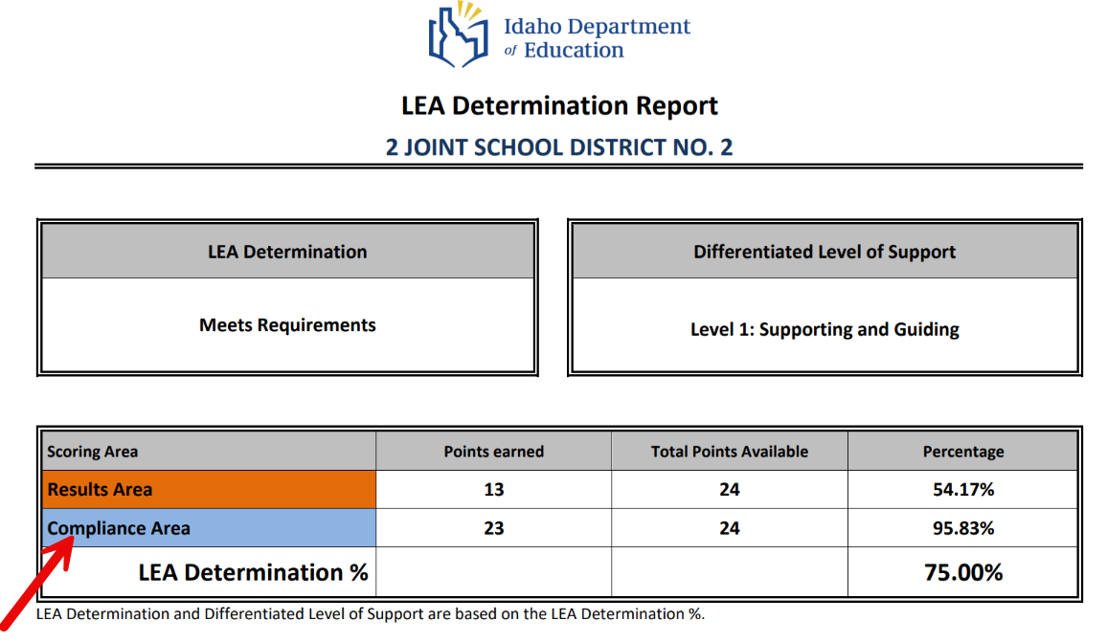
Defining COMPLIANCE in Idaho
Public Reporting of LEA compliance - Idaho

Slide 7
Compliance takes many forms
IDEA indicators
FAPE
OCR and US DOE oversight
…

Slide 8
Laws and Regulations
Federal | State | Local Education Agency (LEA)
Individuals With Disabilities Education Act | Idaho State Special Education Manual | LPOSD Policies
The Americans with Disabilities Act | 9th Circuit Court | WASD Policies
Section 504, Rehabilitation Act of 1973 | State and local laws
Free and Appropriate Education
US DOE Guidance (ex. Dear Colleague Letters)

Slide 9
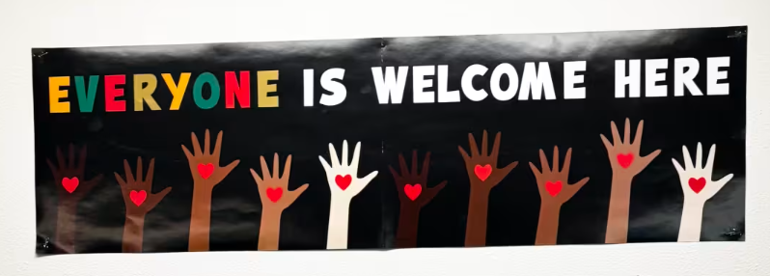
Laws and Regulations
Federal | State | Local Education Agency (LEA)
U.S. Department of Education Launches “End DEI” Portal | U.S. Department of Education | Attorney general: 'Everyone is Welcome Here' sign cannot be displayed in Idaho schools | View Administrative Regulation 0403.50-AR(9): Personnel Conduct - Visual Diplays
 | Code of Ethics for Idaho Professional Educators
 | Idaho House Bill 41
Notes:
Here is a non-special education example which did have an impact on students and programs associated with special education. It gave our district a chance to apply this framework in our district this spring.

Slide 10
Example: Dyslexia
Federal | State | Local Education Agency (LEA)
Individuals With Disabilities Education Act | https://www.sde.idaho.gov/wp-content/uploads/2025/09/Dyslexia-Legislation-Implementation-Summary.pdf | LPOSD Policies
The Americans with Disabilities Act | https://www.sde.idaho.gov/wp-content/uploads/2025/09/Idaho-Dyslexia-Handbook.pdf | WASD Policies
Section 504, Rehabilitation Act of 1973 | https://legislature.idaho.gov/statutesrules/idstat/Title33/T33CH18/SECT33-1811/
US DOE Guidance United States Department of Education letter regarding dyslexia, dyscalculia, and dysgraphia

Slide 11
Example: Seclusion / Restraint
Federal | State | Local Education Agency (LEA)
Restraint and Seclusion: Resource Document | U.S. Department of Education | PDFs: Idaho House Bill 581 | LPOSD Policies
The Americans with Disabilities Act | Restraint and Seclusion Legislation Implementation Summary | WASD Policies

Slide 12
Example: Service Animals (and service animals in training)
Federal | State | Local Education Agency (LEA)
Service Animals | ADA.gov | Section 56-701A – Idaho State Legislature | LPOSD Policies
Legal Brief: Service Animals and Individuals With Disabilities Under the Americans With Disabilities Act (ADA) | ADA National Network | City of Meridian: Dog Licensing | WASD Policies
Fry v. Napoleon Community Schools - SCOTUSblog

Slide 13
What ways do you connect the dots to bring compliance to your district?

Slide 14

Got Procedures?
The detailed guidance to ensure fulfillment of IDEA requirements
Process and content

Slide 15
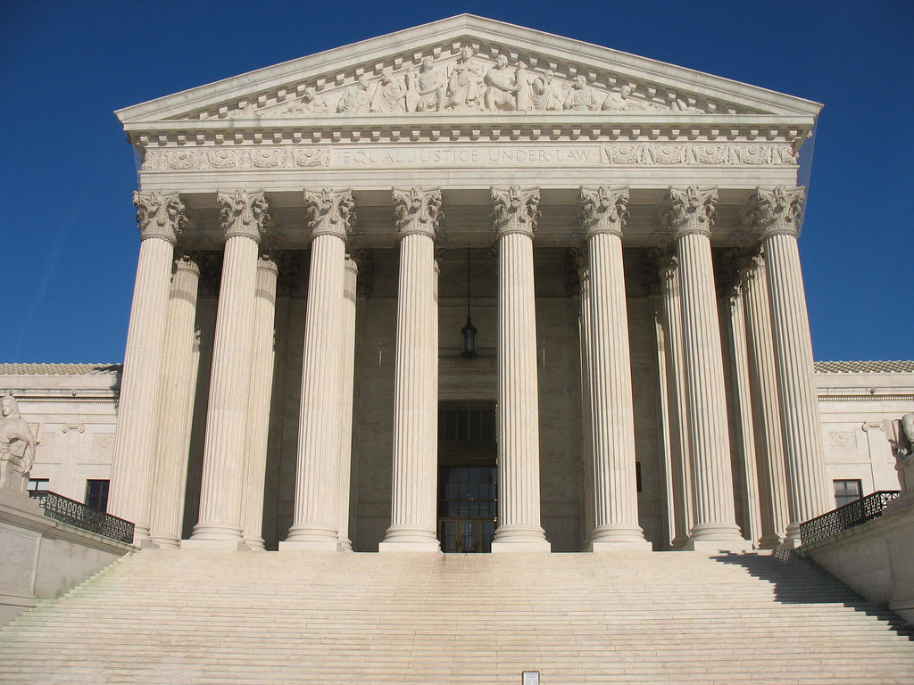
Court Connection
https://sites.ed.gov/idea/questions-and-answers-qa-on-u-s-supreme-court-case-decision-endrew-f-v-douglas-county-school-district-re-1/
This Photo by Unknown Author is licensed under CC BY-SA

Slide 16

Connecting the Compliance Dots in District
Balance Compliance vs. Results
Balance of Proactive vs Reactive Actions
Reasons behind compliance requirements (most are linked to outcomes)
Know > Train/Resources > Checks and Balances > Retrain

Slide 17
Does your district plan include these elements?
Know
Training/Resources
Checks and Balances
Retrain

Slide 18
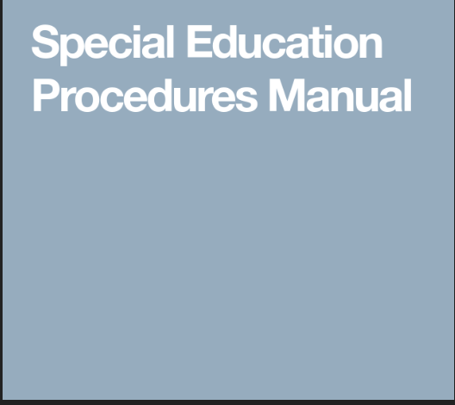
LEA Procedures
Know
Federal Law
State Rules and Regulations
District Policies
Train/Resources
District Procedure Manual
Newsletters
Include Admin in training
Virtual Bite-Size Procedure Training
Advocate, Special Education Scoop

Slide 19
LEA Procedures
Checks & Balances
Internal Audits​
Standard Record Reviews​
Data Drills​
Virtual Meetings: 2 Yearly vs. monthly
Retrain​
Individual coaching & mentoring​
Corrective Action training template

Slide 20
Example: GSFR
KNOW Federal > State > Local Education Agency (LEA)
Office of Special Education and Rehabilitative Services: Guidance on State
General Supervision Responsibilities
General Supervision Toolkit – National Center for Systemic Improvement
District Special Education Procedural
GSFR Training State Resources
GSFR District Training
Internal District GSFR
ID RDA Monitoring

Slide 21
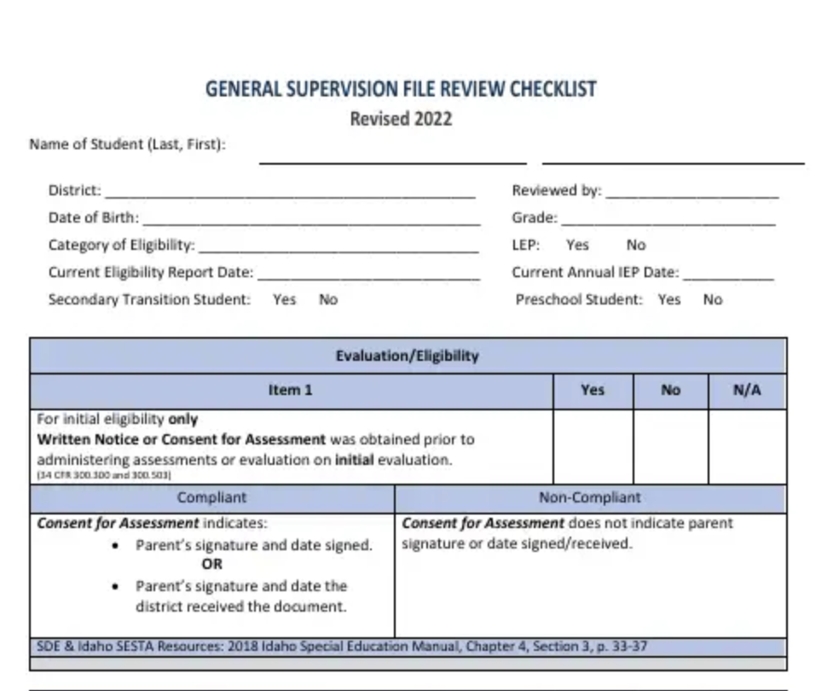
GSFR Scenario
Know
Train/Resources
Checks & Balances
Retrain
Notes:
Attendees will go through the process with whatever GSFR findings they had last year. How will they do each step?

Slide 22
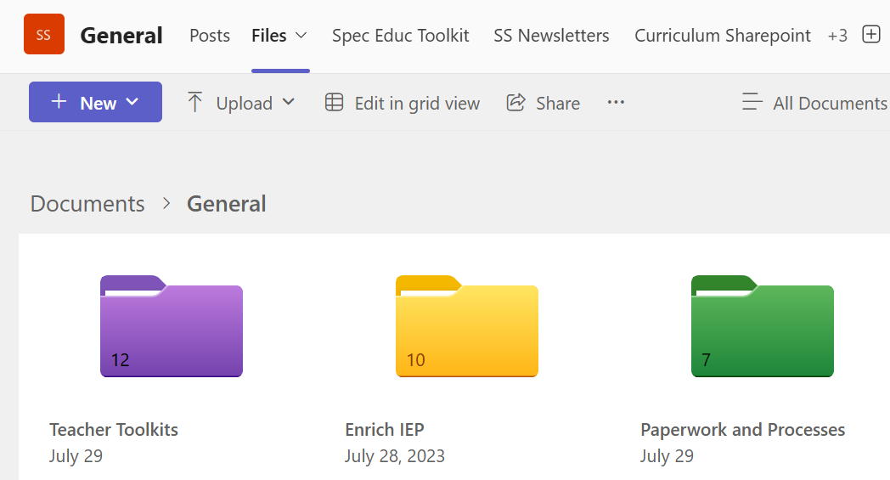
West Ada GSFR Example
Know
Federal Law
State Rules and Regulations
District Policies
Train/Resources
Special Services TEAM
Resources embedded in the software system, including virtual Bite-Size Procedure Training
Special Education Scoop
60-Day timeline calendar

Slide 23
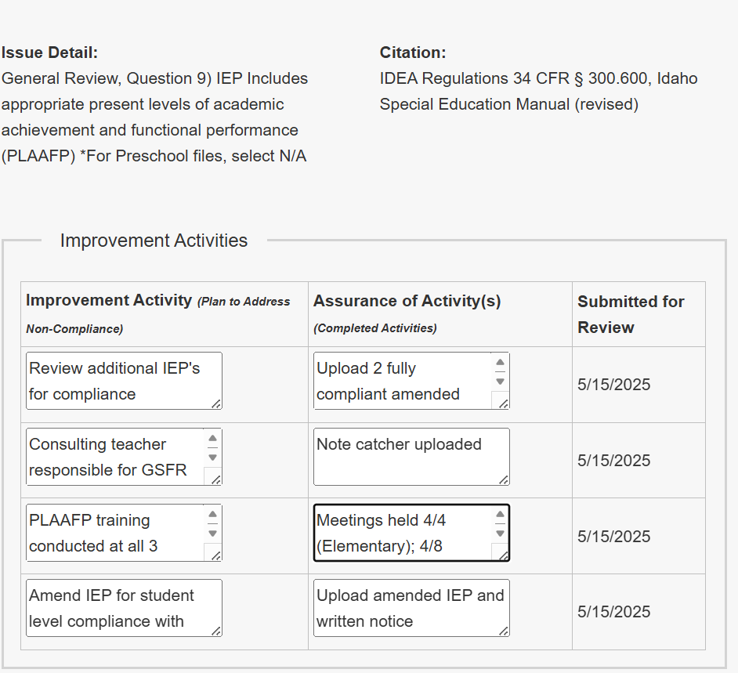
West Ada GSFR Example
Checks & Balances
Building team file reviews – submit one
Compliance Checks embedded
Virtual Meetings: Monthly by level
GSFR System Level Improvement Plan
Retrain
Individual coaching & mentoring (based on submitted files)
Acknowledgement of improvement and compliance!
Recognition in the newsletter
Email to administrator

Slide 24
LPOSD Educational Benefit Review Process
Part 1: Identifying Students Not Making Progress
Diagnostic Data Caseload and Intervention Adaptation Document (DBI Model)
Each case manager completes each quarter
Part II: General Supervision File Review
Select a student not making Progress
Complete 2 Individual Problem-Solving Discussion Guide
Complete GSFR document
Go through the GSFR document with the school team
GSFR is discussed at end of year meeting with the Director and the SEC consulting teacher

Slide 25

We can prepare thoroughly, but what happens when it still goes wrong?
What do we do when we discover our own noncompliance?
Corrective actions!
Better to acknowledge and correct rather than hope it isn't noticed.
Sandra Y G Jones at the 2025 CASE Conference:
Accountability = holding people accountable with care, not cruelty.

Slide 26
Corrective Action Examples
60-day timeline non-compliance
Corrective actions became Proactive training:
Tools; Tracking emails; 60-day timeline calendar
Reminders: Ex 60-day timeline Indicator 11: 60-Day Timeline training (2024-25 School Year) (Preview)

Slide 27
Corrective Action Examples
Insufficient Progress Reporting
Targeted Training

Slide 28
How do you keep yourself current?
District
Policy Work
Administrator training (ex. Graduation Rates)
State Level
Sde.Idaho.gov
www.idahotc.com
National Level
LRP
Perry A. Zirkel
Council for Administrators of Special Education (CASE)
The Weatherly Review (Quarterly)
60 Minutes with Myrna
CASE National Annual Conference
CASE Academy of Law and Leadership
Notes:
Pair up new directors with seasoned directors for partner work

Slide 29

Review of Learning Intentions
What is one small take-away you can implement in your district next week?

Slide 30
lee.Ramona@westada.org joy.Jansen@lposd.org
Questions?
Thank you for attending today!

