Slide 1
School Based Medicaid: Everything you need to know
What DO you need to know?

Slide 2

Presenter
Shannon Dunstan, Early Childhood and School Support Coordinator​
2025 IASA Conference

Slide 3
Session Purpose
To help participants become familiar with the resources and processes needed for providing and seeking reimbursement for Medicaid School-Based Services.
2025 IASA Conference

Slide 4
Session Objectives
An overview of the Medicaid reimbursement process for school-based services
Required documentation and compliance responsibilities
Understanding provider qualifications and service eligibility
Navigating the role of the Medicaid Advisory Committee (MAC)
Tips for collaboration between providers, billing teams, and LEA leadership
2025 IASA Conference

Slide 5

An overview of the Medicaid reimbursement process for school-based services
2025 IASA Conference

Slide 6

Medicaid Overview – Self Paced Module
2025 IASA Conference

Slide 7
Quick Overview of Process
LEA signs up to become a Medicaid Provider
LEA determines if a student is Medicaid eligible
MDT Team creates an IEP
MDT Team determines if the student is eligible for SPED services
Medicaid service provider completes a Service Detail Record (SDR)
Claims are processed and uploaded to Gainwell
DXC posts a weekly Remittance Advice (RA)
LEAs submit match fund payment
LEA receives payment
School-Based Services Eligible for Reimbursement
Evaluations Eligible for Reimbursement
2025 IASA Conference

Slide 8

Required documentation and compliance responsibilities
2025 IASA Conference

Slide 9
LEA signs up to become a Medicaid Provider
  Complete the Health Pas-ONLINE Registration form.
  If the LEA chooses to contract with a billing agency, coordinate with the billing agency for account information
  Complete the Idaho Medicaid Provider Agreement, Medicaid Provider Handbook: General Information and Requirements for Providers.
  Upload the signed and dated Idaho Medicaid Provider Agreement and W9 with the Health PAS-Online Registration form.
  LEA will need a National Provider Identifier (NPI) and an Idaho Trading Partner Account number to seek reimbursement
2025 IASA Conference

Slide 10
Determine if student is Medicaid eligible
Parents sign the Consent to Bill School-Based Medicaid
If a parent denies permission to bill School-Based Medicaid - the LEA may not seek reimbursement for assessments and/or services
LEAs can not use a Consent to Bill School-Based Medicaid from another LEA
Verify if the student is Medicaid eligible at www.idmedicaid.com
LEAs can not bill for assessments/evaluations or School-Based Services prior to obtaining signed Consent to Bill School-Based Medicaid
2025 IASA Conference

Slide 11
Determines if student is eligible for SPED services
LEA must obtain a physician’s recommendation or referral for the Consent for Assessment for non-academic assessments
  An LEA may not seek reimbursement for assessments more than thirty days prior to the signed and dated physician’s recommendation or referral
If the student is found eligible for SPED, proceed to IEP process
  If a student does not qualify for SPED services and are placed on a 504 – an LEA may be able to seek reimbursement utilizing EPSDT services
2025 IASA Conference

Slide 12
Evaluations Eligible for Reimbursement
  Occupational Therapy
  Personal Care Services
  Physical Therapy
  Psychological
  Speech/Language
  Audiological
  Social History
  Developmental
2025 IASA Conference

Slide 13
MDT Team creates an IEP
  LEA must obtain a physician’s recommendation or referral for the IEP
    An LEA may not seek reimbursement for services more than thirty days prior to the signed and dated physician’s recommendation or referral
  Refer to the current Medicaid School-Based Services Reference Guide for additional requirements Idaho Training Clearinghouse > Resources > File View (idahotc.com)
  Services must still be provided even if a student does not have Medicaid coverage
2025 IASA Conference

Slide 14
School-Based Services Eligible for Reimbursement
Behavioral Intervention
Behavioral Consultation
Crisis Intervention
Habilitative Skill Building
Interdisciplinary Training
Medical Equipment and Supplies (refer to DME requirements)
Nursing Services
Occupational Therapy
Personal Care Services
Physical Therapy
Psychotherapy
Skills Building/Community-Based Rehabilitation Services
Speech/Language Therapy
Transportation Services
Interpretive Services
Orientation and Mobility (refer to EPSDT requirements)
2025 IASA Conference

Slide 15
Medicaid service provider completes a Service Detail Record (SDR)
Service Detailed Report
  Name of Student;
  Name, title, and signature of the person providing the service;
  Date, time, and duration of service;
  Place of service, if provided in a location other than school;
  Category of service (also specifying individual or group);
  Brief description of the specific areas addressed (must correspond to the IEP goal); and
  Student’s response to the service when required for the service (must correspond to the IEP goal).
SDR’s are submitted to an LEA Medicaid billing department
Frequency that SDR’s are submitted is determined by LEA
2025 IASA Conference

Slide 16
Claims are processed and uploaded to DXC* by the LEA or the LEAs billing agency
•Claims must be submitted to DXC by 8:00pm MST on Thursday nights to be processed for payment the following week
•The method for submitting claims to DXC is determined by the LEA
•LEAs are not required to submit claims weekly
•LEAs determine the frequency of claim submissions
•Claims must be submitted within 365 from the date of service (DOS)
•Claims received 365 after the DOS will be denied
*Effective June 7, 2010, Idaho Medicaid contracted with Gainwell Technologies, formally known as Molina Medicaid Solutions and DXC to be the MMIS claims processing center as well as provide provider training, billing, and operational support for all Medicaid providers.
2025 IASA Conference

Slide 17
Gainwell posts a weekly Remittance Advice (RA) the Monday after a claim has been submitted
Itemized claim information is included in the RA
Claims are listed in the RA in the following order:
Reversed claims
Paid claims
Denied claims
Claims are sorted by student name
Claims are not sorted by date under student name
2025 IASA Conference

Slide 18
LEAs submit match fund payment
•IDHW mails a monthly Medicaid Match Fund Statement indicating balance due to release payment
•Payments from IDHW will not be released until they have received the match funds payment
•LEAs may also estimate match fund based on RA and submit estimated payment to IDHW prior to monthly statement arriving
•Current match fund percentages can be found here: EXHIBIT 6. Federal Medical Assistance Percentages (FMAPs) and Enhanced FMAPs (E-FMAPs) by State : MACPAC
2025 IASA Conference

Slide 19
Documentation Requirements
Student is found Medicaid Eligible
School-Based Medicaid Services are identified on the IEP
  Type (also specifying individual and/or group), frequency and duration of the services provided;
  The title of the provider(s), including the direct-care staff delivering services under the supervision of the professional;
  Measurable goals, when goals are required for the service; and
  The specific place of service, if provided in a location other than a school.
  Service Detail Report(s) for each service provided
Documented review of the student’s progress every 120 Days
Documentation of Qualification of Providers
Parent Notification regarding services
Primary Care Physician and written consent to release and obtain information between primary care physician and LEA
Documentation that the student meets the qualification for services provided
2025 IASA Conference

Slide 20
Understanding provider qualifications and service eligibility
2025 IASA Conference

Slide 21
Service Eligibility Requirements (Applies to All Medicaid SBS)
Student Eligibility
  Medicaid Eligible: Student must be enrolled in Medicaid on date of service.
  Educational Disability: Student must qualify under IDEA.
  IEP Inclusion: Services must be identified in an active IEP, IFSP, or Service Plan.
  Parental Consent: One-time written consent must be obtained before billing Medicaid.
Medical Necessity
  Required to access the educational program.
  Prescribed or recommended by a physician or licensed practitioner of the healing arts.
Exclusions
  Educational-only services (e.g., general academic instruction)
  Vocational or recreational services
  Services without documented referral or IEP inclusion
2025 IASA Conference

Slide 22
General Requirements for All Providers
All providers must meet service-specific qualifications under IDAPA 16.03.09.
Documentation of qualifications must be retained for 5 years.
All staff, including contracted personnel, must pass an SDE-conducted background check.
LEAs must verify providers are not on exclusion lists (state or HHS-OIG).
Providers must not deliver Medicaid School-Based Services until all qualifications are met and documented
2025 IASA Conference

Slide 23
CHIS Providers (Children’s Habilitative Intervention Services)
Paraprofessionals: Must meet IDAPA 08.02.02 standards; direct services only.
Technicians: Provisional staff within 24 credits of a human services bachelor’s degree or with such a degree.
Specialists: Require credentials plus supervised experience and competencies.
Professionals: Require a master’s in psychology, education, or applied behavior analysis and 1200 hours of relevant experience.
2025 IASA Conference

Slide 24
Nursing Services
Must be delivered by a licensed RN or LPN.
LPNs must work under RN supervision.
Nursing services must be detailed in the IEP and have a physician referral before starting services.
Tasks that can be delegated to non-medical staff are not billable as skilled nursing
2025 IASA Conference

Slide 25
Personal Care Services (PCS)
May be provided by:
  RN or LPN
  Certified Nursing Assistant (CNA)
  Personal Assistant (≥18 years old with appropriate training)
RN must oversee the PCS plan, review quarterly, and document services and supervision.
Must be documented in IEP and tied to a PCS Care Plan
2025 IASA Conference

Slide 26
Psychotherapy Services
Eligible Professionals Include:
  Licensed psychologist
  Licensed clinical social worker
  Licensed marriage and family therapist
  Certified psychiatric nurse
  Licensed master’s social worker (with psychotherapy provision)
  Psychologist extender registered with Division of Occupational & Professional Licenses
2025 IASA Conference

Slide 27
Therapy Services
Occupational Therapy (OT):
  Licensed OT or COTA (under supervision)
  OT aides may only do delegated, non-skilled tasks
Physical Therapy (PT):
  Licensed PT or PT assistant (under supervision)
  Aides may not bill Medicaid
Speech-Language Pathology (SLP):
  Licensed SLP (with or without CCCs)
  Licensed SLP Assistant (must pass ASHA exam unless grandfathered)
  Paraprofessionals no longer eligible to bill Medicaid after July 1, 2024
2025 IASA Conference

Slide 28

Medicaid Advisory Committee (MAC)
2025 IASA Conference

Slide 29
Medicaid Advisory Committee (MAC)
Collaboration​
  Between LEAs, SDE, Division of Medicaid​
  Address concerns​
  Cohesive guidance​
Recommendations​
  Within the scope of applicable state and federal guidelines
2025 IASA Conference
11

Slide 30
Agency Participation
Jacque Hyatt: IDE​
Shannon Dunstan: IDE​
Angie Williams: Division of Medicaid​
Angela Toomey: Division of Medicaid​
Almira Mackaben: Division of Medicaid​
Lori Stiles: Medicaid Program Integrity Unit​
Melissa Vian: Idaho Parents Unlimited
2025 IASA Conference
12

Slide 31
MAC Representatives
Region 1: Joy Jensen, Lake Pend Orielle
Region 2: Peggy Flerchinger, Lewiston SD
Region 3: Alex Hopkins, Boise SD​
Region 4: Greg Durrant, Minidoka SD
Region 5: Janelle Harris, Pocatello SD​
Region 6: Angie Tamayo, Bonneville SD
Traditional Charter School: Kevin Hausmann, Future Public Charter​
Virtual Charter School: Amanda Judd
2025 IASA Conference

Slide 32
Quarterly MAC Meetings
Open meetings​
Location: Hybrid – IDE and Zoom​
Zoom registration required​
Public meeting notices:​
SPED webpage – Agenda and Zoom registration link​
Final agendas & minutes ​
Located on School-Based Medicaid topic page
2025 IASA Conference

Slide 33
Medicaid Advisory Committee 2025-2026
Meeting Dates
  September 17, 2025, 1:00 – 3:00 PM MT
  December 17, 2025, 1:00-3:00 PM MT
  March 18, 2026, 1:00-3:00 PM MT
  June 18, 2026, 1:00-3:00 PM MT
2025 IASA Conference

Slide 34

Tips for collaboration between providers, billing teams, and LEA leadership
2025 IASA Conference

Slide 35
Collaboration Between Providers and Billing Teams
Why It Matters:
  Ensures claims are accurate, timely, and fully compliant with Medicaid rules.
Key Collaboration Practices:
  Providers must:
    Maintain complete and legible Service Detail Reports (SDRs).
    Document student response, service duration, and location.
    Provide signed referrals and proof of qualifications to billing teams.
Billing teams must:
  Validate Medicaid eligibility on the date of service.
  Cross-check that IEP services align with Medicaid billing codes.
  Confirm all claims are backed by compliant documentation.
Tip: Develop a shared documentation checklist and audit timeline.

Slide 36
LEA Leadership’s Role in Medicaid Collaboration
Oversight Responsibilities:
Ensure Medicaid policies and procedures are followed consistently across the district.
Monitor provider qualifications, supervision logs, and licensure status.
Maintain up-to-date background checks and exclusion list screenings.
Accurate Service Detail Reports (SDR)
Support Systems to Establish:
  Routine internal compliance audits.
  Training for both special education and Medicaid staff.
Clear communication protocols between departments.
Note: LEAs—not billing vendors—are ultimately liable for errors or audits.

Slide 37
LEA's Compliance Responsibility
LEAs must meet all the compliance requirements for both Individuals with Disabilities Education Act (IDEA) and Medicaid School-Based Services (SBS).
Completing quality assurance activities with a self-audit process in place to ensure compliance and identifying any overall system improvements.
Providers must have written policies to prevent waste, fraud, and abuse, include them in employee handbooks, and submit an annual compliance affidavit if receiving $5 million or more.
Quality Assurance involves reviews to ensure Medicaid compliance. If issues are found, the LEA must implement a corrective action plan within 45 days, with DHW providing support as needed.
2025 IASA Conference

Slide 38
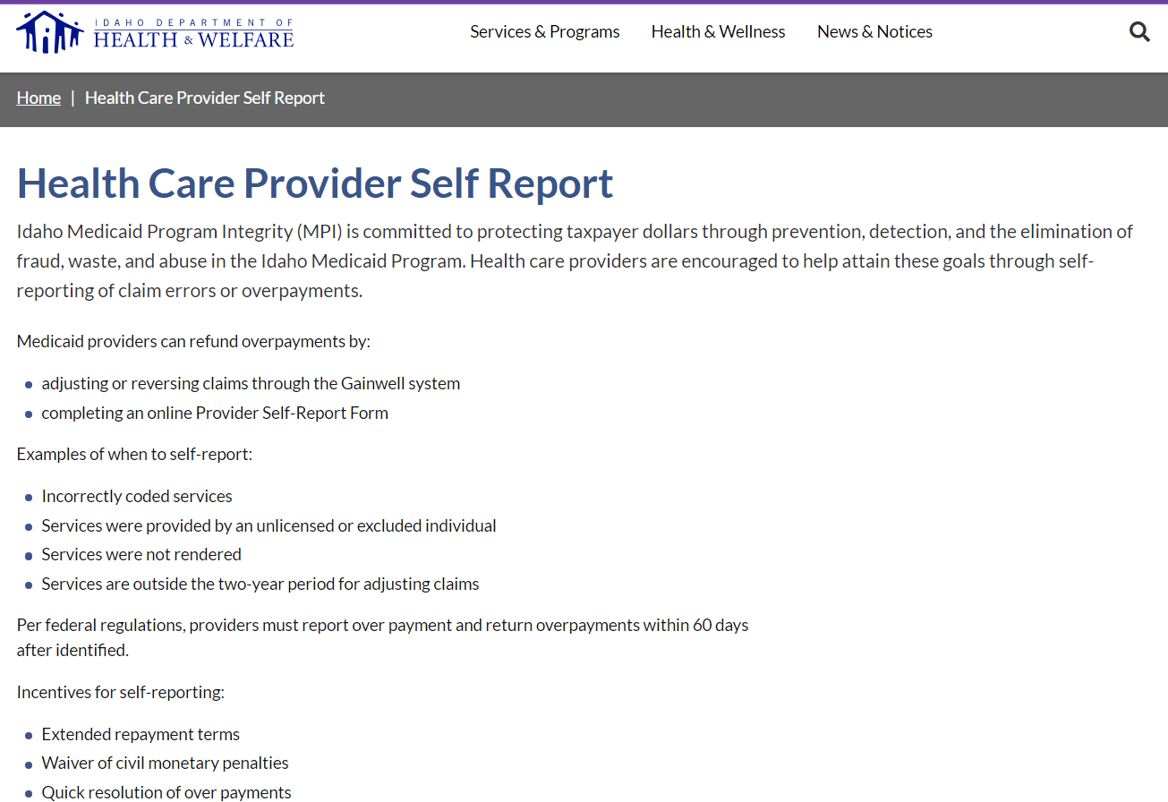
Self Report Form
2025 IASA Conference

Slide 39

Resouces
2025 IASA Conference

Slide 40
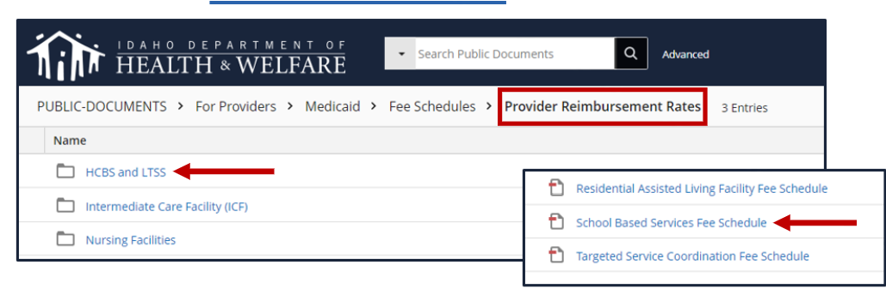
Resources
Training, Resources, and Forms webpage
  Fee Schedules webpage
    Provider Reimbursement Rates webpage
      HCBS and LTSS link
2025 IASA Conference

Slide 41
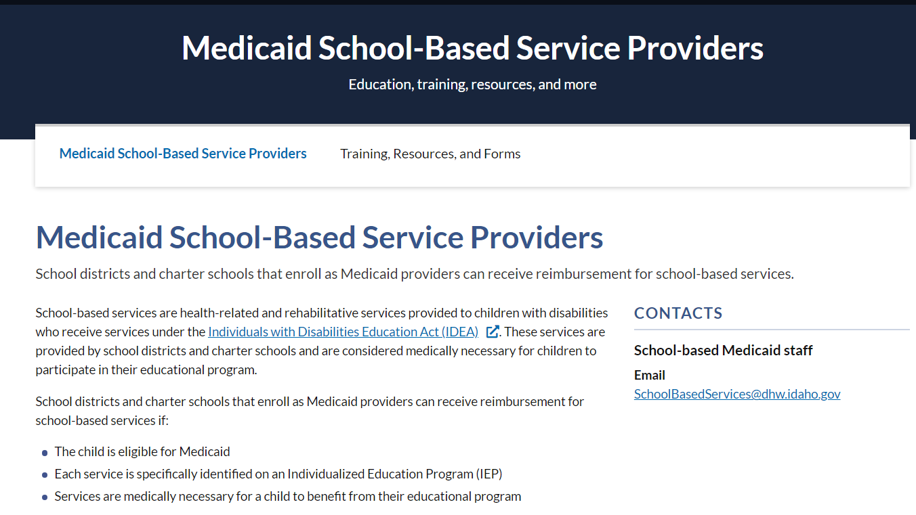
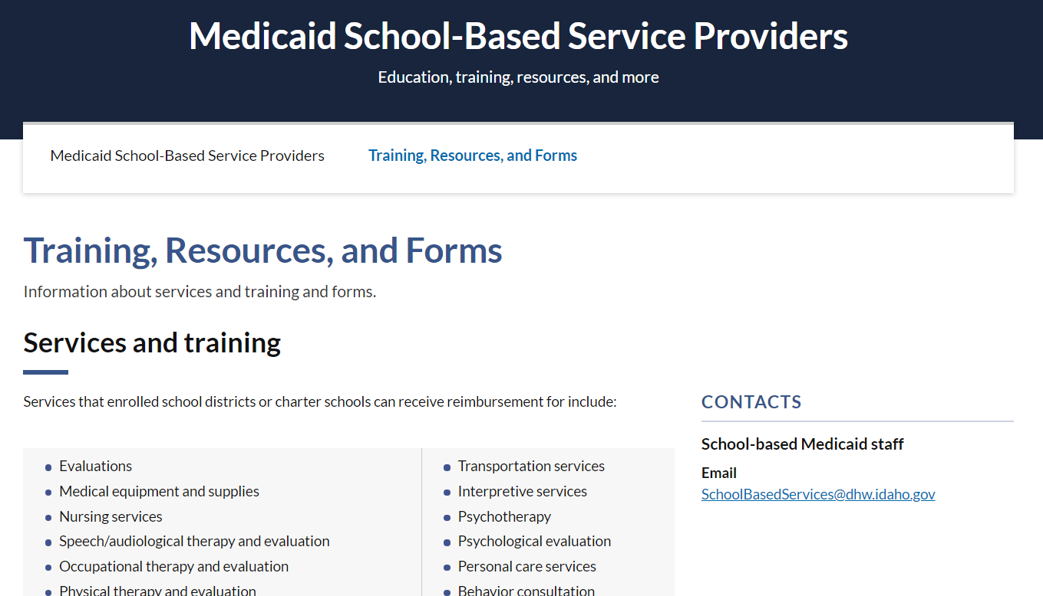
Medicaid SBS Resources: Division of Medicaid
Medicaid School-Based Providers webpage​
Training, Resources, and Forms webpage
2025 IASA Conference

Slide 42

Medicaid School Based Services
Reference Guide 2025-2026 (in revision)
This Photo by Unknown Author is licensed under CC BY-NC-ND
2025 IASA Conference

Slide 43
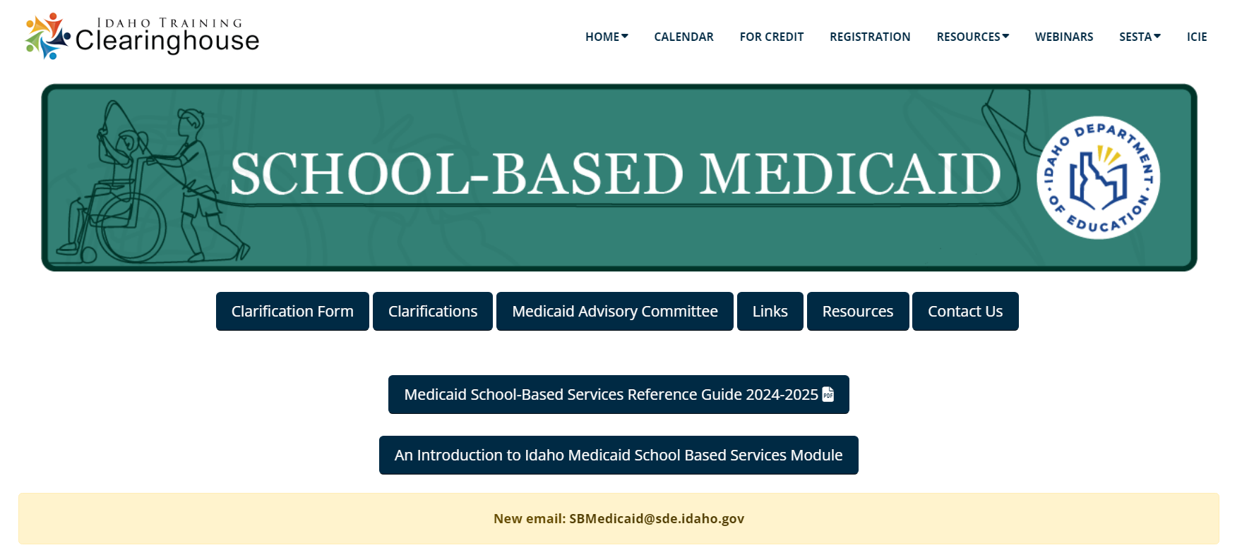
Medicaid SBS Resources: ITC
School-Based Medicaid topic page​
Clarifications page​
Medicaid SBS Clarification form
2025 IASA Conference

Slide 44

Questions
This Photo by Unknown Author is licensed under CC BY-SA-NC
2025 IASA Conference

Slide 45
Thank you !!
Shannon Dunstan
Early Childhood and School Supports Coordinator
Idaho Department of Education
208.332.6908
Sdunstan@sde.Idaho.gov
Almira Mackaben​
Medicaid Program Policy Analyst for School-Based Services​
Idaho Department of Health and Welfare​
Division of Medicaid​
208.287.1169 ​
Almira.Mackaben@dhw.idaho.gov

