Slide 1
Implementation of IDEA: A Shared Responsibility with Building Administrators
David F. Bateman, Ph.D.
DavidBateman@me.com

Slide 2
David Bateman, PhD
DavidBateman@me.com
Blog: SpedLawBlog

Slide 4
Lead IDEA Center
Goal:
Create a Leadership Learning System (LLS) that provides continuous learning from initial education to professional development. This system will improve the abilities and support structures at various levels, including state, regional, district, and individual program levels. The goal is to better prepare, support, and keep administrative staff in schools and early intervention services, focusing on improving the educational experiences and success of students with disabilities (SWDs) and their families.
Establish and maintain state-level partnerships to ensure leaders have competencies to implement IDEA.
Identify IDEA-related professional competencies.
Develop and disseminate resources.
Deliver high-quality professional learning.
Cultivate inclusive leadership practices.
Evaluate effectiveness.
Foster Community Engagement and Collaboration.
Enhance the capacity of state-level partners to use Center products to deliver high-quality professional development.
For More Information:
David Bateman Lynn Holdheide
dbateman@air.org lholdheide@air.org

Slide 5
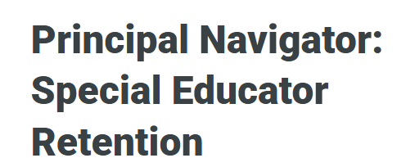
New Lead IDEA Resource
For each issue, explore:
School stories (scenarios)
Strategies & short-, medium-, and long-term solutions
Extensive resources
Practitioner videos
Related IDEA considerations https://bit.ly/reten-nav

Slide 6
“If you’ve seen one school, you’ve seen one school”
Natalie Turner
Notes:
Or – “one size fits one”
Reminder that there is no formula or cookie-cutter approach
We must recognize that each child, each school, each community is different, so to some degree we are forced to think in generalities and then apply those to our unique contexts.
Also a reminder that we should avoid assumptions

Slide 7
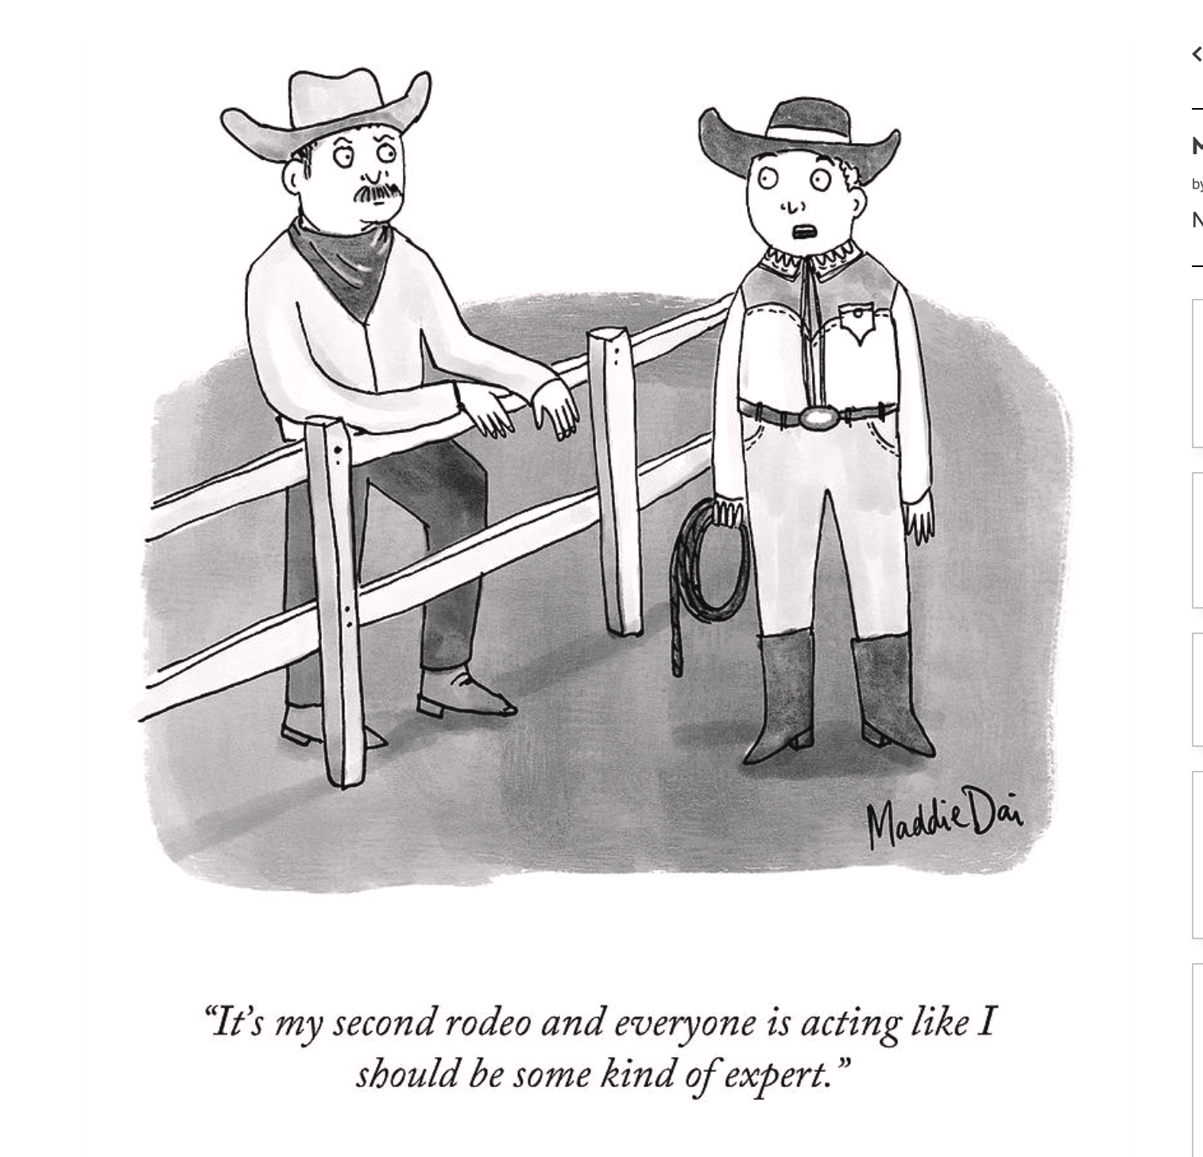

Slide 9
Stuff I’m Sending:
1. Pre-Referral Intervention Manual
2. How to Write a 504 Plan
3. Teacher input for IEPs
4. Newport News, VA case
5. All new IEP steps
Before meeting
Script for during meeting
After the meeting

Slide 10
Two More Things
Sold a Story Podcast
Washington Post:
How Richneck Elementary failed to stop a 6-year-old from shooting his teacher

Slide 11
Words Matter
Individual needs provide a basis for annual goals
How those needs are phrased drives the IEP process
Notes:
Prime example – Autistic student vs. student with autism.
Usually, IEP language is written around what the EDUCATOR wants or needs, rather than the student.

Slide 14
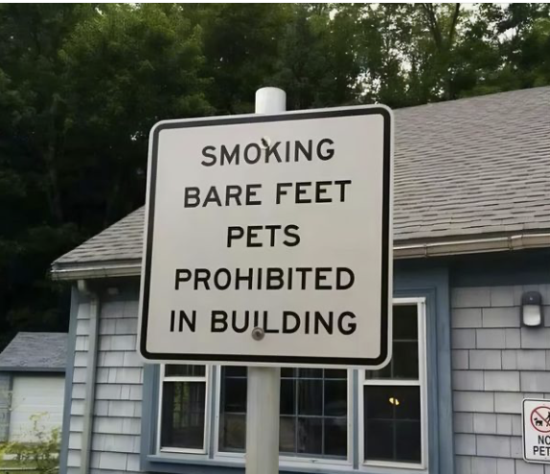

Slide 15
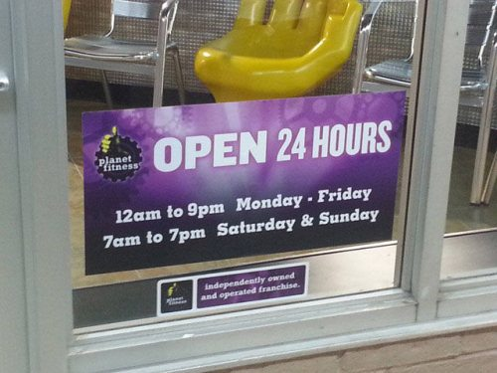

Slide 17
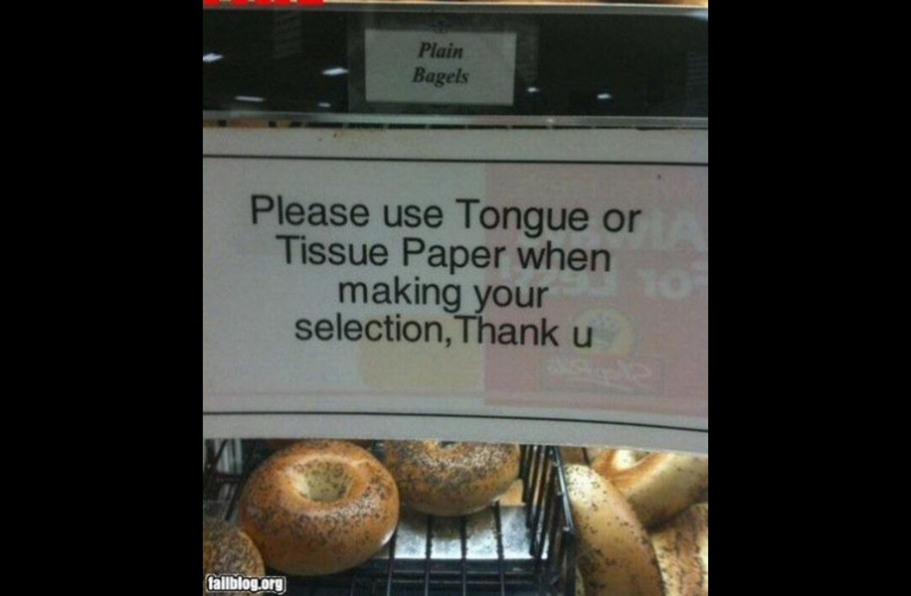

Slide 18
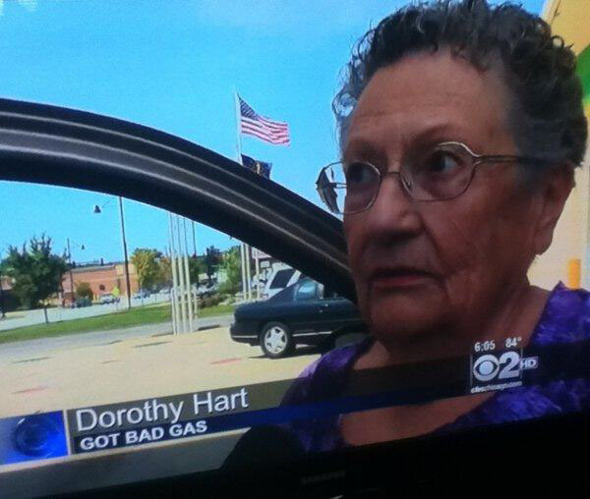

Slide 19
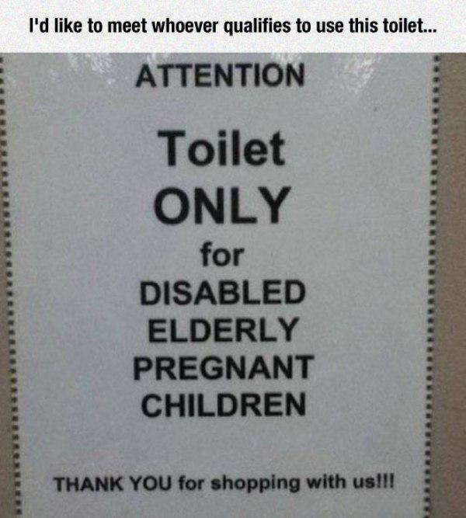

Slide 20
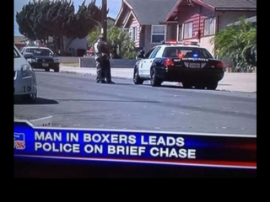

Slide 21
Family-School Collaboration
Pop quiz
In an analysis of local and state procedural safeguards provided to families, how many were written at a college reading level or higher?
A- 52%
B- 68%
C- 75%
D- 94%
Notes:
D - (Mandic, Rudd, Hehir, & Acevedo-Garcia, 2012)
39% scored in the graduate or professional range

Slide 22
Before Meetings
Provide clear communication about
Timing
Parking and transportation options
Participants
Topics to be discussed, and potentially some of the concerns about the student that may arise
Roles and rights
Contact information for questions or concerns

Slide 23
Pop Quiz
The average reading level of psychological reports, based on an analysis by Harvey (2006)
A- 12.8
B- 14.6
C- 18.5
D- 21.2
Notes:
C
in comparison, Stephen Hawking describes Einstein’s theory of relativity at a reading level of 11.3.
It was over 20 for clinical-neuropsych reports

Slide 24
Special Education
Enrollment Quiz

Slide 25
Idaho
312,934 total students
37,000 special education
11.6%

Slide 26
School Board and General Population
1. Down’s Syndrome 80%
2. Blind 5%
3. Wheelchairs 5%
4. Autism 5%
5. Deaf 5%
6. ADHD 5%

Slide 27
Why?

Slide 28
Principal Prep
Not prepared
Great teachers
No requirements
Shortages
Basic skills

Slide 29
Race to the Bottom
Certification is a low bar
Online programs

Slide 30
Six Big Ideas in IDEA
Zero Reject
Protection in Evaluation
Free Appropriate Public Education (FAPE)
Least Restrictive Environment (LRE)
Procedural Safeguards
Parental Participation

Slide 31
Big IDEA #1 Zero Reject

Slide 32
What is Zero Reject?
Children with disabilities aged 3 - 21
Two criteria
Evaluating as having a disability covered by the IDEA
Because of the disability the child needs special education & related services
No student who meets these criteria can be rejected from special education

Slide 33
Child Find
"Child find" refers to the affirmative, ongoing obligation of states and local districts to identify, locate and evaluate all children with disabilities residing within the jurisdiction who either have or are suspected of having disabilities and need special education as a result of those disabilities. (34 CFR § 300.111)
Child find must include: "(1) children who are suspected of being a child with a disability (under 34 CFR § 300.8) and in need of special education, even though they are advancing from grade to grade; and (2) highly mobile children, including migrant children." 34 CFR 300.111(c).

Slide 34
Judicial Issues in Child Find
Did the school district have a reason to suspect that a student may be eligible under IDEA?
Did the school district fulfill its evaluation obligations under IDEA within a reasonable period of time?

Slide 35
Big IDEA #2 Evaluation

Slide 36
Federal Definition: Evaluation
LEAs shall conduct a full and individual evaluation before the initial provision of special education and related services to a child with a disability
20 U.S.C. 1414(a)(1)

Slide 37
Eligibility
Two-part test of eligibility
Does the student meet the criteria of one or more of the disability categories under the IDEA?
If so, does the student need special education services (is there an adverse effect on educational performance)?

Slide 38
Conducting an Evaluation
A request for an initial evaluation to determine whether a student is a child with a disability can be made by either the parent or the LEA. (34 CFR 300.301[b]).
An LEA proposing to conduct an initial evaluation must
Provide the parent a copy of their procedural safeguards notice
Obtain informed parental consent
The LEA has 60 days from the receipt of parental consent to conduct an initial evaluation of a student suspected of having a disability. 34 CFR 300.301(c)(1)(i).
Solicit parent input

Slide 39
Purposes of the Evaluation
Determining eligibility
Assessing all areas of need irrespective of a student’s disability label
Program development
Must provide relevant information so a student’s program may be developed
Continual assessment and reporting of progress are built into the IEP process

Slide 40
Big IDEA #3: Free Appropriate Public Education (FAPE)

Slide 41
Free Appropriate Public Education
FAPE is the central pillar of IDEA
FAPE consists of special education and related services
Provided at public expense
Meet state educational agency standards
Includes an appropriate preschool, elementary, and secondary school education
Provided in conformity with the Individualized Education Program (IEP)

Slide 42
Individualized Education Program
The IEP is the “modus operandi” of the law
Burlington v. Department of Education of Massachusetts, 1985
“The IEP is the central part of this Act as we wrote it and intended it to be carried out.”
Senator Robert T. Stafford, 1978

Slide 43
Participants on the IEP Team
Parents
A representative of the LEA
General education teacher “of such child”
Special education teacher “of such child”
Person knowledgeable about instructional implications of the evaluation
Others at request of IEP participants (special expertise & knowledge)
Whenever appropriate, the child
Notes:
LEA rep-Qualified to provide or supervise the provision of special education-authorized to make decisions for the district & commit district resources

Slide 44
Common Procedural Errors
Failing to provide prior written notice
Failing to ensure parents meaningful involvement
Predetermining services & placement
Improper IEP membership
Determining placement prior to programming (“shoehorning”)
Failing to address transition needs & services

Slide 45
Substantive Errors in IEP Development
The substantive requirements of the IDEA focus on the adequacy of the IEP in terms of its likely or actual results.
In its most recent IDEA decision, Endrew F. v. Douglas County School District RE-1 (2017), the U.S. Supreme Court ruled that a student’s IEP must be “reasonably calculated to enable [the] child to make progress appropriate in light of the child’s circumstances” (Endrew, p. 999).

Slide 46
Common Substantive Errors
Failing to conduct a comprehensive, individualized & relevant assessment
Failing to address all needs in the PLAAFP
Failing to link assessment, goals, & programming
Failing to write measurable annual goals
Failing to collect data to monitor student progress and make instructional changes when needed

Slide 47
Related Services
Related services means transportation and such developmental, corrective, and other supportive services as are required to assist a child with a disability to benefit from special education (34 C.F.R. 300.34[a]).
Consideration of the need for related services is a required component in the IEP development process (34 C.F.R. 300.320[a][4]).
The IEP team must make individual determinations about whether a related service is necessary to assist a student in benefitting from his or her program of special education instruction.
Related services do not include services provided by a medical doctor or a medical device that is surgically implanted.

Slide 48
Non-Exhaustive List of Related Services
Transportation
Speech-language pathology
Audiology services,
Interpreting services,
Psychological services,
Physical and occupational therapy,
Recreation, including therapeutic recreation,
Early identification and assessment of disabilities in children,
Counseling services, including rehabilitation counseling,
Orientation and mobility services,
Medical services for diagnostic or evaluation purposes. Related services also include
School health services and school nurse services,
Social work services in schools,
Parent counseling and training.

Slide 49
Big IDEA #4 Least Restrictive Environment (LRE)

Slide 50
Placement and Least Restrictive Environment
Placement typically made by IEP team
Placement must be based on IEP
Placement must be in least restrictive environment (LRE)
The placement must be individualized
Placement should be in a student’s home school if possible

Slide 51
The LRE Requirement of IDEA
To the maximum extent appropriate, students with disabilities should be educated with children who are nondisabled
Special classes, special schooling, or other removal of children with disabilities from the general education environment should occur only if the nature or severity of the disability is such that education in the general education classroom with the use of supplementary aids and services cannot be achieved satisfactorily

Slide 52
The Continuum of Alternative Placements
Each local educational agency (LEA) must ensure that a continuum of alternative placements is available to meet the needs of students with disabilities for special education services
LEAs must make provision for supplementary services (e.g., resource room, itinerant instruction) be provided in conjunction with general education placement

Slide 53
Continuum of Alternate Placements
Regular Classroom
Self-Contained Classroom
Special Schools
Hospital/Institution

Slide 54
Big IDEA #5 Procedural Safeguards

Slide 55
Procedural Safeguards
Notice & consent requirements
Opportunity to examine records
Confidentiality of student records
Independent educational evaluation
Discipline

Slide 56
Procedural Safeguards
Congress incorporated extensive procedural safeguards into the IDEA when identification, evaluation, placement, and the provision of FAPE is at issue.
The purpose of these procedural safeguards are to protect students with disabilities from unilateral and possibly inappropriate decisions by LEA personnel and to allow parental involvement in the children’s special education.

Slide 57
Examples of Procedural Safeguards
Procedural safeguards notice: Parents must be given a written notice that explains the safeguards at least once a year.
Prior written notice: A reasonable amount of time before the school initiates or changes identification, evaluation, or educational placement or the provision of a FAPE or refuses same, the LEA must send prior written notice, which explains the action they took (or refused to take) and the reasons why the action was taken
Informed consent: Written informed consent must be obtained from a student’s parents before the LEA may (a) conduct an initial evaluation, (b) provide special education and related services, or (c) reevaluate a student.

Slide 58
Examples of Procedural Safeguards
Access to records: IDEA regulations incorporate parents’ right to access records found in the Family Educational Rights and Privacy Act of 1974.
Independent educational evaluation (IEE): Parents are entitled to an IEE at public expense if they disagree with the LEA’s evaluation. The IEP team must consider the results of the IEE when making decisions about the FAPE provided to a student.

Slide 59
Big IDEA #6 Parent Participation

Slide 60
Parental Participation
The most basic of all the requirements of the IDEA is that parents are full and equal participants with the school district personnel in the development of their child’s IEP (Bateman, 2012).
Parental participation is central in all decisions regarding the child’s program and placement and when full and equal parent participation is abridged or denied, a denial of a student’s right to a FAPE will most likely be found (Bateman, 2011).
IDEA confers very specific rights and obligations on the parent including right to consent, object, & the right to due process.

Slide 61
Essential Role of the Parent
Special Education process cannot function without a “parent” -- an active, involved decision-maker who is needed to “consent” to evaluations, services, placement, etc.
IDEA confers very specific rights and obligations on IDEA Parent including right to consent, object, & the right to due process.
Understanding these rights and responsibilities is critical to effective advocacy, collaboration and ensuring a child’s ultimate success in school.

Slide 62
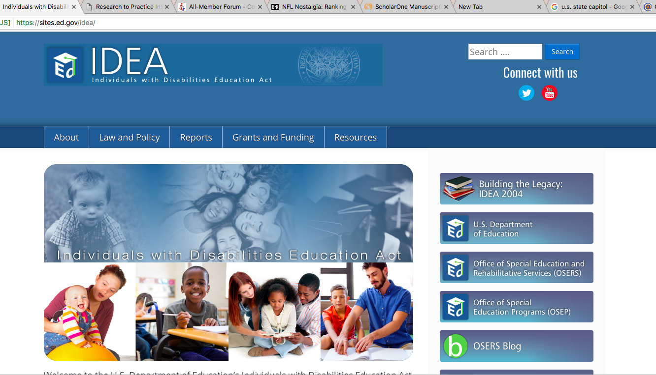

Slide 63
Remember the key phrases
Based on a student’s needs and potential for growth
Challenging, ambitious measurable goals
Progress appropriate in light of a student’s circumstances
Internal Consistency

Slide 64
Monitoring and Reporting Progress
Kathleen Mehfound (Attorney with Reed Smith and Consultant to LRP, 2015): “When I have a school district with a FAPE case the first thing I do is go to the teacher and say ‘Give me information on your student’s progress.’ If the teacher doesn’t have data, I advise the school district to settle.”
Notes:
LRP, used to stand for legal research publications, but now they just use LRP as a name. It is the largest publisher of legal information in special education, owns Special Education Connect database and IDELR (Individuals with Disabilities Education Law Reporter).

Slide 65
Before We Begin…
The U.S. Supreme Court ruling in Endrew F. v. Douglas County School District (2017) affects how special educators develop and implement IEPs.

Slide 66
Ruling in Endrew F.
Main holding: “IEPs be reasonably calculated to enable a child to make progress appropriate in light of the child’s circumstances.”
Extras:
Students must have challenging goals & objectives (if appropriate)
A student’s program must be appropriately ambitious
“The essential function of the IEP is to pursue academic and functional advancement”
Notes:
If appropriate-everyone has to write objectives if a student will or has participated in alternate test

Slide 67
Procedural Requirements of IDEA
These safeguards are designed to protect the rights of parents and their child with a disability by requiring the school district take actions to involve parents in the special education process
Procedural requirements represent the “how” and “when” of IDEA
“Has the school district complied with the procedures set forth in the law?” (Board of Education v. Rowley, 1982)

Slide 68
Involving Parents
General notification rights
Notification of procedural safeguards
Notification of IEP meetings & participants
Prior written notice of proposed changes or refusal to make changes requested by parents
Get the parents involved
Treat with respect!
Notes:
*Be sure two varied attempts at minimum!
If phone is one, you must speak to parent.

Slide 69
Notes:
David

Slide 70
Tip One
Be compassionate
Focus on laws
Be a decent person
Be helpful
Notes:
David

Slide 71
Child Find
The child find duty to refer for an evaluation under IDEA is triggered when there is reasonable suspicion that a student has a disability and a need for special education services.
Notes:
David

Slide 72
Child Find Continued
If an eligibility team finds that sufficient data are not available to make a valid determination about SLD (or other eligibility), then that should be documented and a plan put in place for obtaining the needed information and completing the eligibility process.
Notes:
David

Slide 74
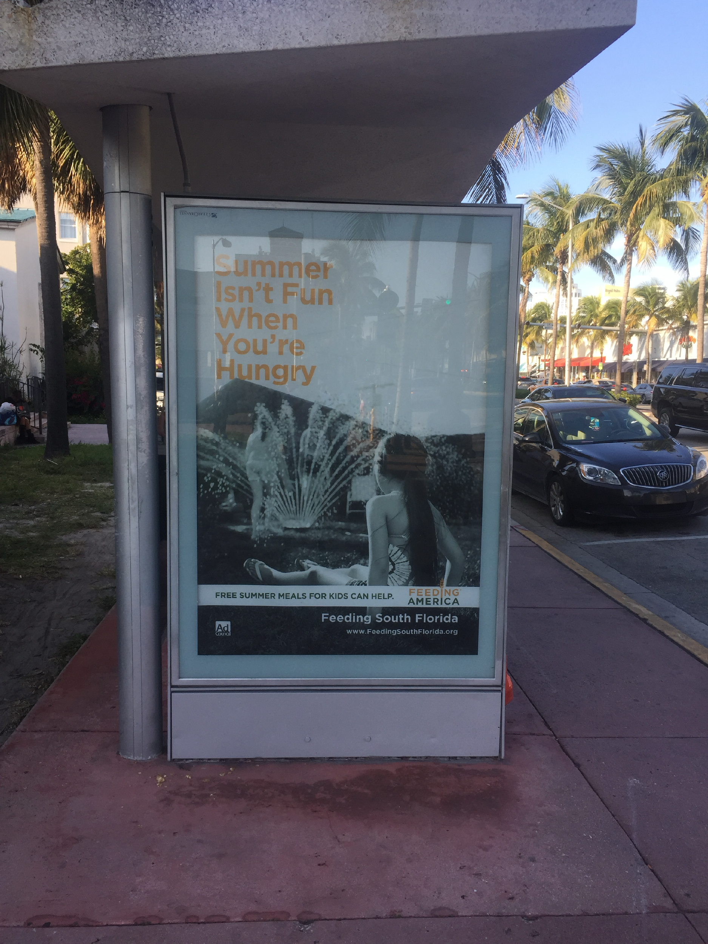

Slide 75
Info from Gen Ed Teachers
* A statement about any forms filled out
* The date the information was provided for the report
* A list of the student’s strengths
* A list of concerns you have as the student’s general education classroom teacher
* A statement of how the student compares with the average students in the classroom
* A statement describing anything out of the ordinary regarding this student’s class schedule or day
* Any accommodations or modifications used that are helpful to the student
* List of current grades

Slide 76
Grade: 4
Teacher: Mrs. Claudette Berman
Date: September 24, 2024
Student’s name: Griffin
What are the student’s strengths?
Positive self-image
Always participates in class
Will ask questions when he is unsure
Exhibits friendly behaviors
What are your areas of greatest concern?
Not always focused while working independently
At least one grade level below in reading
Difficulty understanding and solving math facts and concepts
Difficulty following written and oral directions (i.e., does better in a one-on-one situation where steps and procedures and directions can be explained multiple times).

Slide 77
How does this student compare with the average students (same-age peers) in your classroom?
Average in work completion, overall behavior, behavior in halls, and aggression
Above average with behavior in structured groups
Below average in reading, math, spelling, writing, work accuracy, following directions and behavior in unstructured groups
Grades: Failing in all academic areas
Factors affecting class schedule or day: Receives ESL (English as a second language) instruction during math and for a limited amount of time in language arts.
Accommodations or modifications that are helpful to the student: Benefits from his tests and assignments being read aloud as well as being given extra time to complete assignments and tests.

Slide 78
Basics
Food
Clothing
Sleep
Warmth
Security
Safety
Relationships
Friends

Slide 79
Teacher Roles
Safety!
Autonomy
Choice
Control
Build relationships
Cultural sensitivity
Understand trauma

Slide 80
Reflect
K-12 Teachers
Safety
Security
Nurturing

Slide 81
Teacher Reported Behaviors
Impulsive behaviors
Cutting in line
Pushing, shoving peers
Inappropriate Language
Property destruction
Disturbing/disrupting the classroom
Poor academic progress
Difficulty with transitions
Eating and sleeping problems
Difficult peer relationships
Class clown
Totally withdrawn

Slide 82
What do we diagnosis?
Learning disabilities
Emotional and/or behavior disorders
Attention Deficit Hyperactivity Disorder
Oppositional Defiant Disorder
Obsessive Compulsive Disorder
Autism spectrum (high functioning)
Post Traumatic Stress Disorder
Reactive Attachment Disorder
Grieving

Slide 83
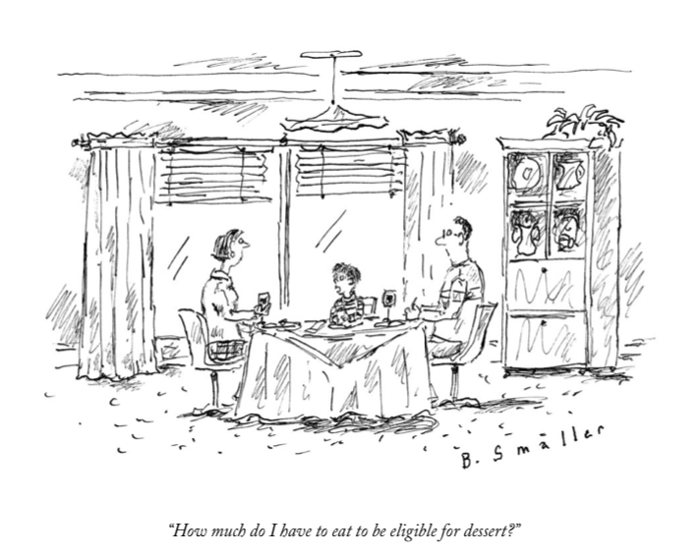

Slide 84
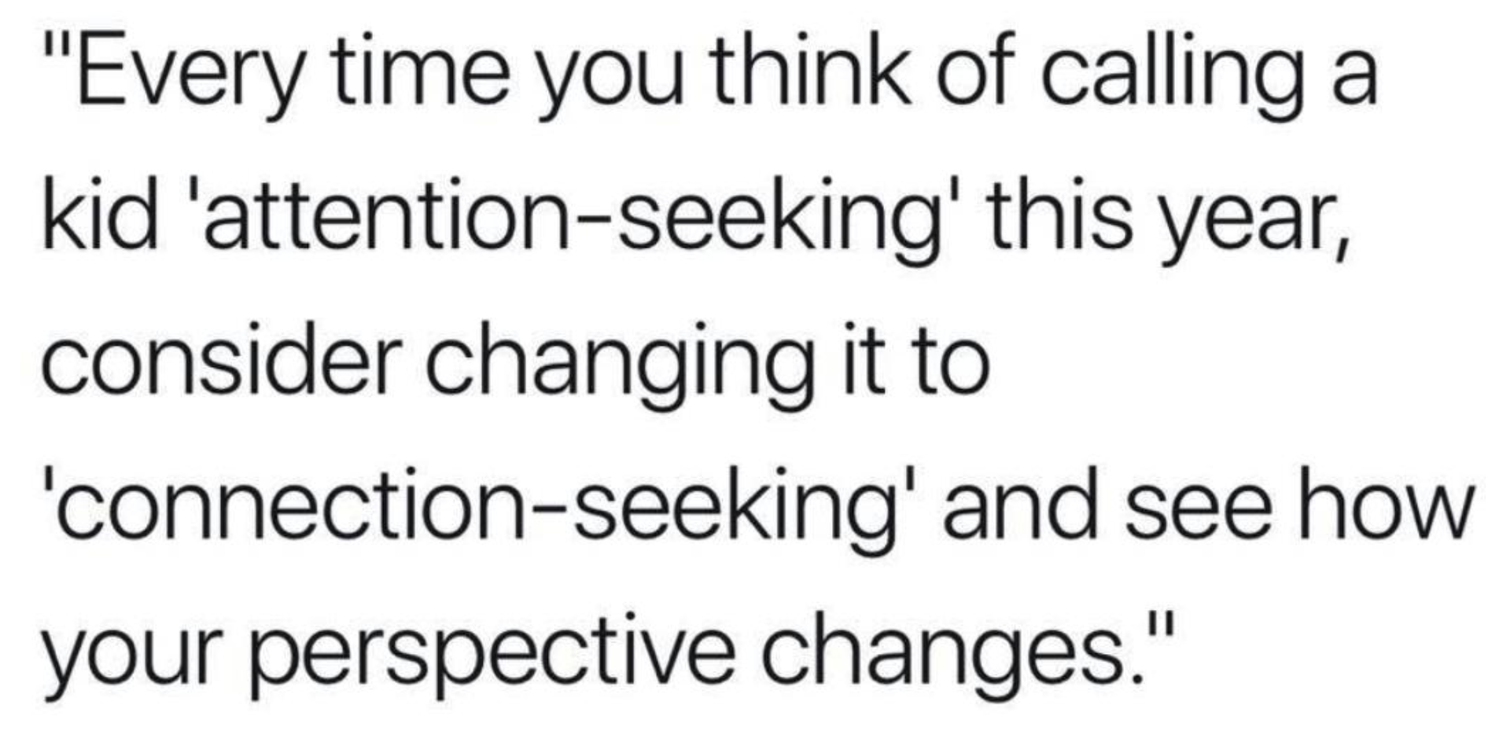

Slide 85
Avoid Blaming the Child
Don’t take challenging behaviors personally, it’s about what works for the child.
This may not always be easy to do
“It’s never the student’s fault.”
(they are just doing what they know how to do)
“The organism is never wrong”
B.F. Skinner
“The student is never wrong”
Ogden Lindsley

Slide 86
Clarifying Why We Do What We Do to Manage Behavior:
There is no value in blaming anyone (student, staff, parents, etc.)
Challenging behavior is often inadvertently the result of what we do to stop problem behavior
Teachers and parents do what we do because it immediately works to stop or lessen problem behavior. Reinforcement works both ways.
Identify patterns so they can be changed
Notes:
Give examples from life, Micayla screaming for access to SR+ leads to me giving in b/c of SR- in certain social situations.
Then give examples from work, student spits and frustrated staff react while never following through with the demand.

Slide 87
Critical Considerations Regarding Problem Behavior
Your reinforcement should be cooperative responses and student progress
NOT ending behavior quickly
Short term gain = long term pain
Problem Behavior = Skill Deficits
They don’t “know better”
Deliberately target cooperation and REINFORCE it!

Slide 88
Shift from asking, “How do I get the student to behave?” or “How can I get the student to stop ____?”
to “What is causing this behavior and how can we mitigate that?” or “What skills does the child need to succeed?”

Slide 89
Bonus Tip #1
Learn about Section 504

Slide 90
Bonus Tip #2
Explain Discipline Procedures

Slide 91
Bonus Tip #3
List of Students Eligible

Slide 92
Bonus Tip #4
Encourage Principals to Attend IEP Meetings

Slide 93
Bonus Tip #5
Progress Monitoring Check
(Sounds big work-but not)

Slide 94
Bonus Tip #6
It is OK to say “I don’t know.” But then help get them the answers. ASAP.

Slide 95
BEST Tip of the Day!
When progress report and other data indicate the student’s annual goal will not be met, determine why, make needed instructional changes, and continue to collect and report data

Slide 96
More
KOSHK
Knew or Should Have Known
Compensatory education demands increased
Lack of FAPE
Lack of progress monitoring data

Slide 97
More #2
All the new staff
Held to the same legal standard
IRIS Center IEP module for teachers
IRIS Center IEP module for administrators
Progress Center Modules

Slide 99
Resources
Progress Center: www.promotingprogress.org
National Center on Intensive Intervention: www.intensiveintervention.org
Council for Exception Children: www.exceptionalchildren.org
Center on Positive Behavior Interventions & Support: www.pbis.org
IRIS Center: https://iris.Peabody.Vanderbilt.edu
OSEP, IDEAs that work: www.OSEPideasthatwork.org
OSEP, The Individuals with Disabilities Education Act: https://sites.ed.gov/idea
OSEP, Find a center: www.OSEPideasthatwork.org/find-center-or-grant
Understood: www.understood.org
Spedlawblog.com – Mitchell Yell, David Bateman, & Kevin Brady

Slide 100
Lead IDEA Center
Goal:
Create a Leadership Learning System (LLS) that provides continuous learning from initial education to professional development. This system will improve the abilities and support structures at various levels, including state, regional, district, and individual program levels. The goal is to better prepare, support, and keep administrative staff in schools and early intervention services, focusing on improving the educational experiences and success of students with disabilities (SWDs) and their families.
Establish and maintain state-level partnerships to ensure leaders have competencies to implement IDEA.
Identify IDEA-related professional competencies.
Develop and disseminate resources.
Deliver high-quality professional learning.
Cultivate inclusive leadership practices.
Evaluate effectiveness.
Foster Community Engagement and Collaboration.
Enhance the capacity of state-level partners to use Center products to deliver high-quality professional development.
For More Information:
David Bateman Lynn Holdheide
dbateman@air.org lholdheide@air.org

Slide 102
David Bateman, PhD
DavidBateman@me.com
Blog: SpedLawBlog

