Slide 1
Supporting students through a district wide approach to social emotional learning (SEL)

Slide 2
What is Social Emotional Learning?
https://youtu.be/Y-XNp3h3h4A

Slide 5
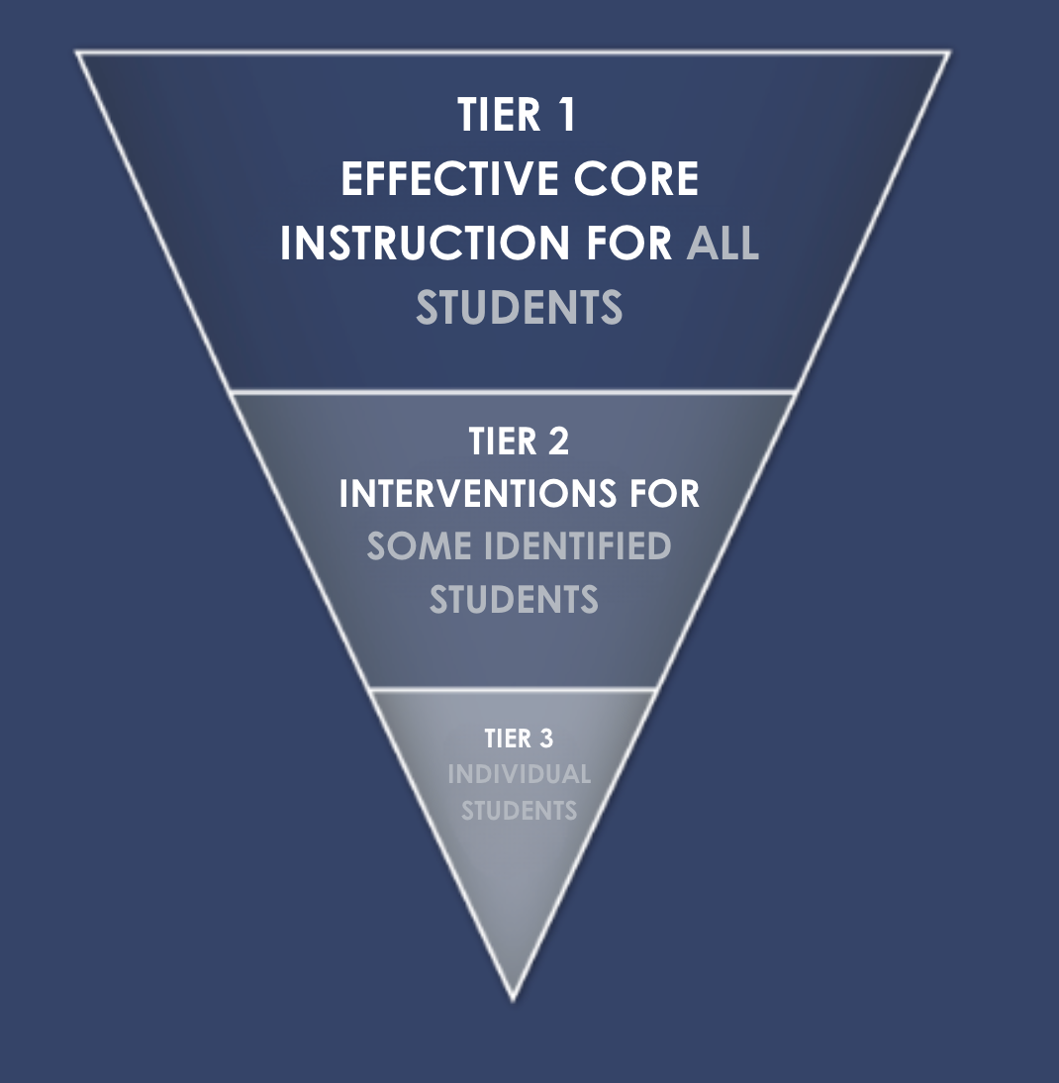
Bonneville District 93 Vision Statement applied to MTSS
(Multi-Tiered Systems of Support)

Slide 6
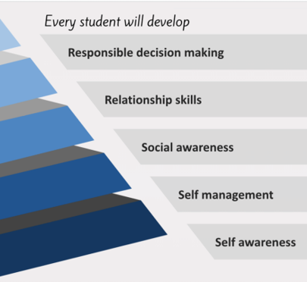
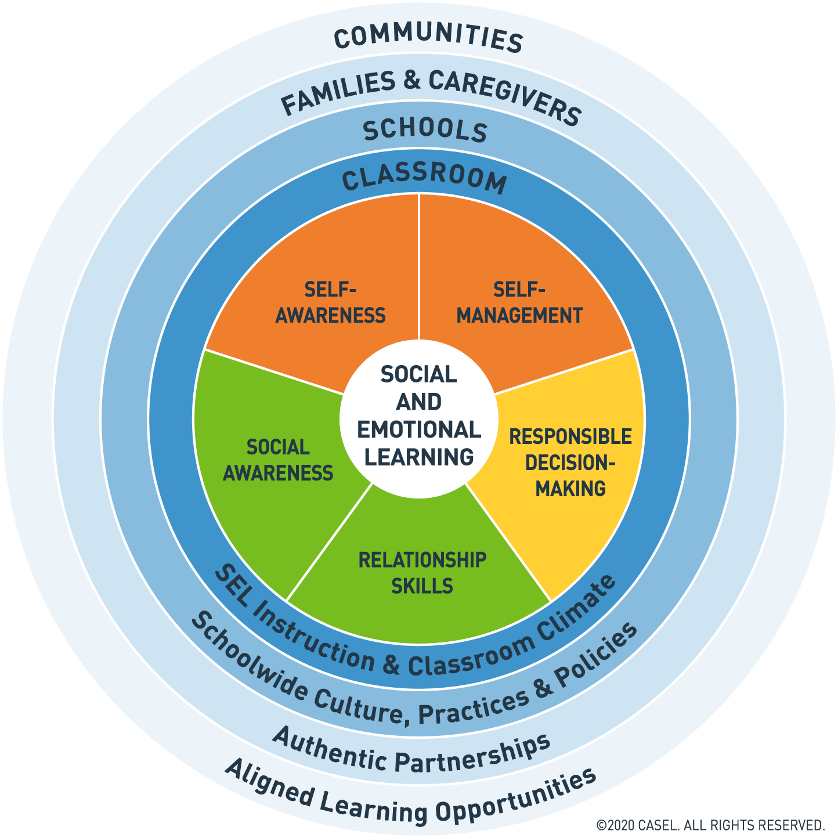
Bonneville District 93 applied to CASEL
(Right Side of the Pyramid)

Slide 7
Bonneville District 93 Vision Statement applied to Behavior Solutions Training
(Right Side of the Pyramid)

Slide 8
Highly Trained Professionals
Mental Health Professionals in EVERY building
15 Elementary School Counselors
7 Middle School Counselors
12 High School Counselors
3 District Mental Health Professionals

Slide 9
Tier 1
Elementary
Secondary
Classroom Teachers
Everyday 20 minutes
2-3 times weekly, 20-30 minutes
School Announcements
School Goals
Assemblies
Student involvement
Classroom Teachers
Twice weekly-Advisory (middle school)
Twice Monthly (high school)
Student involvement
School Announcements
School Goals

Slide 10
Tier 2
Elementary
Secondary
Behavior Academy
Small Groups
Specialized Classroom Lessons
Check-ins
Small Groups
Specialized Classroom Lessons
In School Detention replaced with “School Solutions”
Behavior Academy
Check-ins

Slide 11
Tier 3
Elementary
Secondary
Individual Counseling
Counseling with Parents
Psycho education Conversations
Referrals to outside agencies
Individual Counseling
Counseling with Parents
Personal Management Class (MS)
Referrals to outside agencies

Slide 12
Educating Students. Empowering Teachers. Elevating the world. Through Educator and Student Well-Being
Our Purpose: Lifting students, teachers, and administration for better todays and brighter tomorrows by delivering innovative well-being curriculum for students and educators paired with administrative consulting, teacher coaching and professional development.
InFocus helps students acquire the knowledge, skills, and dispositions for social, emotional, academic, physical, and mental well-being so they can thrive today and in the future with our innovative PreK-Grade 12 Well-being curriculum.
The InFocus well-being curriculum is impeded in Bonneville schools, students are actively engaging in developmentally appropriate lessons that focus on foundational life skills. Learn more about our well-being resources, review our sample lessons, and our scope and sequence at our website: infocuseg.com.
Amy Miner
Amy.Miner@infocuseg.com
801-369-7394

Slide 13
The Leader In Me is an evidence-based, K-12 whole-school whole-child Leadership model. The Leader In Me unites students, staff, and families around the common goal to prepare students with college, career, and life-readiness skills that are necessary to thrive in today’s ever-changing, fast paced environment, such as: critical thinking, creativity, self-discipline, initiative, relationship building, goal achievement, public speaking and cognitive flexibility.
Leader in Me utilizes and integrates leadership and educational models from past and current thought leaders. The 7 Habits of Highly Effective People is a key component of the overall Leader in Me process and is a synthesis of universal, timeless principles of personal, interpersonal, and organizational effectiveness, such as responsibility, vision, integrity, teamwork, collaboration and balance. The 7 Habits are taught directly to students and modeled by staff to create a culture of improvement and leadership.
Austin Haslam
FranklinCovey Education Client Partner
Austin.Haslam@franklincovey.com
541-609-7299

Slide 14
Video
https://www.youtube.com/watch?v=Q632Kl-SDic

Slide 15
Hope Squad
What is Hope Squad?
Hope Squad is a peer-to-peer suicide prevention program. Hope Squad members are nominated by their classmates as trustworthy peers and trained by advisors. The program reduces youth suicide through education, training, and peer intervention. Hope Squad members are NOT trained to be counselors, but rather how to respectfully help their peers get help from a trusted adult.

Slide 16
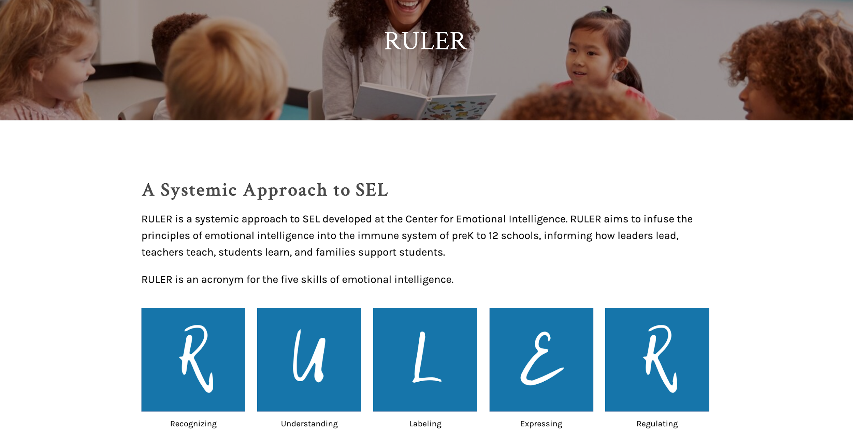
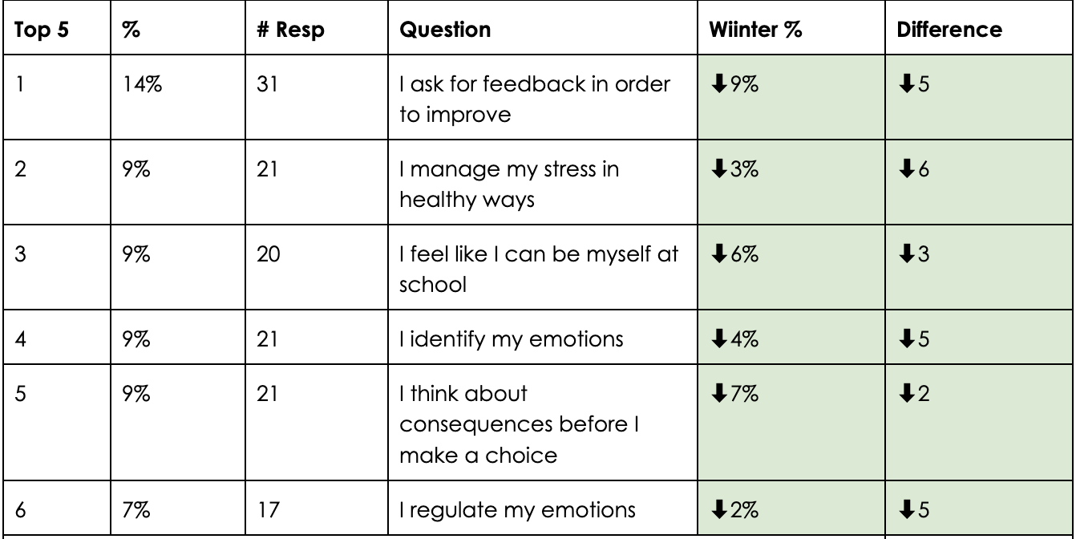
Hillview Elementary School
91 and 96% survey response rate
Year 1 of Pilot
Tier 1: daily, 20 minutes, all teachers all students
Tier 2: Behavior Flex
Improved in
EVERY area!
Notes:
One of the most difficult schools in terms of student population

Slide 17
Woodland Hills Elementary School
Year 2 in Pilot
Amazing School Culture:
Daily SEL Announcements
School Podcast
Tier 1: Daily, 20 minutes, all teachers, all students
Tier 2: Behavior academies
Only 1 topic over 5%
Notes:
Mark

Slide 18
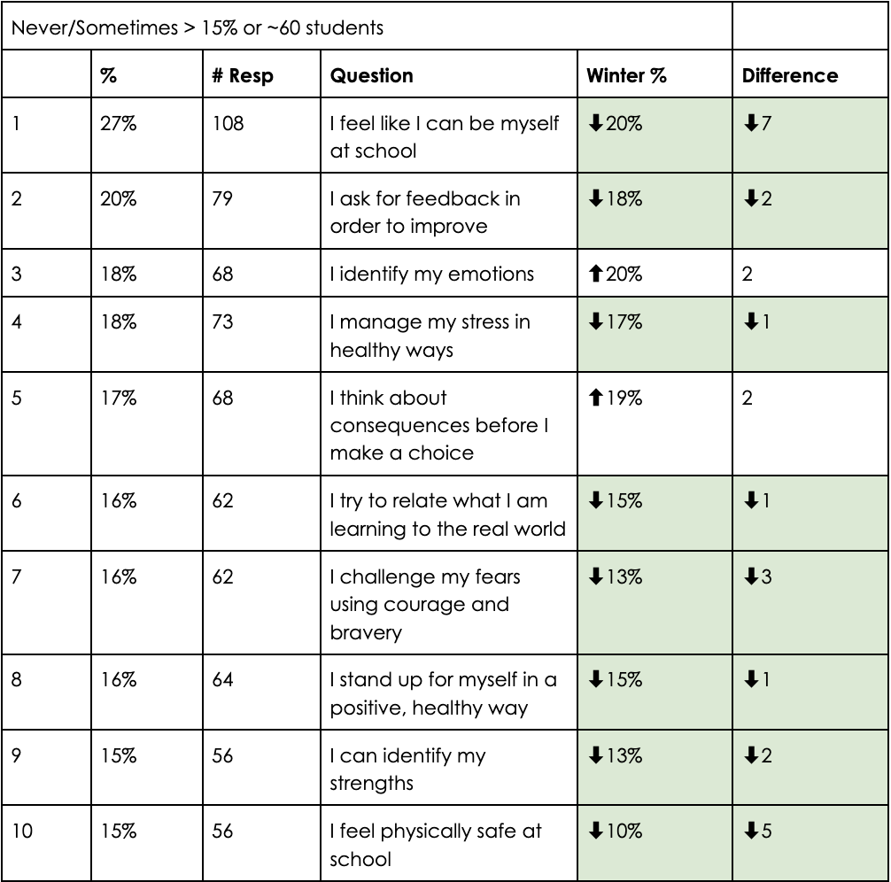
Sand Creek Middle School
Year 2 in Pilot
Tier 1: 2x/week, 20 minutes, every teacher during advisory
Dragon Guard students choose the topics for pacing guide and teach the lessons.
Monthly Educator Well-Being as part of their faculty meetings. Do things to connect with each other as staff.
Giving a pass/fail during advisory to get more buy-in from students.
Notes:
Intentional Conscious Effort

Slide 19
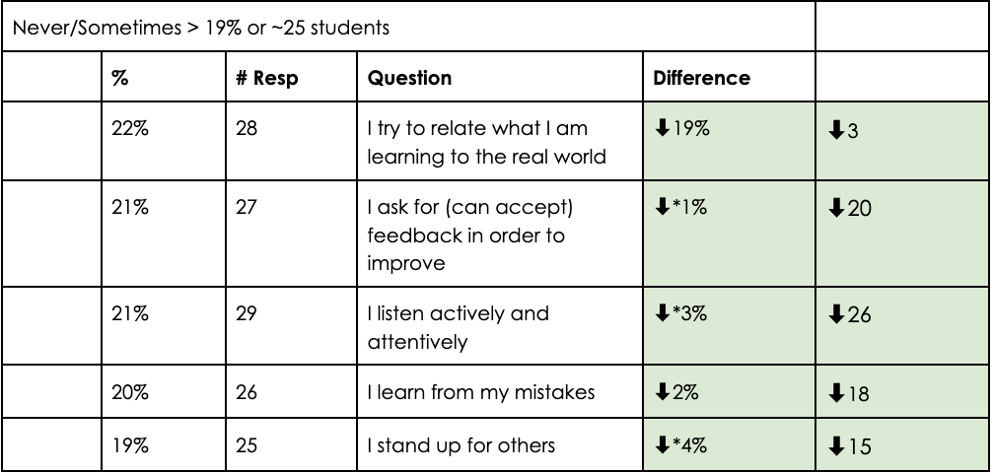
Praxium Middle School
Year 1 in Pilot
99% and 98% response rate
Tier 1: Weekly, Wed and Friday, 30 minutes, rotate between staff.
Had to raise the cut-off to 19%
*means no “never” responses
PLC meetings
Behavior solutions
Tier 2 academies and mentoring
Aligned with their 5Cs
Notes:
We made it a priority. Intentional Conscous Efforts.
-We have tied it into our PLC, we are meeting about students, we are looking at what they need, we are incorporating our behavior solutions, we have put them into academies, mentoring.
-Our students are excited to go to these classes. The students are looking forward to these classes. They enjoy the class. There is student buy-in. The staff is doing an amazing job.
-We are looking at A/B day schedule to have more flexibility to build this into our schedule.
The 5Cs- mentoring grade that has to do with character. The mentoring program. Character, creativity, critical thinking, collaboration, communication.
-In January we started the “hands off” academy. Impulse control. Started with 6 students and 2 have graduated. Using academy lessons from behavior solutions.
-This is the blueprint for how we want to implement. This can be done. Make it a priority and create a plan that works with our school.

Slide 20
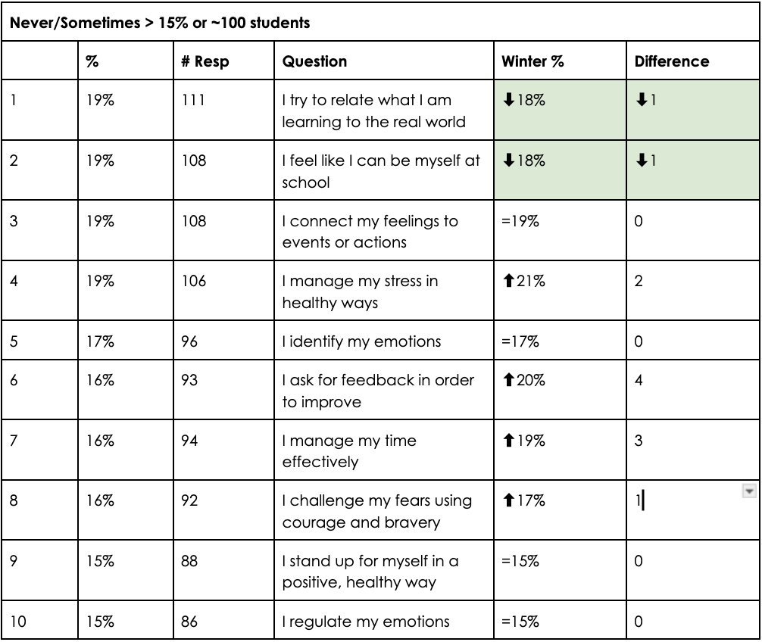
Bonneville High School
Year 1 in Pilot
Tier 1: 2/month, 18 minutes, rotates among teachers
SEL team curates the lessons.
Students are talking about the topics outside of class.
Going to bring students into the process.
When the teachers are doing this consistently. Students openly talk about their mental health challenges. Having them watch us try to implement this communicates that we care.
Brainstorming solutions to create more accountability for students.
Notes:
Mark

Slide 21
Positive Impact of SEL Instruction
Improved Behavior and Social Skills: Many responses highlight a decrease in behavior problems and an improvement in social skills, empathy, and emotional regulation among students. ​
Engagement and Enjoyment: Students are highly engaged and enjoy the SEL lessons, looking forward to them and participating actively in discussions. ​
Application of Skills: Students are applying the skills learned in SEL lessons to real-life situations, both in and out of school, and using the vocabulary and concepts taught. ​
Positive Classroom Environment: The SEL lessons have contributed to a more positive classroom environment, fostering a sense of community, open communication, and mutual respect. ​
Emotional Awareness and Resilience: Students are becoming more aware of their emotions and learning to manage them better, leading to increased emotional resilience. ​
Notes:
Mark

Slide 22
Improved Relationships: The lessons have helped build stronger relationships between students and teachers, as well as among students themselves. ​
Critical Thinking and Self-Reflection: Students are encouraged to think critically about their behaviors and reflect on their actions, leading to better self-awareness and personal growth. ​
Consistent Vocabulary and Concepts: The use of consistent vocabulary and concepts across the school has made it easier for teachers and students to address and resolve issues. ​
Parental Feedback and Home Application: Positive feedback from parents indicates that students are discussing and applying SEL concepts at home, reinforcing the lessons learned at school. ​
Support for Diverse Needs: The SEL curriculum is adaptable and beneficial for students with diverse needs, including those with special needs, helping them develop essential social and emotional skills.
Notes:
Mark

Slide 23
Questions?
Bonneville District 93
Ken Marlowe- 208-552-8480
Nancy Erickson- 208-552-8481

