Slide 1
Prior Written Notices
Ryan J. Spencer
208.500.2069
rspencer@hawleytroxell.com

Slide 2
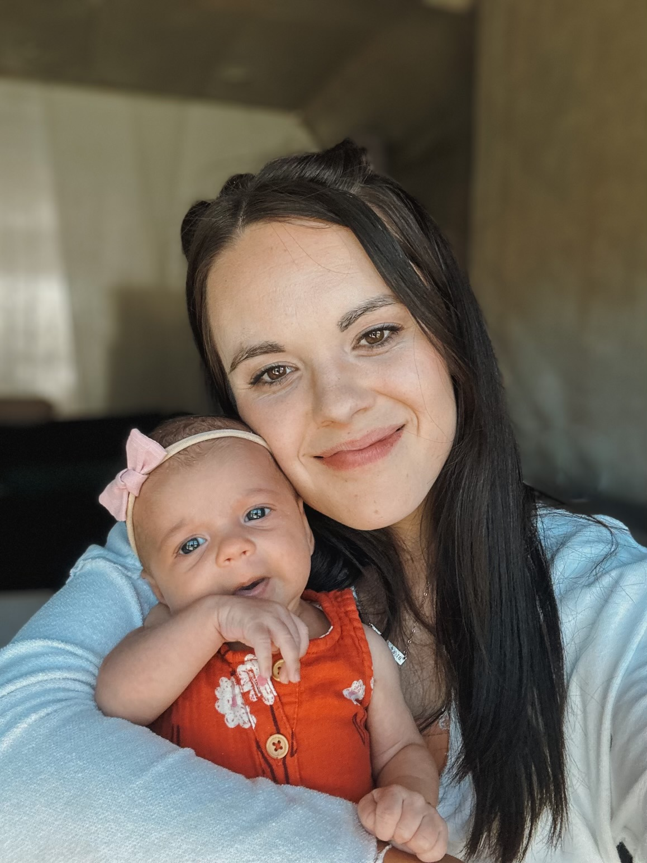
About Me
Brigham Young University – Idaho B.S. Special Education, 2020
Severe Disabilities emphasis
University of Idaho College of Law, J.D., 2020-2023
Licensed in Idaho, Utah, and Wyoming
Associate Attorney with Hawley Troxell in Idaho Falls
Special Education, Litigation, and Civil Defense

Slide 3
Format and Ground-Rules
Topic: Prior Written Notices
Ground-Rules:
Ask questions as we go
Discussion is encouraged
Assume the best intentions of all attendees
*This is not legal advice*

Slide 4
Purpose
IDEA emphasizes providing families with explanation of school district’s proposal.
Parents must be invited to meetings;
Parents have a right to inspect educational records (IEPs, Placement Determinations, etc.);
Decisions must be documented via PWN;

Slide 5
When
“Written notice that meets the requirements of paragraph (b) of this section must be given to the parents of a child with a disability a reasonable time before the public agency –
(1) Proposes to initiate or change the identification, evaluation, or educational placement of the child or the provisions of FAPE to the child; or
(2) refuses to initiate or change the identification, evaluation, or educational placement of the child or the provision of FAPE to the child.”
34 C.F.R. 300.503(a); Idaho SPED Manual Ch. 11(4)(A)
In other words: Whenever a special education change is proposed or refused.

Slide 6
Content
Notices must include:
(1) A description of the action proposed or refused by the agency;
(2) An explanation of why the agency proposes or refuses to take the action;
(3) A description of each evaluation procedure, assessment, record, or report the agency used as a basis for the proposed or refused action;
(4) A statement that the parents of a child with a disability have protection under the procedural safeguards of this part and, if this notice is not an initial referral for evaluation, the means by which a copy of a description of the procedural safeguards can be obtained;
(5) Sources for parents to contact to obtain assistance in understanding the provisions of this part;
(6) A description of other options that the IEP Team considered and the reasons why those options were rejected; and
(7) A description of other factors that are relevant to the agency’s proposal or refusal.”
34 C.F.R. 300.503(b)

Slide 7
Templates
The Idaho State Department of Education provides template forms, including PWN.
Sde.Idaho.gov/sped/sped-forms/
General Forms
Written Notice
Do you have to use a template?
No – can use alternative forms so long as all components are met. See 71 Fed. Reg. 46, 691 (2006); El Paso Cnty Sch. Dist. 2, 113 LRP 44602 (SEA CO 08/15/13 (an IEP could meet notice requirements; but, must be provided on the same timeline that PWNs must meet).

Slide 8
Language Requirements
“(1) The notice required under paragraph (a) of this section must be –
(i) Written in language understandable to the general public; and
(ii) Provided in the native language of the parent or other mode of communication used by the parent, unless it is clearly not feasible to do so.
(2) If the native language or other mode of communication of the parent is not a written language, the public agency must take steps to ensure –
(i) That the notice is translated orally or by other means to the parent in his or her native language or other mode of communication;
(ii) That the parent understands the content of the notice; and
(iii) That there is written evidence that the requirements in paragraphs (c)(2)(i) and (ii) of this section have been met.” 34 C.F.R. 300.503(c).

Slide 9
“The nature of the IEP process ensures that parents and school representatives will fully air their respective opinions on the degree of progress a child’s IEP should pursue; thus, by the time any dispute reaches court, school authorities will have had the chance to bring their expertise and judgment to bear on areas of disagreement.”
Endrew F. Douglas Co. Sch. Dist., 137 S. Ct. 988, 993 (2017)

Slide 10
Common Pitfalls
PWN is not specific to the student
In Cincinnati Public Sch., 116 LRP 11536 (SEA OH 03/11/16)
Annual IEP Review
PWN Provided to Parent:
Description of Action: Annual IEP
Explanation of Action: The annual IEP review is required by law and will allow the team to review academic progress and implement new objectives.
Other options considered: No other options were considered; annual review required by law.

Slide 11
Common Pitfalls
In Cincinnati Public Sch., 116 LRP 11536 (SEA OH 03/11/16) (Cont’d)
Description of each evaluation procedure, assessment, record, or report District used as basis for action: Progress monitoring and academic assessments
Description of other factors: Input from the IEP team, including the parent/guardian and consideration of any outside evaluation.

Slide 12
Common Pitfalls
In Cincinnati Public Sch., 116 LRP 11536 (SEA OH 03/11/16) (cont’d)
State Department of Education Finding: “This Prior Written Notice does not provide sufficient content, as required by the regulation, and for that reason is not in compliance with the regulation.”
Requirements:
Training
District to offer to parent opportunity to have student reevaluated in specific areas, documentation of offer, refusal or acceptance (and assessments)

Slide 13
Common Pitfalls
PWN requires outside information to understand.
Fern Ridge Sch. Dist. 28J, IDLR 676 (SEA OR 1990)
“After four days of testimony concerning what options the District considered and why it ruled out various options, I understand the notice. The ODE staff who corresponded with the District concerning its placement procedures would likely understand the notice. However, without that lengthy explanation or background, I did not understand it prior to the hearing. Parents should not be and are not required to read between the lines. The regulation is clear. It is not very burdensome.”

Slide 14
Other Documentation Tools
Does the IDEA require meeting minutes?
No, but a good PWN will accomplish the same thing. Alternatively, meeting minutes could meet PWN requirements (so long as contents are present).

Slide 15
Other Documentation Tools
What about audio/video recordings?
Letter to Anonymous, 40 IDELR 70 (OSEP 2003)
District “has the option to require, prohibit, limit, or otherwise regulate the use of recording devices at IEP meetings.”
Parents do not have a general right to record IEP meetings. See, e.g., Norwood Pub. Schs., 44 IDELR 104 (SEA MA 2005) (“As the above DOE guidance makes clear, a parent does not have an absolute right to tape record and IEP Team meeting”).
More recently, Pitta v. MedeirosI, 90 F.4th 11 (1st. Cir.), cert. denied, 144 S. Ct. 2631 (2024)
No First Amendment right to record.

Slide 16
Other Documentation Tools
Video Recordings
Exceptions: When necessary to participate in the IEP Process
Disabilities (e.g. processing disorder)
Use other accommodations. See e.g. Belvidere Cmty. Unit. Sch. Dist. No. 100, 112 LRP 12955) (SEA IL 02/27/12) (Parent with ADHD and dyslexia asked to record, but district offered to pay for an advocate to take notes and assist).
Language barriers
See E.H. v. Tirazzi, 735 F.Supp. 53 (D. Conn. 1990) – Parent from Denmark asked to record to later listen to recording with disctionary)
Accommodations (e.g., interpreter)
Think ADA/Section 504/Parental Participation

Slide 17
Other Documentation Tools
Recordings
Consistency is important in order to not retaliate.
If a recording does occur:
Both parties should record;
Recording becomes an educational record.

Slide 18
Additional Requirements
Is Verbal Notice Sufficient?
No.
Is there a “receipt of notice” requirement?
No, but it is good to have a process for showing that notice was sent out. See Bd. Of Educ. Of the N. Rockland Cent. Sch. Dist. V. C.M., 72 IDELR 172 (2d Cir. 2018, unpublished) (documentation showing that PWN was sent out helped prove that due process complaint was untimely).
Aks what the parent’s preferred method of receiving PWN (email, snail mail, student’s backpack, etc.)

Slide 19
Challenging PWN Content (FERPA)
Education Record Amendment Process
Allowed under FERPA, See 34 C.F.R. 99.20-22.
Can challenge documents that are:
Inaccurate;
Misleading; or
Violation of student’s privacy or other rights.
Applies to education records; does not apply to records that fall outside the definition of “education records.”

Slide 20
Record Amendment Process (FERPA)
Parent makes request and district decides whether to amend or not. 34 C.F.R. 99.20(b); 34 C.F.R. 300.618(a); and 34 C.F.R. 300.618(b).
If district declines, parent may request a hearing to challenge the information in the records. 34 C.F.R. 99.21; 34 C.F.R. 300.618©; and 34 C.F.R. 300.619.

Slide 21
Record Amendment Process
Hearing Procedures (minimum requirements)
(a) The educational agency or institution shall hold the hearing within a reasonable time after it has received the request for the hearing from the parent or eligible student.
(b) The educational agency or institution shall give the parent or eligible student notice of the date, time, and place, reasonably in advance of the hearing.
(c) The hearing may be conducted by an individual, including an official of the educational agency or institution, who does not have a direct interest in the outcome of the hearing.
(d) The educational agency or institution shall give the parent or eligible student a full and fair opportunity to present evidence relevant to the issues raised under Section 99.21. The parent or eligible student may, at their own expense, be assisted or represented by one or more individuals of his or her own choice, including an attorney.
The educational agency or institution shall make its decision in writing within a reasonable period of the time after the hearing.
(f) The decision must be based solely on the evidence presented at the hearing, and must include a summary of the evidence and the reasons for the decision. 34 C.F.R 99.22

Slide 22
Record Amendment Process
After hearing, record will be changed or not. If not, parent has right to place a statement in the record containing their comments about the information/reason for disagreement, which will become part of the student’s educational record. 34 C.F.R. 99.21 and 34 C.F.R. 300.620.

Slide 23
Timeline for PWN
Before Meeting?
Do not do this. This demonstrates predetermination. See 71 Fed. Reg. 46, 691 (2006) (“Providing prior written notice in advance of a meeting could suggest, in some circumstances, that the public agency’s proposal was improperly arrived at before the meeting and without parent input. Therefore, we are not changing Section 300.503 to require the prior written notice to be provided prior to an IEP Team Meeting).
PRIOR = Prior to implementation of IEP Team decision.

Slide 24
Timeline for PWNs
Within a “reasonable time” before action is taken. (34 C.F.R. 300.503(a).

Slide 25
Objections
If a parent/adult student disagrees with an IEP program change or placement change that is proposed by the IEP Team, they may file a written objection to all or part of the proposed change. The district may respond as follows:
(1) If objection is postmarked or hand delivered within 10 calendar days of the date the parent received the PWN, the changes in the PWN cannot be implemented for 15 calendar days (or more if mutually agreed) 10-day attempt to resolve the dispute.
(2) If changes have been implemented but notice is still received within 10 days of receiving the PWN, the provision of the changes shall cease.
(3) If an objection is made after the 10 day period from the date of receiving the PWN, the district may continue to implement the change, but the parent/adult child retains the right to exercise other procedures under the IDEA
Idaho SPED Manual, Ch. 11, Section 4(F).

Slide 26
Takeaways
Write PWN in a narrative format, for the benefit of someone who was not at the meeting;
Write in plain English; do not rely on acronyms and/or terms of art (remember, 34 C.F.R. 300.503(c)(1)(i) requires PWNs to be “written in language understandable to the general public”);
Note areas of agreement and/or disagreement, and why one course of action was taken over another;
Be frank.

Slide 27
Questions?
Thank you!
www.hawleytroxell.com

