Slide 1
Writing Legally Defensible IEPs
Ryan J. Spencer
208.500.2069
rspencer@hawleytroxell.com

Slide 2
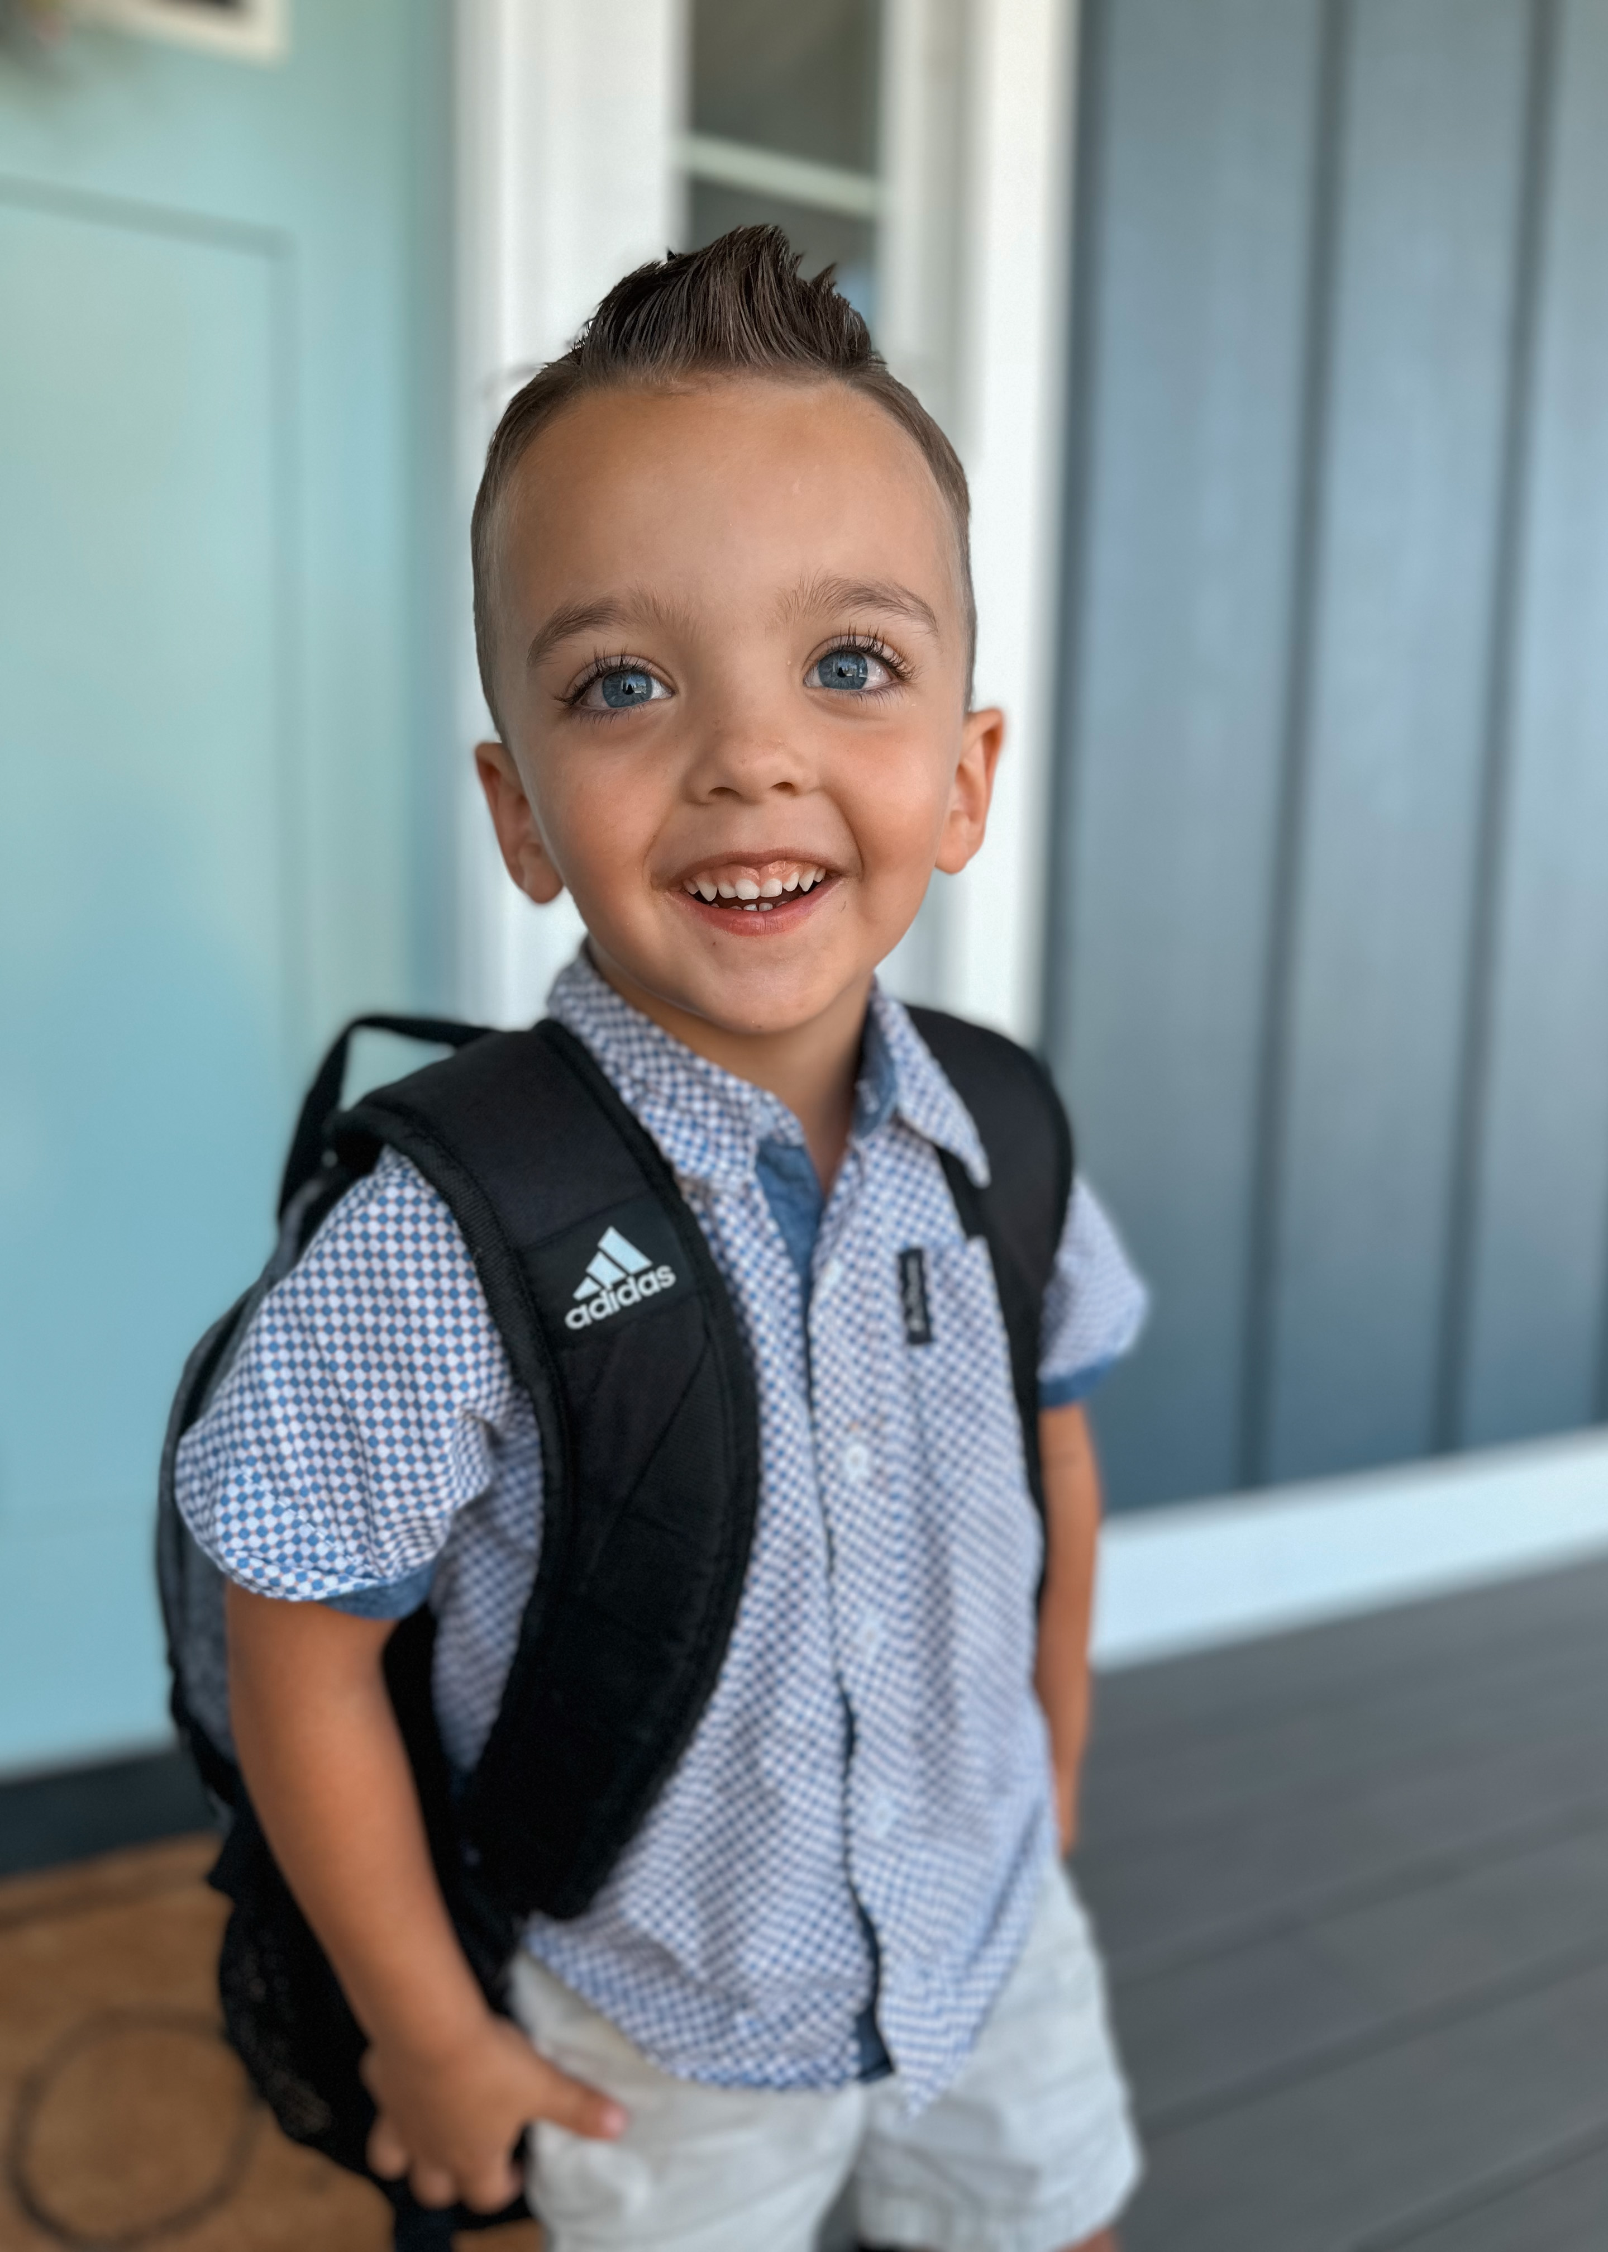
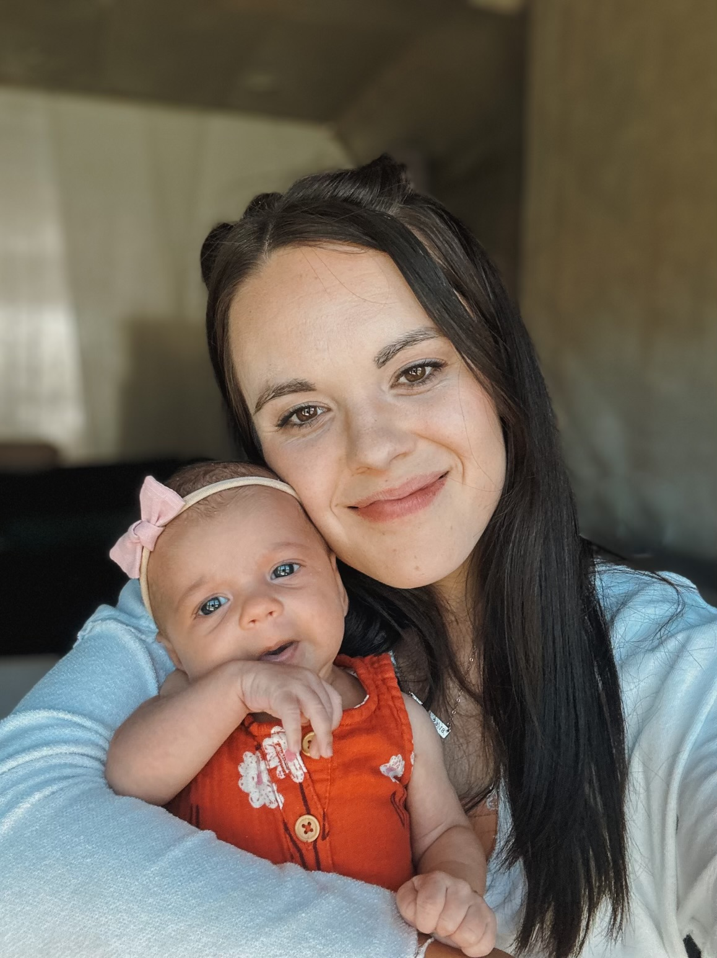
About Me
Brigham Young University – Idaho B.S. Special Education, 2020
Severe Disabilities emphasis
University of Idaho College of Law, J.D., 2020-2023
Licensed in Idaho, Utah, and Wyoming
Associate Attorney with Hawley Troxell in Idaho Falls
Special Education, Litigation, and Civil Defense

Slide 3
Format and Ground-Rules
Topic: How to Draft Legally Defensible IEPs
Ground-Rules:
Ask questions as we go
Discussion is encouraged
Assume the best intentions of all attendees
*This is not legal advice*

Slide 4
Agenda
Developing the IEP
Contents of the IEP
Implementing the IEP
Notes:
Procedural = hoops to jump through. Violation of procedure does NOT automatically = denial of FAPE.
Substantive = FAPE, the Oomph of the IDEA. Violation of substantive does = denial of FAPE.
Arguments often are if this court finds that there was a violation of the IDEA it was merely procedural and not sufficient to deny a FAPE.

Slide 5
Developing the IEP
Eligibility
After obtaining parental consent LEAs have 60 days to complete the initial evaluation of the student and determine eligibility.
*RTI should be used before a referral is made, but it cannot be used to delay a referral or evaluation.*

Slide 6
The IEP Meeting: Who? What? When?
Who?
Required Participants
Parent(s)
General Education Teacher (at least 1)
Sped teacher
LEA Rep

Slide 7
The IEP Meeting: Who? What? When?
Who? (cont’d)
LEA Rep:
Qualified to provide or supervise special education program
Knows the general education curriculum
Knows availability and resources LEA can offer
Absences:
If a required person is unable to attend (with exception of the parent*), the parent must provide their written signature prior to the meeting.

Slide 8
The IEP Meeting: Who? What? When?
Permissive Participants
Student (required for secondary IEP)
Related Services provider
Anyone else the parents may request
Prior teacher
Neighbor
Family friend
Professional advocate
Attorney*

Slide 9
Developing the IEP
What is an IEP?
A written plan which explains the provision of regular and/or special education and related services in the least restrictive environment designed to meet the student’s individual needs.
Special Education is specially designed instruction to meet the unique needs of a child with a disability.
The intent of the IDEA was to create a cooperative practice between the school district and the parents which ultimately results in an appropriate IEP for the student.
Endrew F. v. Douglas Cnty Sch. Dist. – An IEP must be “Reasonably calculated to enable a child to make progress appropriate in light of the child’s circumstances.”

Slide 10
Developing the IEP
Contents
An Individualized Education Program under the IDEA is a written statement for each child with a disability that is developed, reviewed, and revised in accordance with specific statutory requirements.
The IEP must include:
A statement of the child’s present levels of academic achievement and functional performance, including how the child’s disability affects their involvement and progress in the general education curriculum.
A statement of measurable annual goals, including academic and functional goals, designed to meet the child’s needs resulting from their disability to enable the child to be involved and make progress in the general curriculum
A description of how the child’s progress toward meeting the annual goals will be measured and when periodic reports on the progress will be provided
A statement of the special education and related services and supplementary aids and services to be provided to the child, and a statement of the program modifications or supports for school personnel that will be provided to enable the child to advance appropriately toward attaining he annual goals, be involved and progress in the gen. ed. Curriculum, and participate in extracurricular activities

Slide 11
Developing the IEP
Contents cont’d
The IEP must include
An explanation of the extent, if any, to which the child will not participate with nondisabled children in the regular class and in the activities described (LRE)
A statement of any individual appropriate accommodations necessary to measure the academic achievement and functional performance of the child on state and districtwide assessments
The projected date for the beginning of the services and modifications, and the anticipated frequency, location, and duration of those services and modifications

Slide 12
Developing the IEP
Goals:
The IDEA requires that every IEP include a description of:
How the child’s progress toward meeting annual goals will be measured
When the periodic reports on the progress the child is making toward meeting the annual goals will be provided.
Goals should be clear and objectively measurable. (See Kuszewski v. Chippewa Valley Sch. Dist., 56 F. App’x 655, 659 (6th Cir. 2003)
Goals should align with instruction or services. (See Burlington Sch. Dist., 20 IDELR 1303).
Goals should be “reasonably calculated to enable a child to make progress appropriate in light of the child’s circumstances.” (See Endrew F., supra).

Slide 13
Developing the IEP
Alignment
Goals should address PLAAFP as a starting point
Goal must be addressed as an area of ‘need.’
Create a goal tracking sheet as you write the goal to ensure consistency
All goals require progress monitoring!
Goals should be individualized—not just taken from a “goal bank”
Goals should not contain discretion!
“The IEP is not a form document. It is constructed only after careful consideration of the child’s present levels of achievement, disability, and potential for growth.” See Endrew F. v. Douglas Cnty Sch. Dist.)

Slide 14
Developing the IEP
Progress Monitoring
Must be clear
Must be easily implemented
Should not contain discretion (i.e., “as needed” or “as determined by teacher”)
Progress monitoring should be clear enough that any teacher, aide, or substitute, may conduct the progress monitoring consistently.

Slide 15
Developing the IEP
Least Restrictive Environment
Under the IDEA, children with disabilities must be educated with children who are not disabled to the fullest extent possible.
Each LEA must ensure that:
To the maximum extent appropriate, children with disabilities are educated with children who are non-disabled; and
Special classes, separate schooling or other removal of children with disabilities from the regular educational environment occurs only of the nature or severity of the disability is such that education in regular classes with the use of supplementary aids and services cannot be achieved satisfactorily.

Slide 16
Developing the IEP
How do we determine what the LRE is?
The 9th Circuit Court of Appeals, in Sacramento City Unified Sch. Dist., Bd. Of Educ. v. Rachel H. adopted a 4-part test to determine whether the student is being mainstreamed to the maximum extent possible:
The educational benefits of placement full-time in a regular classroom;
The non-academic benefits of such placement;
The effect [the student] has on the teacher and children in the regular classroom; and
The costs of mainstreaming the student.
Remember…the analysis begins at full-time general education placement and gets more restrictive as the analysis goes on.

Slide 17
Developing the IEP
Least Restrictive Environment:
Options:
General Education Classroom
Special Education Classroom
Special/Private School
Homebound (Home School*)
Hospital/Residential Facility
(or a combination of these)

Slide 18
Review & Revising The IEP
Under the IDEA, the IEP team MUST review the child’s IEP at least once a year.
There is nothing preventing the IEP team to review and revise the IEP more than once a year.
The LEA or the Parents may request an IEP meeting to revise the child’s IEP.
When is this necessary?
The student is not making progress toward their IEP goal(s)
The student has achieved their IEP goal(s)
A change in the student’s life that would require a change in services (i.e., new medication, family event, school event, etc.)

Slide 19
Reviewing and Revising the IEP
Code of Federal Regulations at 34 C.F.R. §300.324(a)(4)(i) provides:
“In making changes to a child’s IEP after the annual IEP Team meeting for a school year, the parent of a child with a disability and the public agency may agree not to convene an IEP Team meeting for the purposes of making those changes, and instead may develop a written document to amend or modify the child’s current IEP.”
If no meeting is held, documentation is key.

Slide 20
Review and Revising the IEP
What if the parent(s) do not want to/cannot meet to revise?
DOCUMENT, DOCUMENT, DOCUMENT
Phone calls
Emails
Letters
Stand-Ready letter
Due Process Hearing (if needed)

Slide 21
Common Pit-Falls
Vague Goals
Student will improve reading skills (Good? Bad? How to Improve?)
With guidance and support from adults, [the student] will be able to respond to questions and suggestions from peers and add details to strengthen writing as needed(Good? Bad? How to improve?)
Student will be able to demonstrate command of the conventions of standard English grammar and usage when writing or speaking (Good? Bad? How to improve?)
Generic Accommodations
Provide verbal and written instructions (Good? Bad? How to improve?)
Use visual aids, graphic organizers, or manipulatives (Good? Bad? How to improve?)

Slide 22
Common Pit-Falls
Insufficient Data
Eligibility
Progress Monitoring
Lack of Collaboration
The IEP Team is a Team – everyone, especially the parents, should be involved.
Pre-Determination
IEP meetings are the time to develop the IEP, not present it to the parents.

Slide 23
Key Takeaways
IEPs must be reasonably calculated for progress
A legally defensible IEP ensures the student makes meaningful progress appropriate to their unique circumstances (Endrew F. v. Douglas Cnty. Sch. Dist.)
Thorough Documentation and Consideration is Critical
Clearly document what was considered, what was not considered, and what was decided.
Goals Must Be Clear and Objectively Measurable
Goals should be specific, objective, and based on present levels
Progress monitoring must be clear, consistent, and actionable.
Consider the 4 “Rachel H.” factors when determining the LRE
IEPs Are Not Form Documents
Review and Revise the IEPs as often as needed. Once per year is the minimum requirement.

Slide 24
Questions?
Thank you!
www.hawleytroxell.com

